Slide 1




Lepton Flavour Violation Experiments in the LHC Era
Fabrizio Cei
INFN and University of Pisa – Italy
On Behalf of the MEG Collaboration
PASCOS 2010 Conference, Valencia 19th-23rd July 2010

Slide 2
Outline
LFV: what and why
The muonic channel
  μ → eγ (MEG) (new preliminary results);
  μ → e e e
  μ → e conversion (Mu2e, COMET, PRISM/PRIME);
The tauonic channel
  τ → μγ, eγ (BABAR, BELLE);
  τ → lll (BABAR, BELLE);
  Other decays (τ → lh, τ → lhh …) briefly discussed.
A look at the future
  Possible improvements in the muonic sector;
  Super-B factory
Conclusions

Slide 3
LFV: what and why 1)
In the SM of electroweak interactions, leptons are grouped in doublets and there is no space for transitions where the lepton flavour is not conserved.
However, lepton flavour is experimentally violated in neutral sector (neutrino oscillations) ⇒ needed to extend the standard model by including neutrino masses and coupling between flavours.
cLFV indicates non conservation of lepton flavour in processes involving charged leptons.

Slide 4
LFV: what and why 2)
Including neutrino masses and oscillations:
Experimentally not measurable !
However, huge rate enhancement in all SM extensions, expecially in
SUSY/SUSY-GUT theories (mixing in high energy sector) ⇒ predicted
rates experimentally accessible ! (Barbieri, Masiero, Ellis, Hisano ..)
SUSY
≈ 10⁻¹²
⇒ Observation of LFV clear
evidence for physics beyond SM

Slide 5
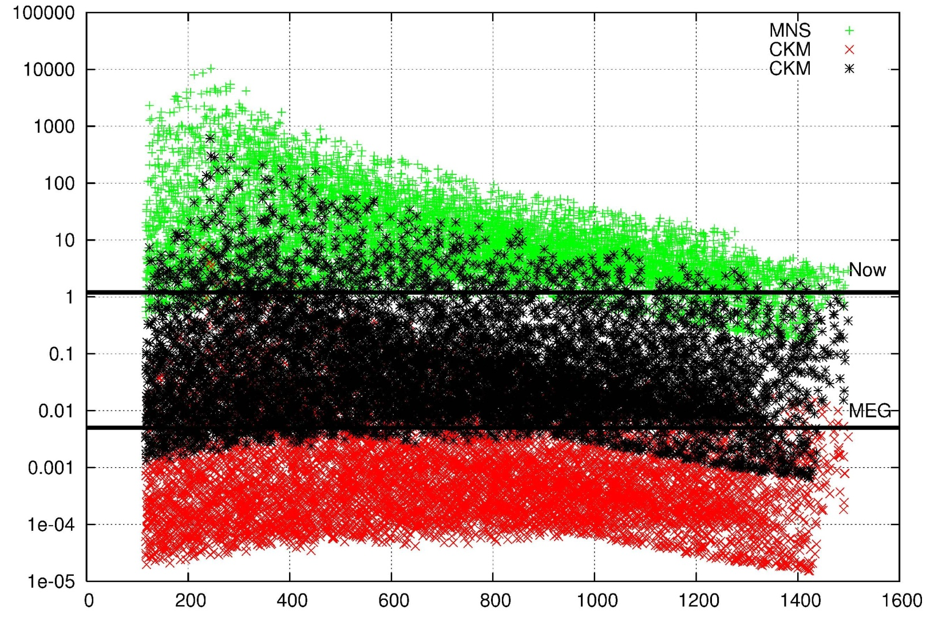
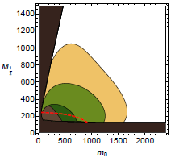
LFV: what and why 3)
Strong impact of LFV searches in particle physics development:
beginning of lepton physics; (Pontecorvo & Hincks, 1947)
universality of Fermi interaction ⇒ standard model; (1955)
flavour physics (> 1960)
possibility to explore high mass SUSY scale (> 1000 TeV) and give insights about large mass range, parity violation, number of generations ... (now)
BR(μ → eγ)/10⁻¹¹
(L. Cabibbi et al.,
Phys. Rev. D74, 011701, 2006)
Examples of recent predictions
(L. Cabibbi et al.,
hep-ph 0909.2501
MEG
Super B
Babar+Belle
M_{1/2} (GeV)
MEGA

Slide 6
The muonic channel
Muons are very sensitive probes to study Lepton Flavour Violation:
intense muon beams can be obtained
at meson factories;
muon lifetime is rather long (2.2 μs);
final states are very simple and can
be precisely measured

Slide 7
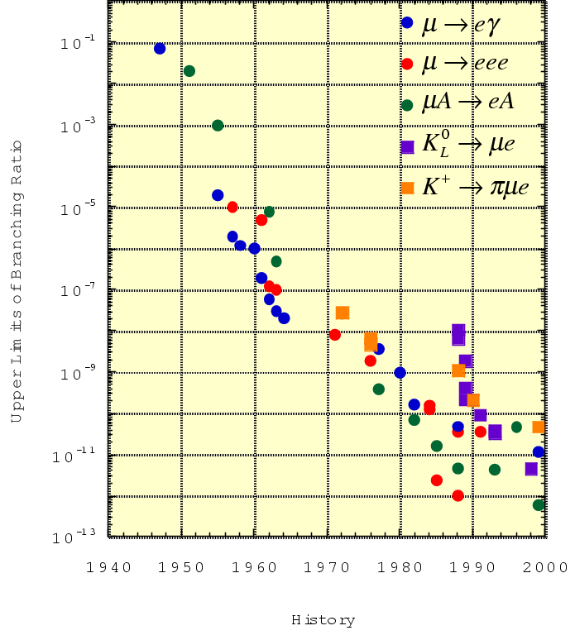
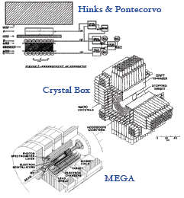
Experimental limits
Cosmic μ
MEG
Mu2e
COMET
BR < 0.1
PRIME
Stopped π
μ beams
Present limit
1.2 x 10⁻¹¹

Slide 8
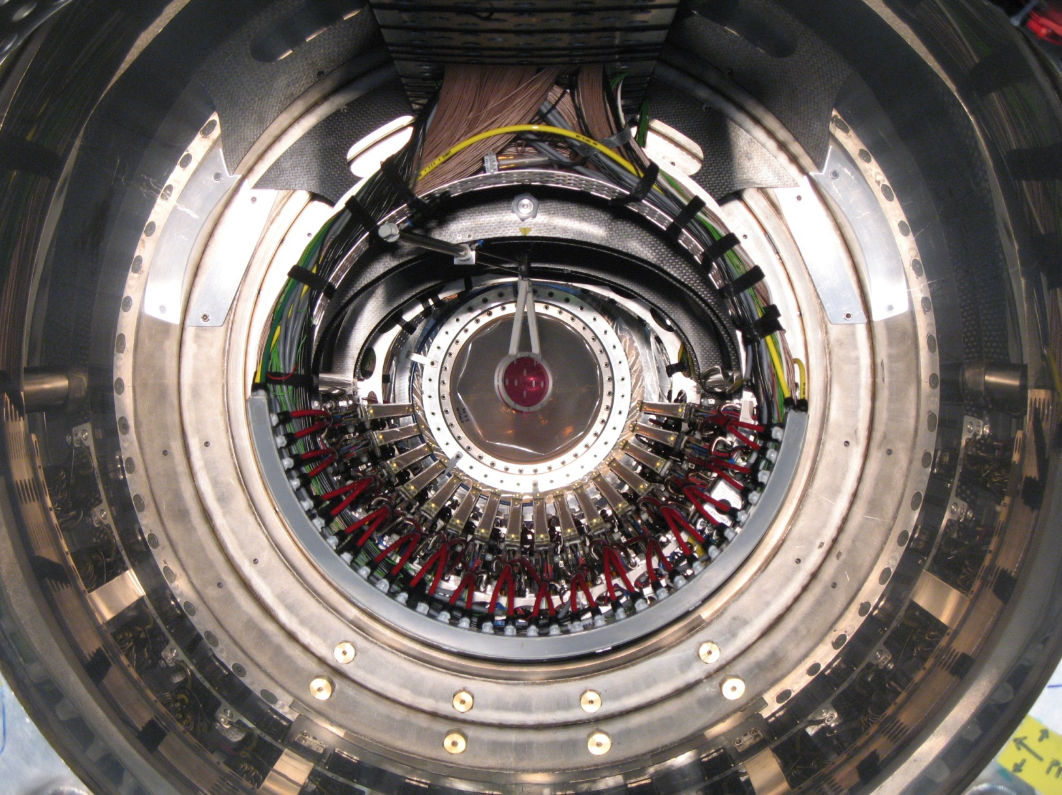
The MEG Experiment at PSI

Slide 9
μ → eγ signal and background 1)
signal
μ → e γ
background
accidental
μ → e ν ν
μ → e γ ν ν
ee → γ γ
eZ → eZ γ
physical
μ → e γ ν ν
(radiative decay)
e⁺ μ⁺ γ
ν
θ_{eγ} = 180°
E_{e} = E_{γ} = 52.8 MeV
T_{e} = T_{γ}
e⁺ μ⁺ γ
ν
ν
ν
e⁺ μ⁺
γ

Slide 10
μ → eγ signal and background 2)
R_{signal} = R_{μ} * BR(μ → eγ)
R_{RD} = R_{μ} * BR(μ → eννγ)
R_{acc} ∝ (R_{μ})² * (ΔΘ)² * (ΔE_{γ})² * ΔT * ΔE_{e}
⇓
Muon rate to be used is a trade off between expected
number of signal events and background level;
Sensitivity is limited by accidental background;
High resolution detectors are mandatory.

Slide 11
The MEG goal
FWHM
Need of a DC beam
Exp./Lab | Year | ΔE_{e}/E_{e} (%) | ΔE_{γ} /E_{γ} (%) | Δt_{eγ} (ns) | Δθ_{eγ} (mrad) | Stop rate (s⁻¹) | Duty cyc.(%) | BR (90% CL)
SIN | 1977 | 8.7 | 9.3 | 1.4 | - | 5 x 10⁵ | 100 | 3.6 x 10⁻⁹
TRIUMF | 1977 | 10 | 8.7 | 6.7 | - | 2 x 10⁵ | 100 | 1 x 10⁻⁹
LANL | 1979 | 8.8 | 8 | 1.9 | 37 | 2.4 x 10⁵ | 6.4 | 1.7 x 10⁻¹⁰
Crystal Box | 1986 | 8 | 8 | 1.3 | 87 | 4 x 10⁵ | (6..9) | 4.9 x 10⁻¹¹
MEGA | 1999 | 1.2 | 4.5 | 1.6 | 17 | 2.5 x 10⁸ | (6..7) | 1.2 x 10⁻¹¹
MEG | 2012 | 0.8 | 4 | 0.15 | 19 | 3.0 x 10⁷ | 100 | 2 x 10⁻¹³
With these resolutions: BR(ACC) ~ 2.10⁻¹⁴, BR(RD) ~ 10⁻¹⁵
Improvement by two orders of magnitude ! A tough experimental challenge; possible, but excellent detector resolutions are needed.

Slide 12
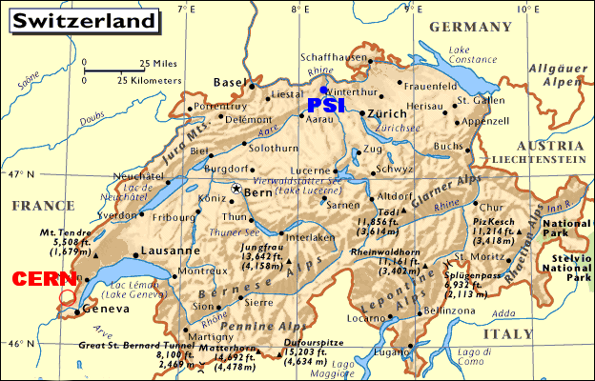
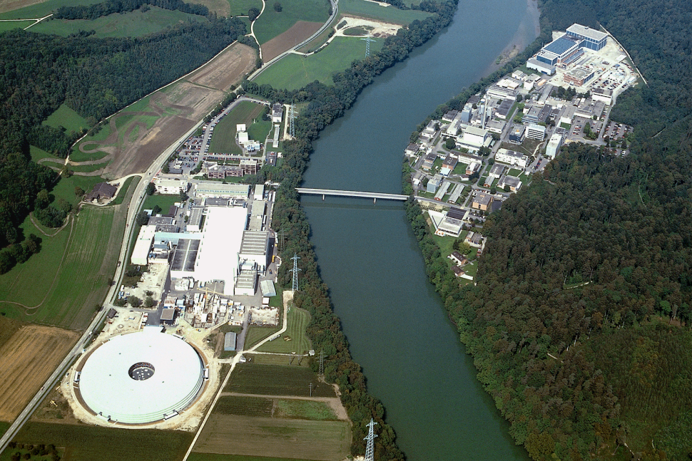
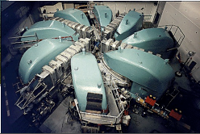
The Paul Scherrer Institute (PSI)
The most powerful continuous
machine (proton cyclotron) in the
world;
Proton energy 590 MeV;
Power 1.2 MW;
Nominal operational current 2.2 mA.

Slide 13
MEG Detection Technique
Stopped beam of 3 x 10⁷ μ/sec in a 205 μm target.
Liquid Xenon calorimeter for γ detection (scintillation).
Solenoid spectrometer (COBRA) & drift chambers for
e+ momentum measurement.
Scintillation counters for e+ timing.
Method proposed in
1998; PSI-RR-99-05:
10⁻¹⁴ possibility
MEG proposal in
2002: 10⁻¹³ goal
A. Baldini and T. Mori
spokespersons:
Italy, Japan,
Switzerland, Russia,
Usa.
≈ 60 physicists

Slide 14
MEG Calibration
MEG is a precision experiment;
High experimental resolutions are mandatory
(background level depends on resolutions);
Good detector performances must remain
stable for a ~ 3 year scale;
Electromagnetic calorimeter uses an innovative
technology;
⇒ Frequent and reliable calibration procedures
represent one of the fundamental quality factors
for MEG.

Slide 15
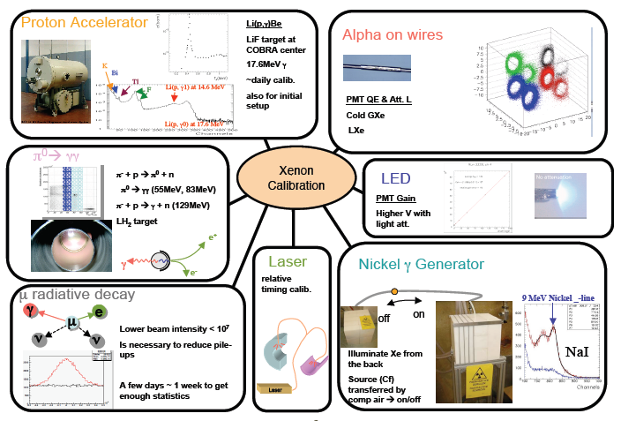
Calibration tools 1)

Slide 16
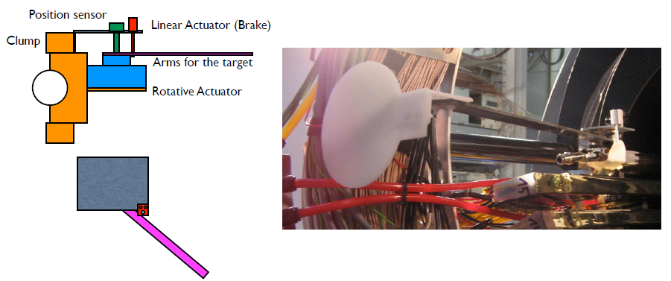
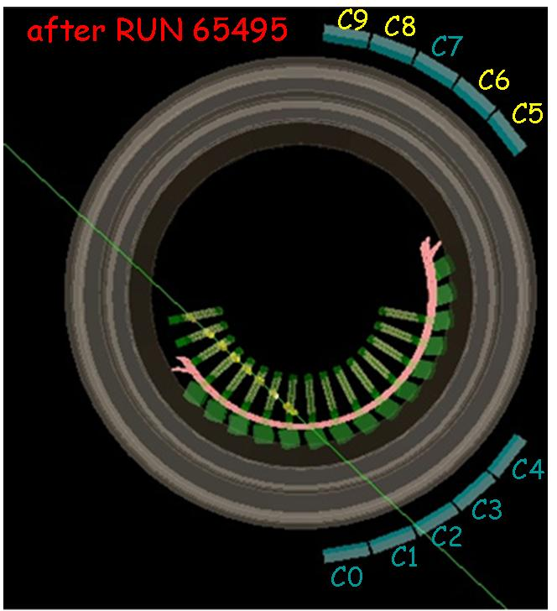
Calibration tools 2)
Positron monoergetic
beam + CH₂ target
for Mott scattering
40 ÷ 60 MeV positron beam
Event rate ∼ kHz for
10⁸ e+/s. First tests promising.
NEW DEVICE !
Cosmic rays triggered by Scintillation Counters
and crossing several DCH chambers.
No magnetic field → straight line trajectories:
single hit chamber resolution and alignment.
Collected about 2 millions of cosmic muons.

Slide 17
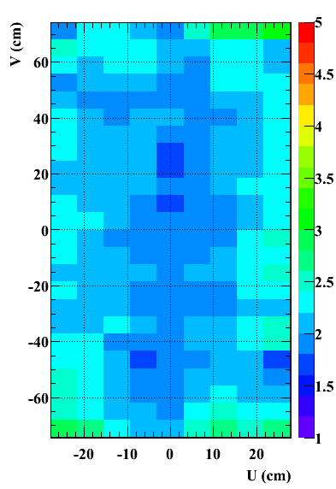
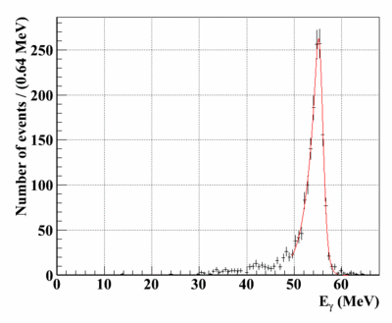
XEC performances 1)
55 MeV γ (from π⁰ decay)
σ_{R} = 1.6%
FWHM = 4.6 %
Spatial uniformity
of energy resolution

Slide 18
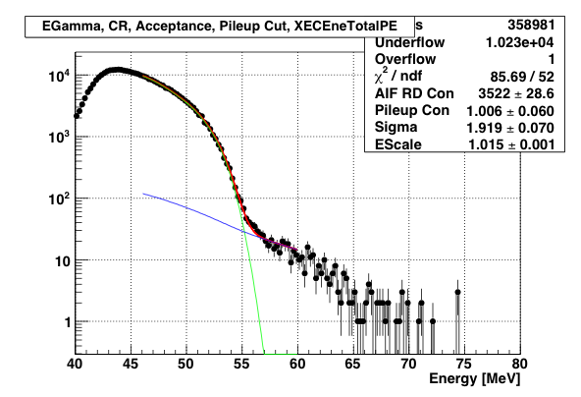
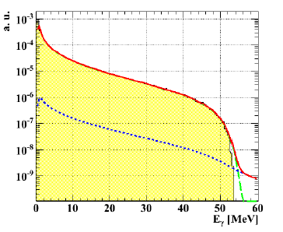
XEC performances 2)
Photon BCK spectrum vs MC
Simulated components
Red: Total
Green: resolution
Yellow: RD + AIF
Blue: pileup
XEC performances summary:
σ_{E}/E = 2.1%, σ_{x} = (5 ÷ 6) mm, ε = 58 %
(averaged over detector surface)

Slide 19
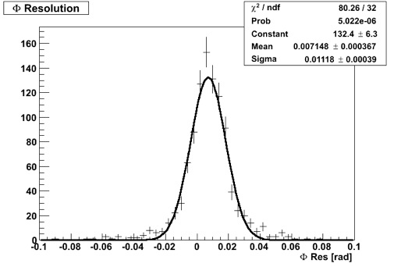
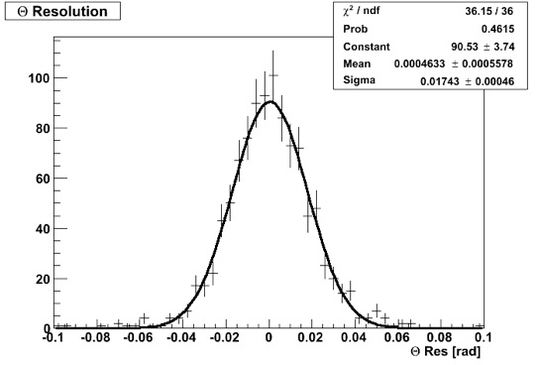
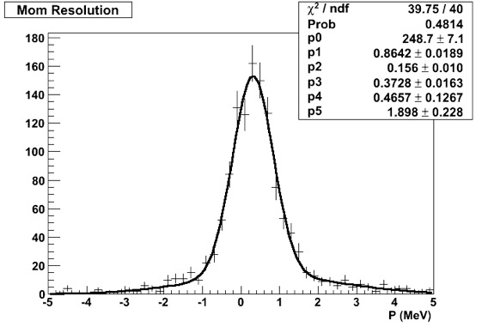
Tracking Performances
σ_{φ} = 7.9 mrad
σ_{θ} = 12.3 mrad
Two gaussian fit:
σ_{φ,core} = 7.1 mrad
Two gaussian fit:
σ_{θ,core} = 11.2 mrad
DCH momentum and angular resolution measured by double turn method (two segments of track, making two turns in the spectrometer, treated as independent).
Double gaussian
convolution
(no sqrt(2) factor)
σ_{p} (core) = 373 keV

Slide 20
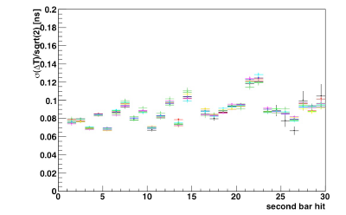
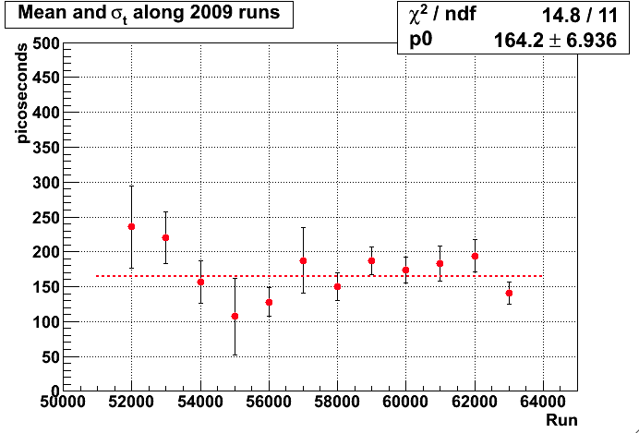
Timing performances
Single bar timing resolution
Different colors correspond
to different weeks
Average values ∼ 80 ps
RD resolution as a function
of time. Good stability
Average value ≈ 160 ps
For signal σ = 142 ps because
of energy dependence.

Slide 21
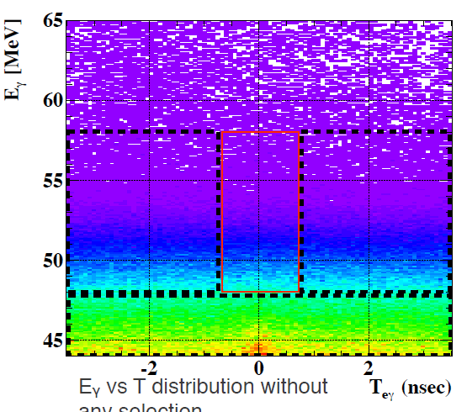
Blind + likelihood analysis
Blinded region
Plane (E_{γ}, Δt) used
for pre-selection +
reconstructed track
with associated TC hit
Blinded files:
0.2 % events
Open files: 16 % events
Open and blinded files reprocessed several times with improving calibrations
and algorithms. Analysis box: ± 0.7 ns around zero (∼ 10 σ_{Δt}).
2009 sample: 6 x 10¹³ stopped muons, 43 days of data taking.

Slide 22

Normalization
where:
10⁷ pre-scaling factor
TRG = 22: Michel events trigger (only DCH track required)
TRG = 0: MEG events trigger
k = (1.0 ± 0.1) x 10¹²
PRELIMINARY

Slide 23
Generalities on analysis
Three independent blind-likelihood analyses to evaluate systematics
RD and accidental event rates in the signal region fitted or
estimated a priori by means of side-bands information.
Feldman-Cousins method for C.L. determination.
Kinematical variables used:
- Positron and Gamma Energies;
- Relative timing and relative angle;
Likelihood function:
Signal PDF
RD PDF
N_{obs} = number of observed events
Accidental BCK PDF

Slide 24
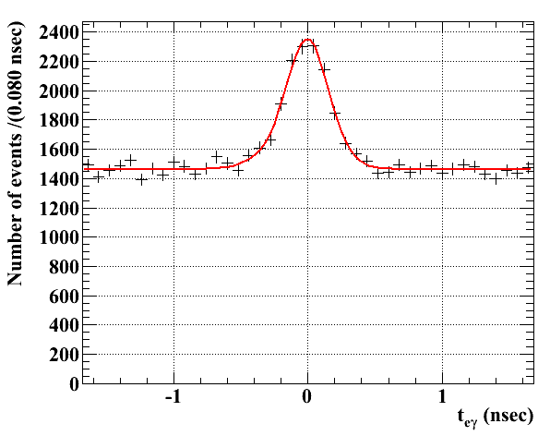
PDF determination
Signal:
- calibration data (π⁰, Michel edge, CW, XEC single events ...)
for photon/positron energy and relative angle;
- RD data for timing (corrected for energy dependence);
RD:
- 3-D theoretical distribution folded with detector response to
take into account kinematical constraints;
- direct measurement for timing
Accidental background:
- Everything measured on sidebands
Important: the most dangerous background is measured !

Slide 25
Sensitivity evaluation
Expected sensitivity evaluated
with two methods:
Toy MC assuming zero signal:
- generated 1000 independent samples of events using bck and RD pdf’s
(systematic effects not included);
- upper bound on number of signal events evaluated for each sample;
- average upper bound @90% C.L: 6.1 events ⇒
- average upper bound on B.R.(μ → eγ) = 6.1 x 10⁻¹².
Fit to events in the sidebands:
- applied same fitting procedure used for data in the signal region;
- upper bound: B.R.(μ → eγ) ≤ (4 ÷ 6) x 10⁻¹².
Comparison: present upper bound from MEGA experiment: 1.2 x 10⁻¹¹
PRELIMINARY

Slide 26
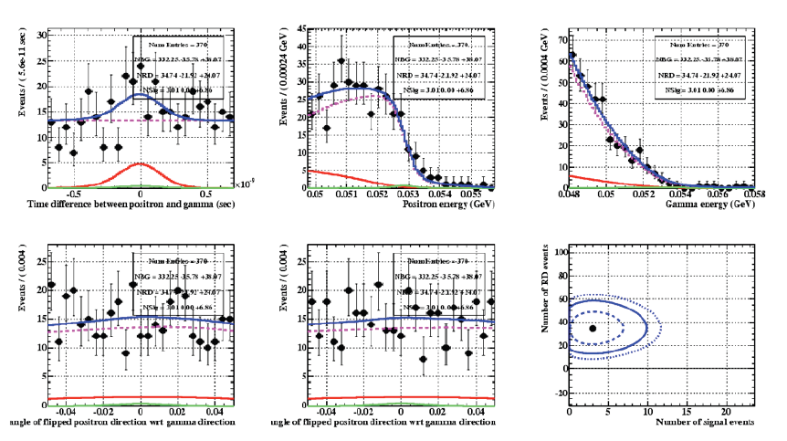
Likelihood analysis 1)
PRELIMINARY
Fit to events in analysis region
(370 total events)
Blue: total
Magenta: BCK
Red: RD
Green: Signal
Best fit: NSIG = 3.0
Depending on analysis technique this number varies in the range: 3 ÷ 4.5

Slide 27
Likelihood analysis 2)
UL on signal: N_{sig} < 14.5 @90% C.L. (depending on
analysis prescriptions varies between 12 and 14.5);
With this upper limit on Nsig:
(previous result: BR < 2.8 x 10⁻¹¹, Nucl. Phys. B834, 1-12, 2010)
Null hypothesis has a probability in the range
(20 ÷ 60)% depending on analysis prescriptions.
BR(μ → eγ) @90% C.L. ≤ 1.5 x 10⁻¹¹
PRELIMINARY

Slide 28
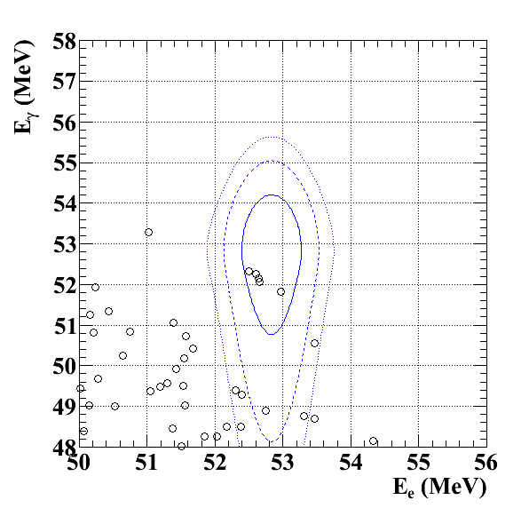
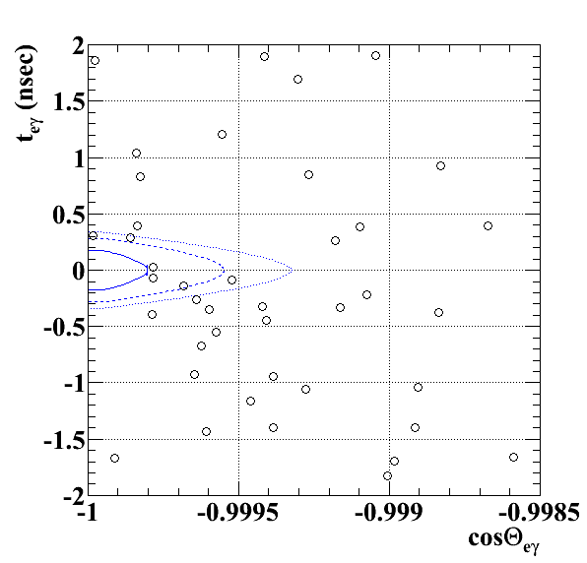
A look at events in signal region
E_{γ} vs E_{e+}
ΔT vs cos(ΔΘ)
Cut at approximately 90% on other variables.
Probability contours PDFs correspond to 39.3%, 74.2%, 86.5% of signal events

Slide 29
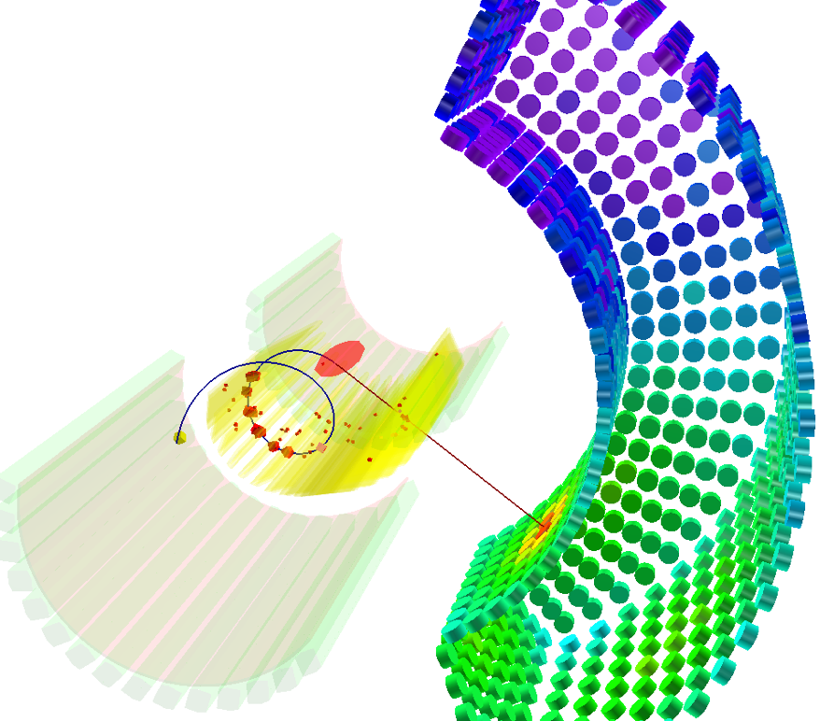
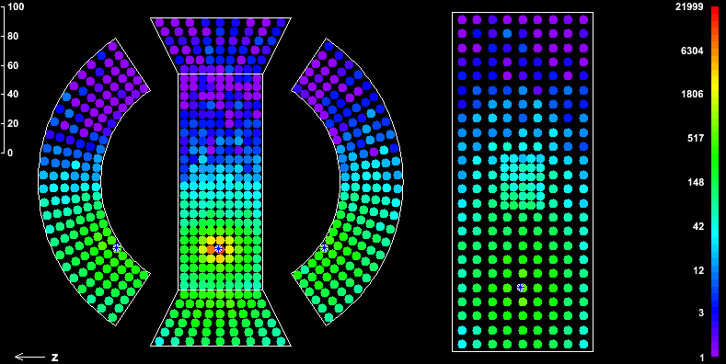
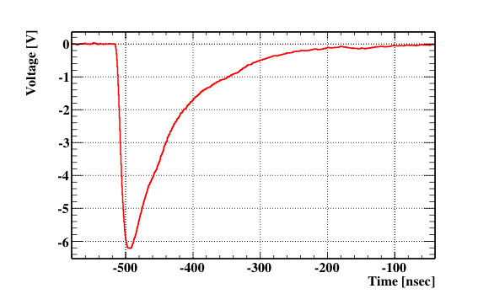
A picture of an interesting event
E_{γ} = 52.25 MeV
E_{e+} = 52.84 MeV
ΔΘ = 178.8 degrees
ΔT = 2.68 x 10⁻¹¹ s
Calorimeter sum WF

Slide 30
MEG Perspectives
Data taking will be restarted at end of July;
Strategies to combine 2008 and 2009 data under discussion;
We would have 3 years of stable data taking from now until end of 2012
(large fluctuations expected to disappear);
Expected improvements:
- a factor 2 on electronic contribution to timing (hardware fine tuning);
- possible better positron calibration (monocromatic beam) + DCH noise reduction ⇒
σ_{θ}: 11 mrad → 8 mrad; σ_{p}: 0.85% → 0.7% (single gaussian);
- relative timing resolution: 160 ps → 120 ps (timing + track length evaluation);
- possible refinement in calorimeter analysis (σ_{E}/E = 2.0% → 1.5%).
Continue running for the final goal (sensitivity ∼ few x 10⁻¹³)
LoI
Proposal
now
1998 1999 2000 2001 2002 2003 2004 2005 2006 2007 2008 2009 2010 2011
Planning
R & D
Assembly
Data Taking
http://meg.psi.ch
http://meg.pi.infn.it
http://meg.icepp.s.u-tokyo.ac.jp
More details at

Slide 31
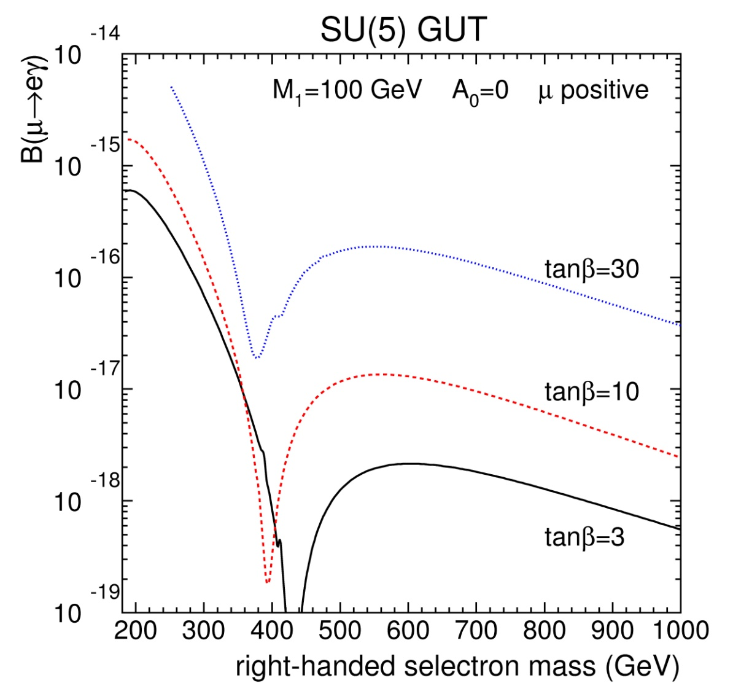
What next for μ → eγ ? 1)
It should be very
interesting to explore
lower BR’s …
Can we gain order of
magnitudes in
sensitivity by using
more intense muon
beams (≥ 10¹⁰ μ/s) ?
J. Hisano et al., Phys. Lett. B391 (1997) 341 and B397 (1997) 357

Slide 32
What next for μ → eγ ? 2)
Not an easy task ! Sensitivity limited by accidental background:
a simple increase of muon rate does not improve sensitivity !
We need much better detectors to reach BR (μ → eγ) ≤ 10⁻¹⁴.
Some possible suggestions to reduce the background:
- use high resolution beta spectrometers (ΔE_{e}/E_{e} = 0.1 % feasible);
- reduce the target thickness to improve Θ_{eγ} resolution
(possible because of higher intensity of muon beams);
- use a finely segmented target (it requires good directional
sensitivity to distinguish adjacent targets);
- use pixel detectors to track e⁺ & e⁺e⁻ pair after photon conversion;
- some R&D studies under way …

Slide 33
μ → eee
BR(μ → 3e) ~ α BR(μ → eγ) ~ 10⁻² BR(μ → eγ)
Present limit BR(μ → 3e) < 10⁻¹²
(SINDRUM Coll., Nucl. Phys. B260 (1985) 1)
Also limited by accidental background ⇒ dc muon beam
(Michel positron & e⁺e⁻ pair from Bhabha scattering or γ conversion in detector)
Experimental advantage: no photons
→ no need of e.m. calorimeter.
However: expected very high rate in tracking system
→ dead time, trigger & pattern recognition problems.

Slide 34
μ⁻A → e⁻A: Conversion Mechanism
Low energy negative muons are stopped in material foils
(Al for MU2E & COMET, Al or Ti for PRIME), forming muonic atoms.
Three possible fates for the muon:
  Nuclear capture;
  Three body decay in orbit;
  Coherent LFV decay (extra factor of Z in the rates):
Signal is a single mono-energetic electron:
Muon lifetime in Al ~ 0.86 μs, in Ti ~ 0.35 μs (in vacuum: 2.2 μs).
Present limit: BR(μ → e) ≤ 7 x 10⁻¹³ in Au (SINDRUM II).

Slide 35
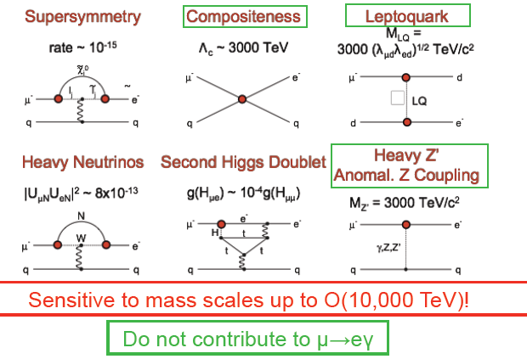
Muon Conversion physics
Muon conversion and μ → eγ are complementary measurements
(discrimination between SUSY models)

Slide 36
SUSY predictions for μ⁻A → e⁻A
10 ⁻¹¹
From Barbieri,Hall, Hisano …
R_{μe}
10 ⁻¹³
10 ⁻¹⁵
MU2E, COMET expected sensitivity
10 ⁻¹⁷
PRIME expected
sensitivity
10 ⁻¹⁹
10 ⁻²¹
100 200 300
100 200 300
→ eγ & μ⁻A → e⁻A Branching Ratios linearly
correlated in photon dominated models

Slide 37
μ⁻A → e⁻A: Signal and Background
signal
μ (A,Z) → e (A,Z)
main backgrounds
MIO (muon decay in orbit)
μ (A,Z) → e ν ν (A,Z)
(A,Z)
RPC (radiative pion capture) π (A,Z) → γ (A,Z-1)
↓
e⁺ e⁻
e⁻ μ⁻ γ
E_{e} = m_{μ} – E_{B} - E_{R}
Beam related background
N.B. No coincidence → no accidental background

Slide 38
Reduction of beam background
1) Beam pulsing:
Muonic atoms have some hundreds of ns lifetime → use a pulsed
beam with buckets short compared to this lifetime, leave
pions decay and measure in a delayed time window.
2) Extinction factor:
Protons arriving on target between the bunches can produce e⁻ or π
in the signal timing window ⇒ needed big extinction factor (∼10⁻⁹)
3) Beam quality:
  insert a moderator to reduce the pion contamination (pion
  range ≈ 0.5 muon range); a 10⁶ reduction factor obtained by SINDRUM II. No more than 10⁵ pions may stop in the
  target during the full measurement (≤ 1 background event);
  select a beam momentum < 70 MeV/c (muon decaying in
  flight produce low energy electrons).

Slide 39
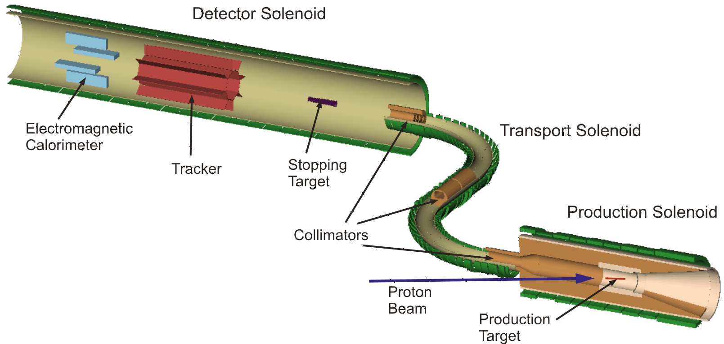
Mu2e at Fermilab
Derived from original MECO project at AGS.
Expected tracker resolution
900 keV FWHM @100 MeV
Graded magnetic field
to select electrons with
P>90 MeV/c and recover
backwards going electrons
8 GeV, 100 ns
width bunches
Sign selection and
antiprotons rejection

Slide 40
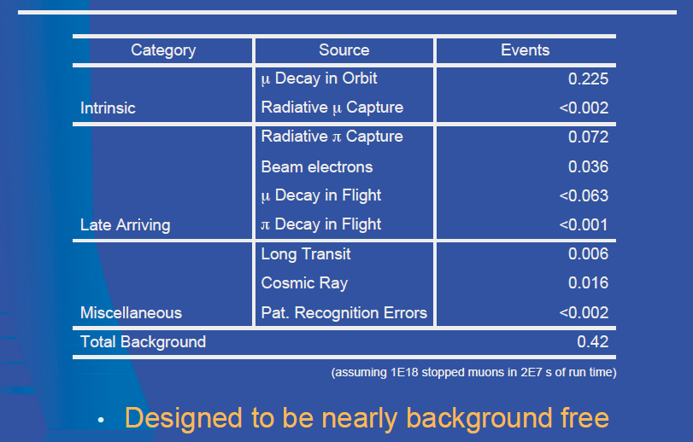
Mu2e background
Assumed
10⁻⁹ extinction
factor
Expected signal
40 events for
R_{μe} = 10⁻¹⁵
Expected upper
Limit for no
signal 6 x 10⁻¹⁷
(D. Glezinsky,
NuFact 09)

Slide 41
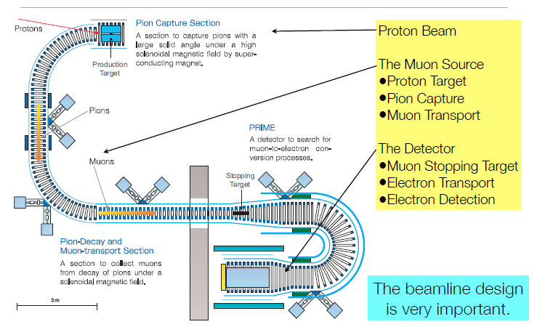
COMET at JPARC
Y. Kuno, Nufact 08

Slide 42
COMET features
Similar to Mu2e for muon beam line and detector;
Main differences:
  C-shaped (180 degree bending) instead of S-shaped
  solenoid beam line (well matched with vertical
  magnetic field to perform momentum selection);
  curved solenoid spectrometer to eliminate low
  energy electrons.
8 GeV proton beam;
Expected 1.5 x 10¹⁸ stopped muons in 2 years running;
Estimated BCK 0.4 events ⇒ sensitivity 3 x 10⁻¹⁷.

Slide 43
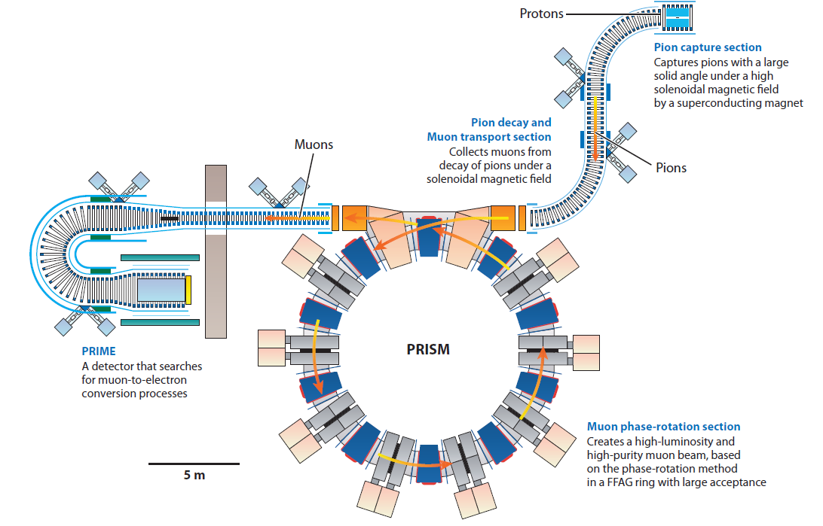
PRISM/PRIME 1): Layout
2nd stage of japanese μ→e conversion search program
Phase
Rotated
Intense
Slow
Muon source
PRIsm
Muon
Electron conversion experiment

Slide 44
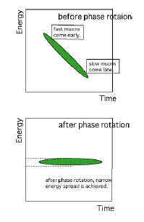
PRISM 2): concept
Muon energy spread reduction by means of a
RF field ⇒ 3 % FWHM energy spread;
Intensity ≈ 10^{(11÷12)} μ/s (no pions);
Muon momentum 68 MeV/c.
Small energy spread essential to stop enough muons in very thin targets. If a momentum resolution ≤ 350 keV (FWHM) is reached, the experiment can be sensitive to μ → e conversion BRs down to 10⁻¹⁸.
Experimental demonstration of phase rotation in PRISM-FFAG ring underway.
Phase rotation

Slide 45
A look at the future
High intensity machines under study (like NUFACT at CERN or
Project X at Fermilab) should provide proton beams at the level of
10¹⁵ protons/s of some GeV energy. Secondary muon beams of
intensity ~ 10¹⁴ muons/s could be obtained from these machines.
The μ⁻A → e⁻A conversion experiments are not limited by accidental
background → in principle they can benefit of the increased
muon beam intensity better than μ → eγ experiments.
Can we hope to gain a couple of order of magnitudes in
the experimental sensitivity for LFV muon decays with
respect to present experiments ?

Slide 46
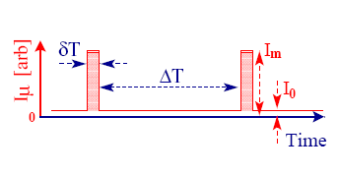
Beam requirements
The total number of muons looks within the
reach of proposed high intensity machines
Total number of muons
Experiment |  | I₀/I_{m} | δT [ns] | ΔT [μs] | p_{μ} [MeV] | Δp_{μ}/p_{μ} [%]
μ⁻A → e⁻A μ → eγ μ → eee | 10²¹ 10¹⁷ 10¹⁷ | < 10⁻¹⁰ n/a n/a | < 100 n/a n/a | > 1 n/a n/a | < 80 < 30 < 30 | < 5 < 10 < 10
Surface muons
n/a = continuous beam
Various technical remarks:
radiation, target heating → need of cooling;
large momentum spread → need of a
PRISM-like ring; beam intensity reduction;
….
(F. DeJongh, FERMILAB –TM–229 –E, CERN-TH 2001-231, J. Äystö et al., hep-ph/0109217)

Slide 47
The tauonic channel
The τ channel is in principle very interesting for studying LFV
because of the τ large mass (m_{τ} ≈ 18 m_{μ})
Many decay channels;
BR’s enhanced wrt μ → eγ by (m_{τ}/m_{μ})^{α} with α ~ 3
Experimental problem: production & detection of τ large samples.
To be competitive with dedicated experiments one must reach
BR(τ → μγ) < 10^{-(9÷10)}
First significant results by B-factories (BELLE,BABAR).

Slide 48
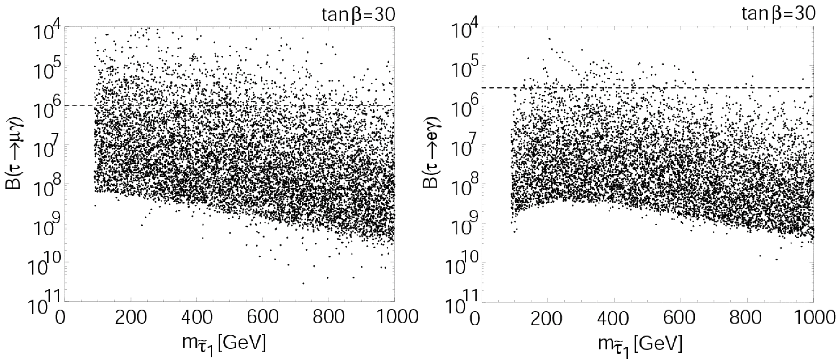
SUSY predictions for LFV τ decays
J.Ellis, J.Hisano, M.Raidal and Y.Shimizu, PR D66 (2002) 115013
τ → μγ
τ → eγ
Almost coincident; limited
drawing resolution
Br(τ→μee) / Br(τ→μγ) ≅ 1/94
Br(τ→μμμ)/ Br(τ→μγ) ≅ 1/440
Br(τ→eee) / Br(τ→eγ) ≅ 1/94
Br(τ→eμμ)/ Br(τ→eγ) ≅ 1/440
Blue: old CLEO limit (2000)
Green: Belle
Yellow: BaBar
B-factories are τ-factories too:

Slide 49

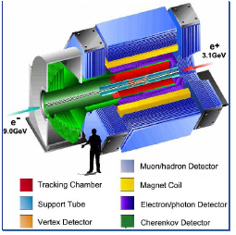
τ → μγ/eγ BABAR 1)
The BABAR experiment at SLAC
Data sample:
425.5 fb⁻¹ @Y(4S) +
90 fb⁻¹ off-peak
(963 ± 7) x 10⁶ τ decays
BABAR Collaboration (B. Aubert et al.), hep-ex/0908.2381v2

Slide 50

τ → μγ/eγ BABAR 2)
Search strategy: divide the “event world”
in two emispheres and look for τ⁺τ⁻ pairs;
one candidate LFV decay in the “signal side”
and one SM decay in the “tag-side”.
(eγ)
tag-side
signal-side
Main backgrounds from τ decays, pairs, radiative processes (e.g. e⁺e⁻ → μ⁺μ⁻γ).
In the signal side, look for one single muon (electron) plus at least one photon; then, look at the μγ (eγ) invariant mass M_{EC}
(it should be = m_{τ}) and to the energy difference in CM frame
ΔE = (E_{μ/e}+E_{γ})_{CM} – E_{CM}/2 (it should be zero).

Slide 51
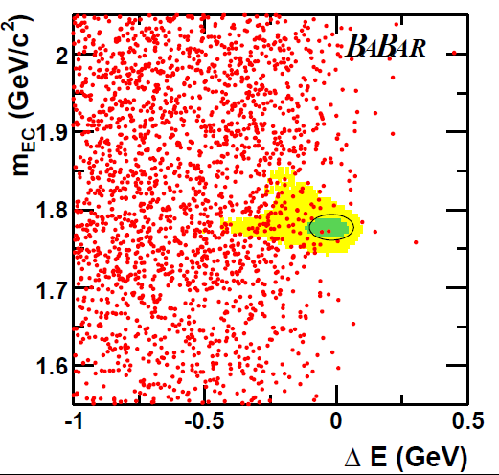
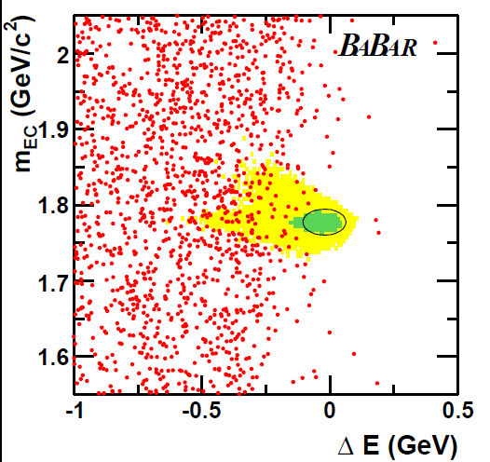
τ → μγ/eγ BABAR 3)
μγ
eγ
Green ellipse (2 σ’s):
events observed 2 (μ), 0 (e) efficiency (6.1 ± 0.5) % (μ)
events expected 3.6 (μ) 1.6 (e) (3.9 ± 0.3) % (e)
⇒ Upper Limit @ 90% C.L.:
BR(τ → μγ) < 4.4 x 10⁻⁸ BR(τ → eγ) < 3.3 x 10⁻⁸

Slide 52
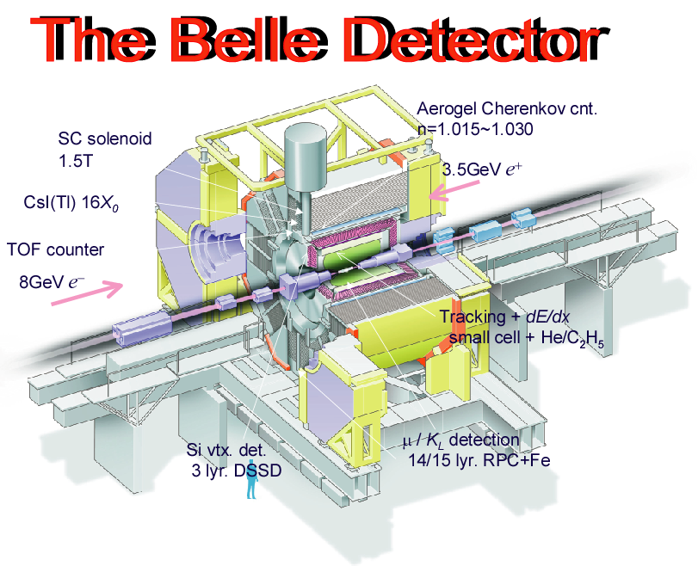
τ → μγ/eγ BELLE 1)
BELLE experiment at KEKB: asymmetric e⁺e⁻ collider with energy peak at Y(4S)
Data sample:
Integrated luminosity 535 fb⁻¹
≈ 4.77 x 10⁸ τ⁺τ⁻ pairs
Similar search strategy:
look for two opposite charge tracks,
accompanied in “signal-side” by one or
more photons; background from
e⁺e⁻ → μ⁺μ⁻ (e⁺e⁻) γ
and radiation in initial state;
reduce other background by cuts on
missing quantities;
examine surviving events in the plane
(ΔE, M_{μ/e-γ});
BELLE Collaboration (K. Abe et al.), PL B666 (2008) 16-22

Slide 53
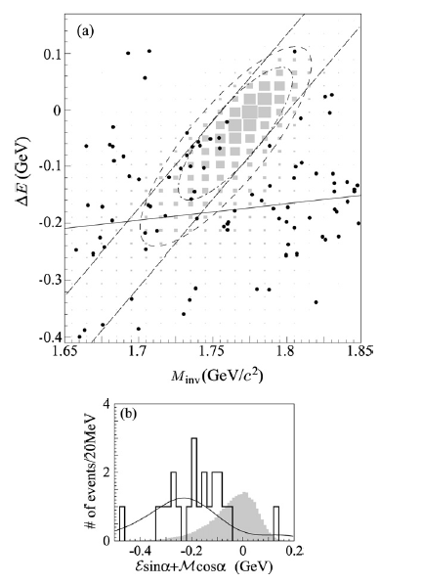
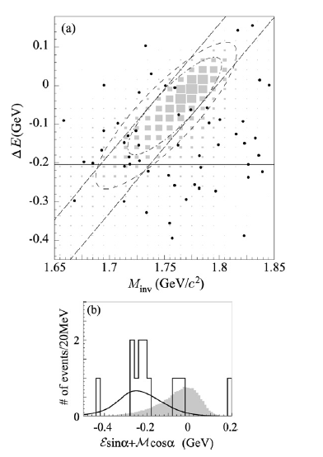
τ → μγ/eγ BELLE 2)
μγ
3 σ ellipse
2 σ ellipse
eγ
Data
Signal MC
Maximum likelihood fit to signal & bck. UL: BR(τ→μγ) < 4.5 x 10⁻⁸, BR(τ→eγ) < 1.2 x 10⁻⁷

Slide 54
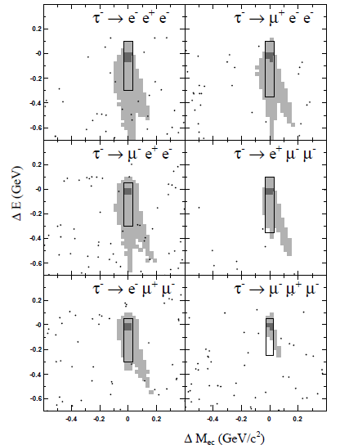

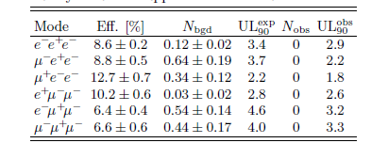
τ → lll BABAR
BABAR Collaboration: arXiv: 1002.4550v1
Same tag-side;
signal side with
three charged tracks
Data sample 468 fb⁻¹
Main backgrounds from and
Bhabha pairs; very low background
in the search window.
Search still based on invariant mass
and ΔE; no excess observed.
U.L. Range: (1.8 ÷ 3.3) x 10⁻⁸ (90% C.L.)

Slide 55
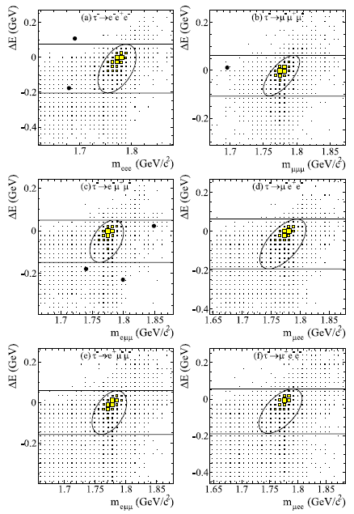
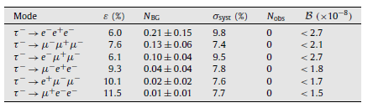
τ → lll BELLE
BELLE Collaboration PL B687 (2010) 139-143
Data sample 782 fb⁻¹
Very low background as for BABAR.
U.L. Range: (1.5 ÷ 2.7) x 10⁻⁸ (90% C.L.)
→ 3l search as no irreducible bck
(no photons ⇒ no problems with initial
state radiation)

Slide 56
Very briefly: τ → l+h (2h)
Both BELLE and BABAR reported results on searches for LFV τ decays
involving one lepton (e or μ) and one or two hadrons (2006 – 2010).
Three cathegories:
τ → l + V (vector meson: φ, ω ...)
τ → l + h₀ (pseudo-scalar meson: π⁰, η, K_{S}⁰ ...)
τ → l + h₁,h₂ (charged mesons: K±, π ± ..)
Clean channels, without irreducible background.
No evidence found in any channel. Different data samples used.
90% C.L. Upper Limits on BR in the range:
(3 ÷ 20) x 10⁻⁸

Slide 57
A look at the future: SuperB
Projects of Super-B factories in Japan (KEKB upgrade) and Italy (Frascati).
Expected luminosities:
10³⁵ cm⁻² s⁻¹ (SuperKEKB), 10³⁶ cm⁻² s⁻¹ (SuperB)
SuperB would reach an integrated luminosity L = 75 ab⁻¹, a couple of orders of magnitude larger than the combined BELLE and BABAR sample.
To take advantage of this increasing in luminosity, detector upgrades could be needed, since the expected B.R. scales as 1/L only for a background-free experiment (otherwise, it scales as 1/sqrt(L)) ⇒ τ → 3l and τ→ l+h (2h) seems more promising than τ → lγ.
Expected sensitivies:
BR(τ → lγ) < 2 x 10⁻⁹
BR(τ → 3l) < 2 x 10⁻¹⁰
BR(τ → l + h(2h)) < (2 ÷ 6) x 10⁻¹⁰
Studies under way to reduce irreducible bck from ISR

Slide 58
Conclusions
An exciting era for LFV searches:
MEG starting long term stable data taking; sensitivity
two times lower than present limit already reached.
Projected sensitivity: BR(μ → eγ) ≤ few x 10⁻¹³.
New μ → e conversion experiments (Mu2e & COMET) should
be installed in some years; expected sensitivities ≤ 10⁻¹⁶;
First significant results from B-factories for LFV τ
decays (BR Upper Limits ∼ few x 10⁻⁸);
Expected (10 ÷ 100) improvement from SuperB projects.
Discovery of LFV just around the corner ???

Slide 59
Backup slides

Slide 60
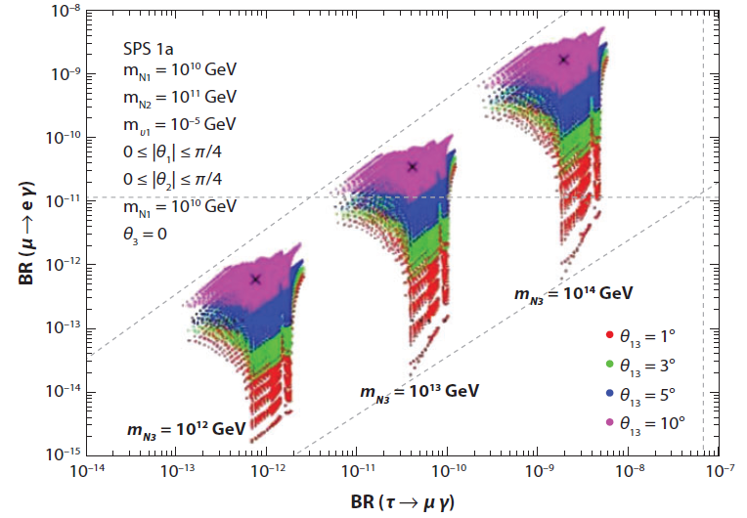
LFV Correlation
S. Antush et al.,
JHEP 11(2006)90
Complementarity
between
measurements

Slide 61
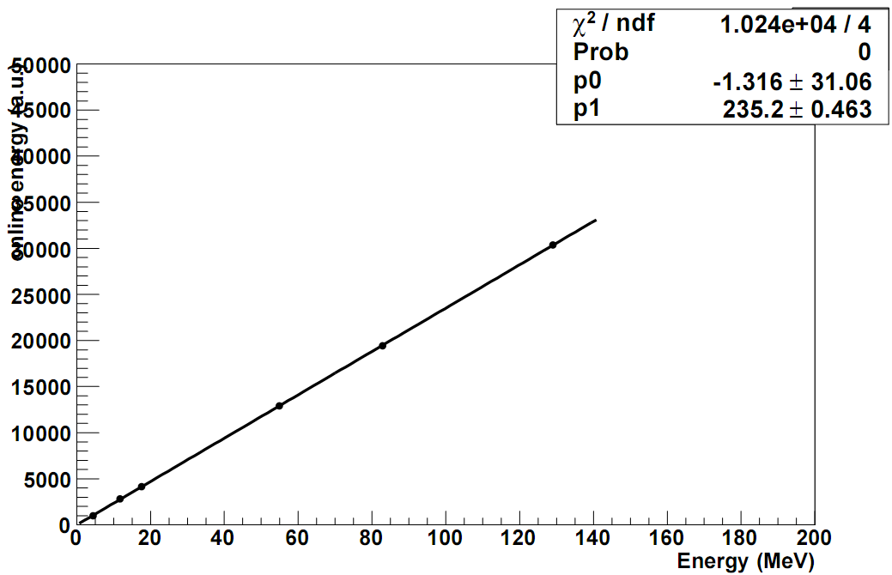
XEC Linearity
π⁻ p → π⁰ n
→ γ γ
π⁻ p → γ n
¹¹B(p,γ)¹²C
offset < 150 keV
int. non-linearity < 1%
⁷Li(p,γ)⁸Be

Slide 62
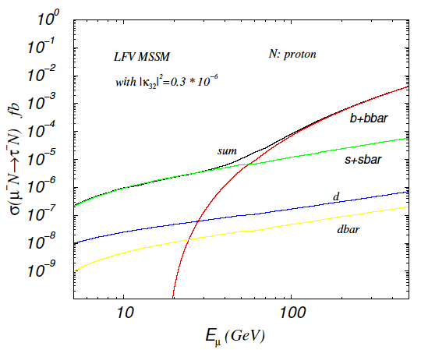

μ⁻A → τ⁻A,X; a brief mention 1)
In recent years, some interest was devoted to the possibility of exploring
the μ → τ conversion LFV channel. It could be a reasonable alternative to
LFV t decays, as τ → μγ, τ → eγ etc., not yet competitive with μ decays
(M. Sher et al., Y. Kuno et al., …)
μA → τX
Largely enhanced at
E_{μ} > 50 GeV for
b-quark processes
μA → τA
(S.N. Gninenko et al.,
Mod. Phys. Lett.
A17 (2002) 1407,
M. Sher et al.,
Phys. Rev.
D69 (2004) 017302)

Slide 63
μ⁻A → τ⁻A,X; a brief mention 2)
  Different experimental approach:
  need of an intense high energy muon beam:
  a) E_{μ} > 20 GeV b) 10²⁰ muons/year
  (for instance at a muon/neutrino factory);
  Expected t production: from hundreds to tens of
  thousands of τ’s (depending on muon energy);
  Signal selection based on angular distribution of τ
  decay products (hard hadrons) and missing momentum;
  Potential backgrounds from mis-identified hard muons
  from μA → μA’ and from hard hadrons from target;
  Need of realistic MC simulations and detector design !

Slide 64
A look at the future: LHC
LHC (N. Ünel, talk at 40th Rencontres de Moriond, March 2005)
MC studies of possible detection of LFV violating processes at LHC . In the τ channel, with one year of data taking at low luminosity, ~ 10¹² τ’s will be produced and several hundred millions could be used to search for LFV τ decays.
Main τ sources: W → τν, Z → τ⁺τ⁻, B → τνD
The predicted sensitivities in the τ → μγ and τ → 3 muons BRs
are ~ 10⁻⁷ ÷ 10⁻⁸, not competitive with present B-factories results (the τ → 3 muons channel has the best signal/noise ratio).
Potentially interesting are also LFV decays of SUSY particles, like

