Slide 1
XEC Hardware Status
MEG Review Meeting 2010
Liquid Xenon Group

Slide 2
Contents
Operation overview
Performance
Problems
Schedule for 2010 DAQ

Slide 3
Operation overview

Slide 4
2009 XEC Operation
Liquid recovery to high pressure tank
New hardware installation
  New liquid purifier/NEG(Getter) pump/Getter gas purifier replacement
  Replacement of PMTs with larger gain change
Evacuation
  4.6x10⁻⁴ Pa thanks to the newly installed NEG pump
Liquid filling
  Liquefaction in the 1000 L dewar (23/May-12/June), then transferred to the detector (4 days)
  All xenon was purified through Getter purifier before liquefaction in the 1000 L dewar
PMT/Detector calibration
  LED, alpha, CR, and CW
Collimator runs
CEX beam
MEG DAQ
  Collimator run
Liquid recovery

Slide 5
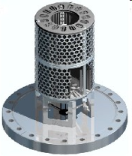
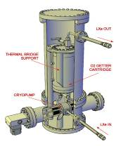
New installation in 2009 shutdown
PMTs
  Replacement of PMTS with large gain change (only on lateral)
New NEG pump for cryostat evacuation
  and also for purification
New liquid purifier tower
  Piston-type pump
    50 cc / cycle, 60 rpm operation
    180 liter/h liquid circulation
  Liquid purifier used in 2008

Slide 6
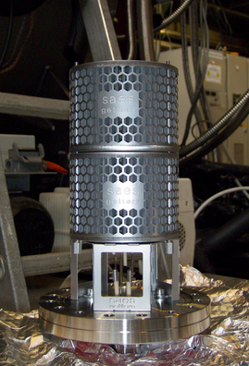
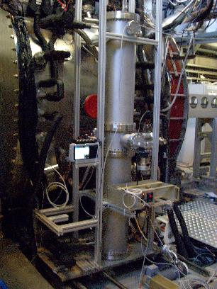
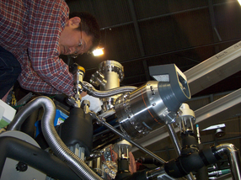
Installation
NEG pump and new purifier tower

Slide 7
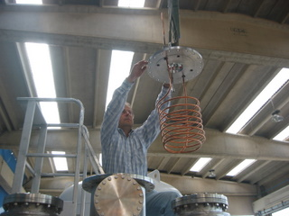
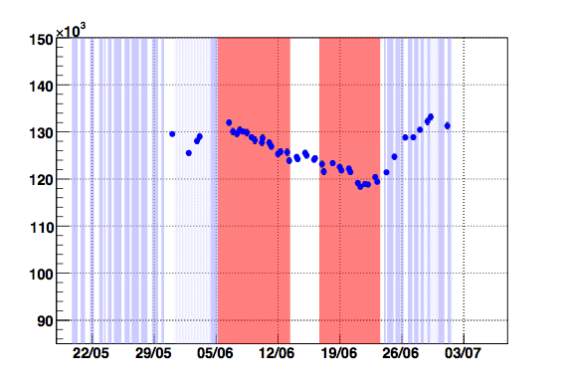
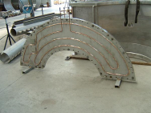
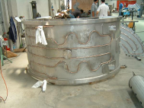
Nitrogen Leak from the cooling pipe (in 2008)?
Cooling by flowing LN2 in the inner spiral copper pipe
Qsum
Operation in 2008
LN2 cooling pipe
  In the cryostat
  On the inner vessel wall and covers
Date
Cooling by flowing LN2 in the copper pipes on the cryostat outer face

Slide 8
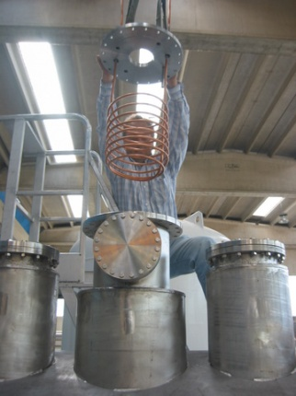
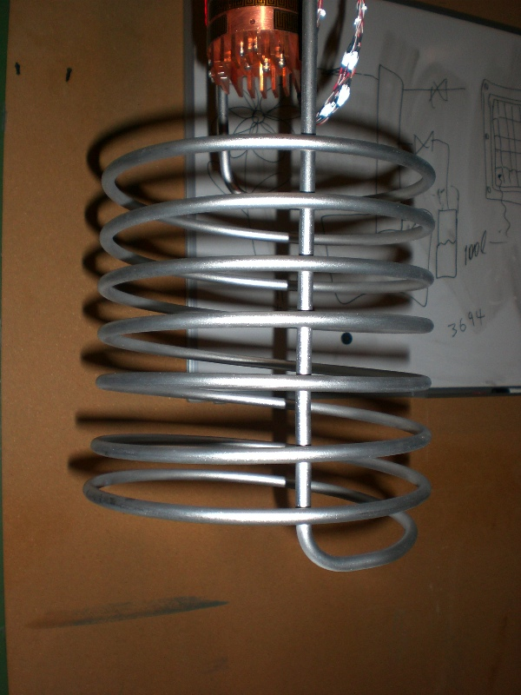
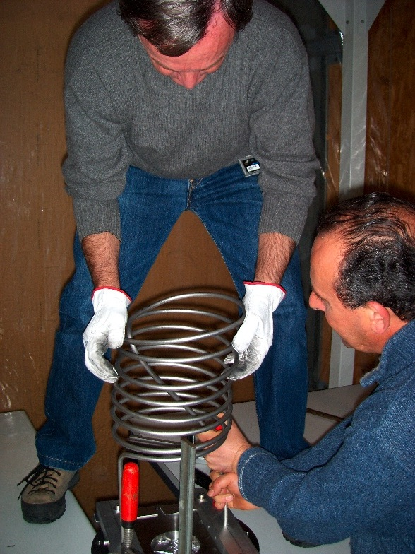
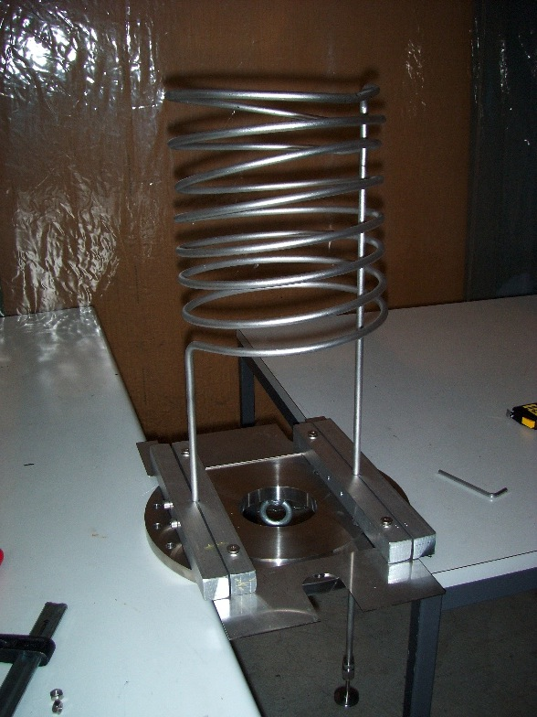
Replacement of the suspicious pipe
The suspicious copper pipe was replaced with a new steel LN2 cooling pipe

Slide 9
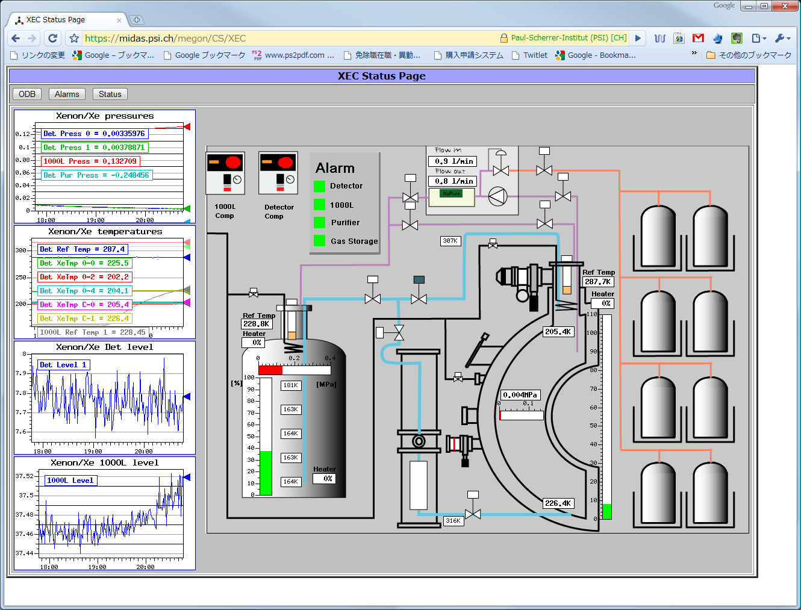
Monitor on the Web

Slide 10
Detector Performance
Details are presented in analysis presentation

Slide 11
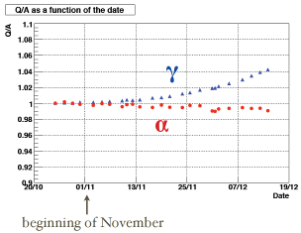
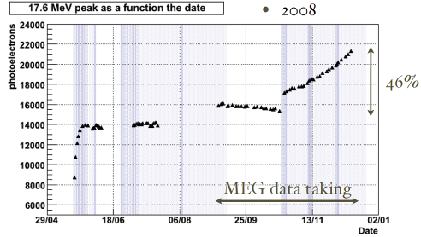
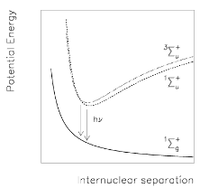
Scintillation Light in 2008 Run
Rapid increase at the beginning thanks to the liquid-phase purification
  Removal of water/oxygen
  LN2 cooling was necessary to help limited cooling power during purification
Increase (~14%) in summer by gaseous purification, however this was not significant
Large increase (46%!) in Oct-Dec after replacing the diaphragm of the gas-circulating pump
e
Xe
Xe
e
e
Xe
Xe

Slide 12
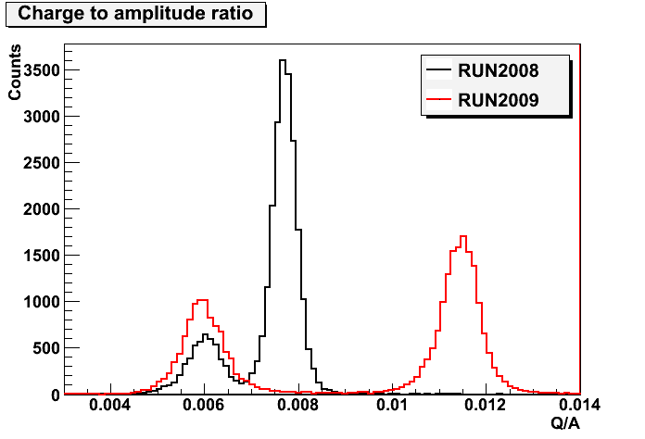
Scintillation Light in 2009 run
Successful separation between alpha and gamma events
  Xenon purification in gas phase through the getter purifier before liquefaction
  New NEG pump for better evacuation
  Replacement of the suspicious cooling pipe
Stable at 1% during 2009 run
Q/A
A
Q
α
γ
γ
α

Slide 13
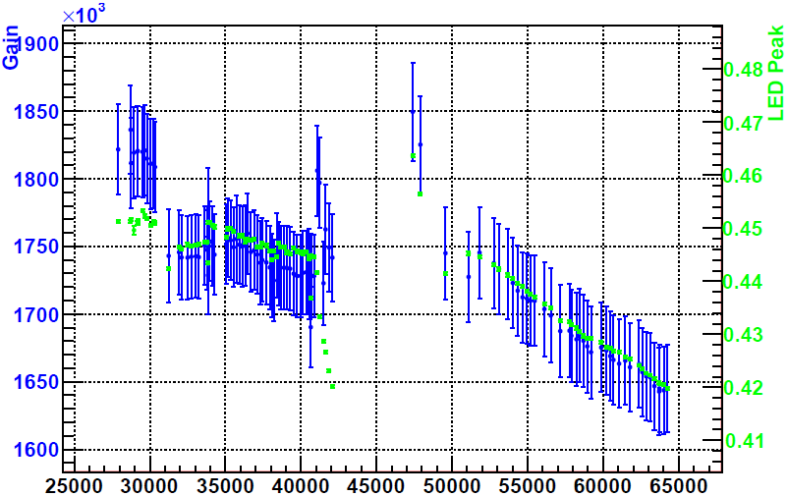
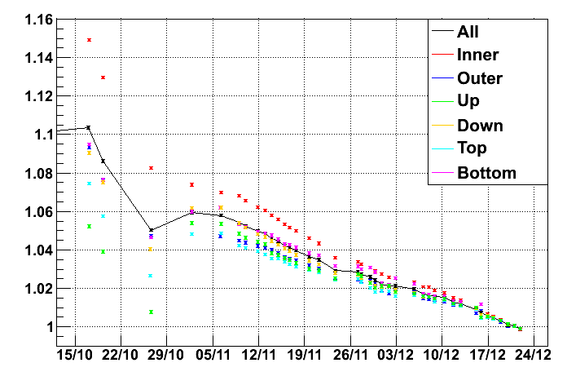
PMT Gain in 2008 and 2009
PMT gain and LED peak with beam on
  LED was constantly flushed during DAQ
  0.1% per day
changed HV
2008
2009
MEG
MEG
CEX
CEX
2009 Oct.-Dec.
Each face, beam on
At the end of 2009
  1.65e6 (beam on)
  1.6e6 (beam off)
Larger decrease on inner face

Slide 14
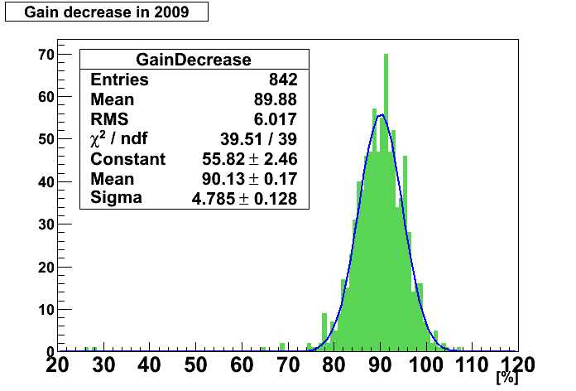
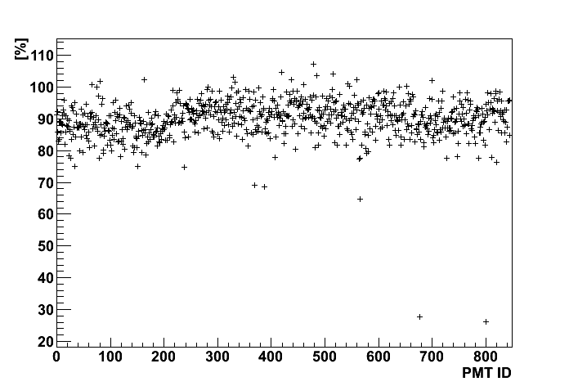
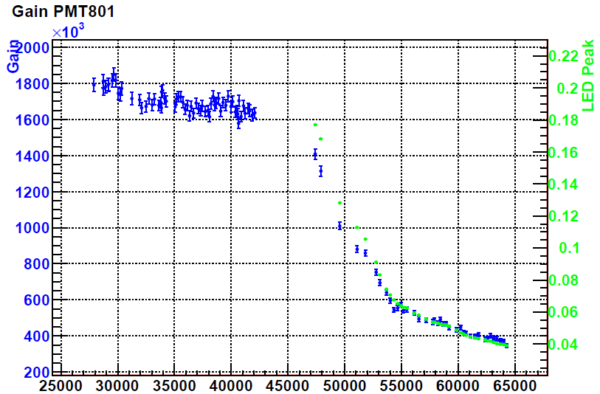
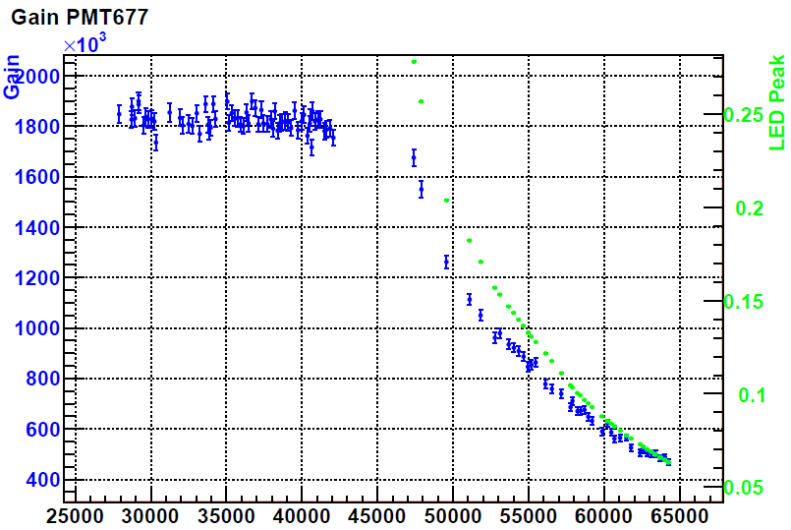
Look on Individual PMT
Change of all PMTs
Gain changed by 10% during run 2009
inner
2PMTs showed larger gain change, finally reached 4~5e5
2008
2009
2008
2009
PMT801
->4e5
PMT677
->5e5

Slide 15
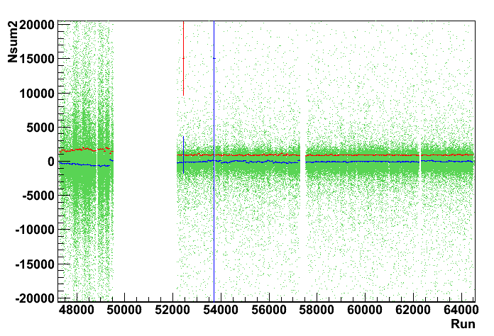
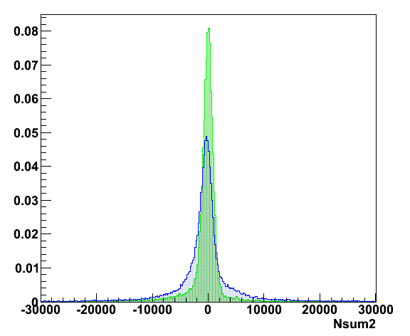
Pedestal in 2009
Pedestal distributions are different btw π⁻ and μ⁺
CEX
MEG
Peak
σ
MEG
CEX
Exchanged degrader

Slide 16
Problems
All are minor

Slide 17
Problems(?)
Cooling Power
Liquid Recovery Procedure
UCN kicker

Slide 18
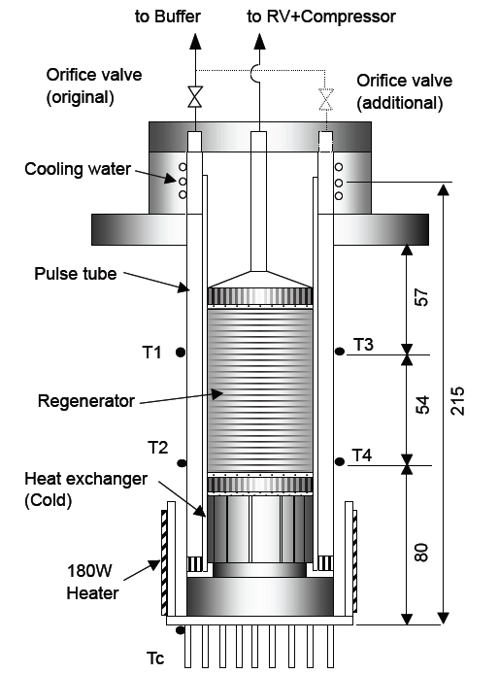
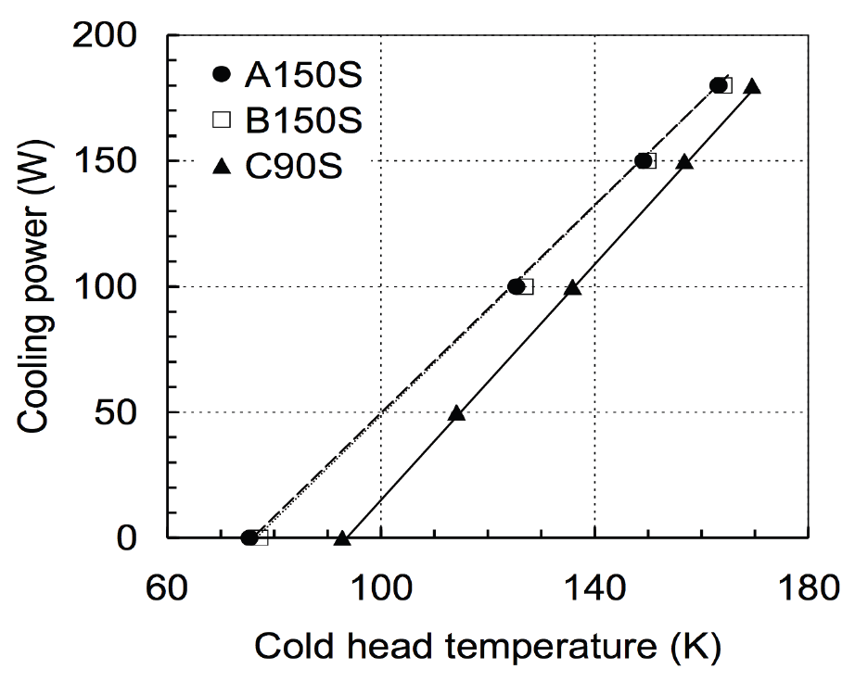
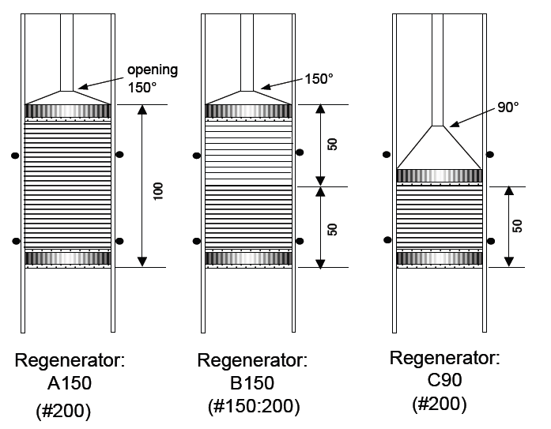
Cooling Power
Looks not sufficient even now
  Additional cooling with LN2 is necessary to keep the pressure. Once in a few – several hours.
  Effect of convection?
Refrigerator R&D is in progress at KEK
Compressor Power Upgrade
  Higher helium rate certainly gives higher cooling power!
  LEYBOLT 6.5kW 50Hz → CRYOMECH 10.5kW 50Hz

Slide 19
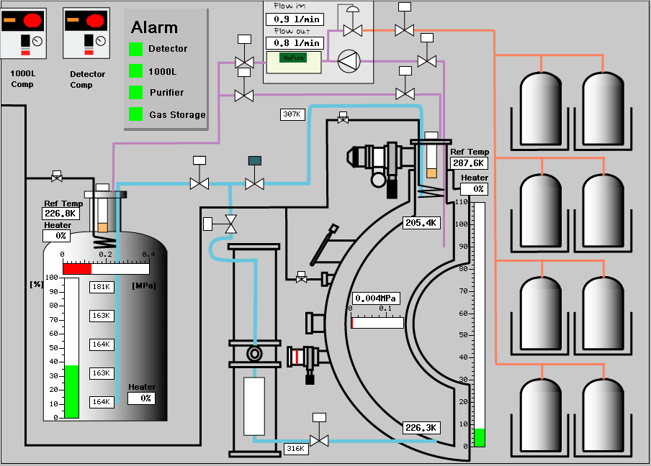
Liquid Recovery Procedure
We found that the new pump is not suitable for liquid transfer from the detector to the dewar
  Install the previous centrifugal pump in parallel for quick recovery of Lxe for the case of emergency and maintenance

Slide 20
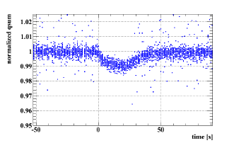
UCN kicker in operation in 2010
UCN kicker in operation
  UCN: “spill” for 8 sec, every 15 min.
Effect on PMT gain?
  0.5% decrease at 8 sec beam break
  Probably no problem
    but need careful monitor
    Special logic to take LED in “UCN spill”?
PMT gain change example in 2008 runs for 19s beam interruption

Slide 21
Operation plan 2010

Slide 22
Operation for 2010 DAQ
5-9/April
  Liquid transfer from the dewar to the detector
12/April-
  Liquid purification (if necessary)
  PMT/Detector calibration
    LED, alpha, CR, and CW
End of April
  Ready for DAQ

Slide 23
Summary
Successful operation of the detector in 2009
  New installations for 2009 DAQ
  Good separation between alpha and gamma events
PMT gain change as scintillation light illumination (and by beam loading)
  Regular LED runs
  Single Pulse LED
Detector will be ready for DAQ end April
  UCN kicker in operation in 2010
Refrigerator cooling power upgrade is foreseen
  Higher power compressor
  Refrigerator R&D is (still) in progress

Slide 24
PMT Gain Shift
Gain decrease in pi0 runs
PMT gain shift was found with muon beam on ( 2~3% )
  Time constant : short and long
  CR peak during MEG run
  LED run with normal muon beam
  LED constant intensity with open/close beam blocker
Beam on
Beam off

Slide 25
Hamamatsu Investigation
Too much alkali ?????

