Slide 1
MEG実験 陽電子スペクトロメータの 性能と今後の展望
Yuki Fujii
On behalf of the MEG collaboration
JPS meeting @ Hirosaki University
17th Sep. 2011

Slide 2
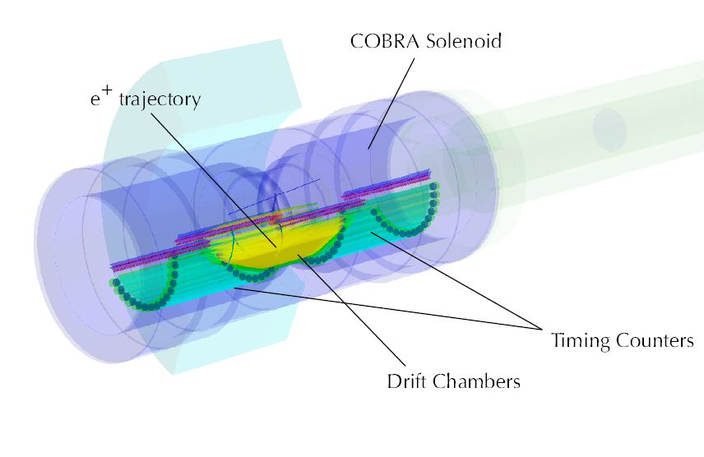
Outline
Introduction
Run 2009 & 2010
Status of run 2011
Noise reduction
Summary and prospects

Slide 3
Introduction
γ
The decay of μ→eγ is strictly forbidden in the standard model because of lepton flavor conservation
BUT… some of beyond the SM (e.g. SUSY) predict this decay can happen in the range of 10⁻¹¹-10⁻¹⁵
Previous upper limit is 1.2x10⁻¹¹ (MEGA experiment)
μ→eγ is a good probe to search for new physics !
Background
Radiative decay (prompt)
Michel decay + γ (accidental)
Experimental requirement
High resolution detector → reduce background
Operation under high luminosity → high statistics
μ
e
signal
γ
ν
γ
ν
ν
μ
μ
?
ν
e
prompt
e
accidental
dominant

Slide 4
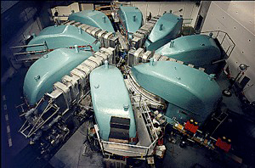
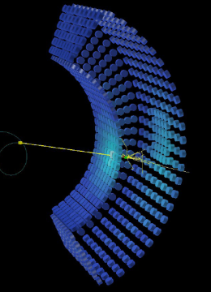
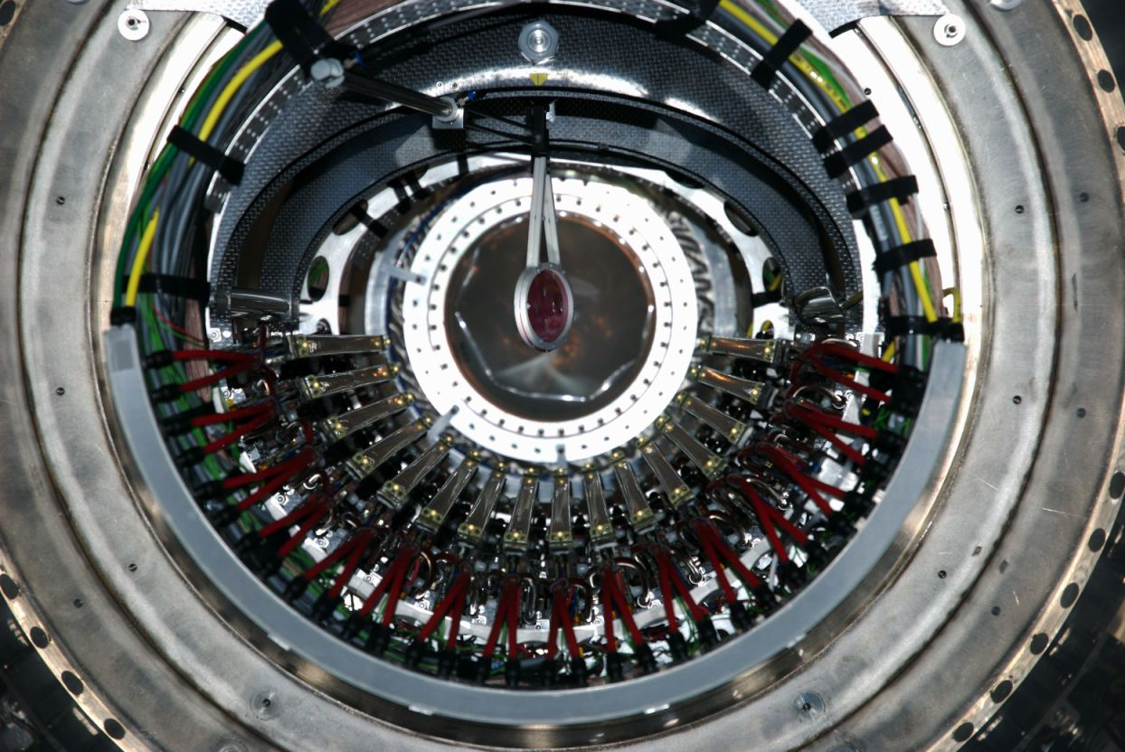
Introduction
The MEG experiment started to search for μ→eγ in 2008
World’s most intense DC μ⁺ beam @ PSI
900 litter large Xenon calorimeter → (白:17pSE2, 金子:17pSE3)
The COBRA (COnstant Bending RAdius) spectrometer → main topic
Result 2009 & 2010 : Br(μ→eγ) < 2.4x10⁻¹² (90 % C.L.)
5 times lower than previous one
→ (大谷:18aSJ4, 岩本:19aSD7, 澤田:19aSD8)
Our sensitivity goal is a few × 10⁻¹³
Performance improvement is essential !

Slide 5
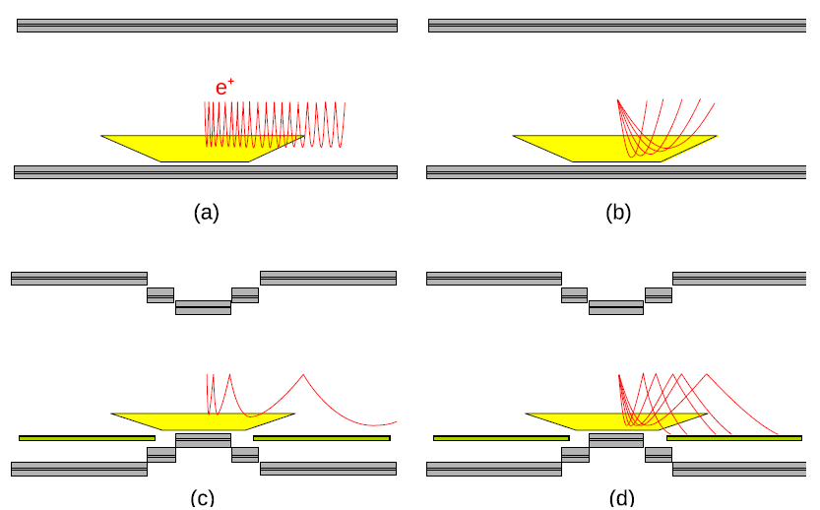
Introduction
The COBRA spectrometer
COBRA magnet : fast sweeping low momentum e+ and get uniform angular response for signal e+
Drift chamber : e+ tracking, low mass materials to reduce the production of background gamma ray
Vernier pattern method
Waveform data acquisition
Timing counter : e+ timing, bar counters (φ measuring) + fiber counters (z measuring)

Slide 6
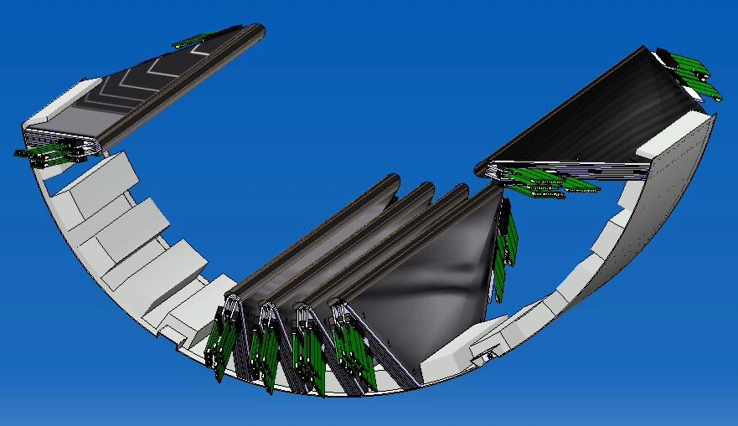
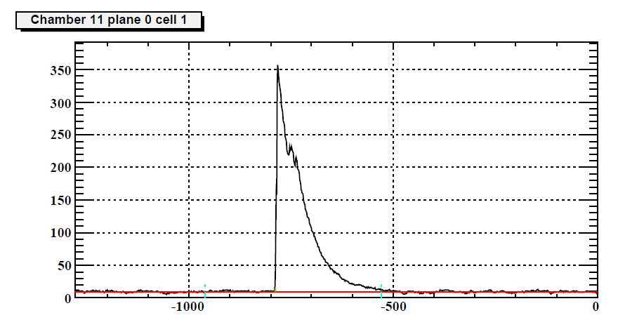
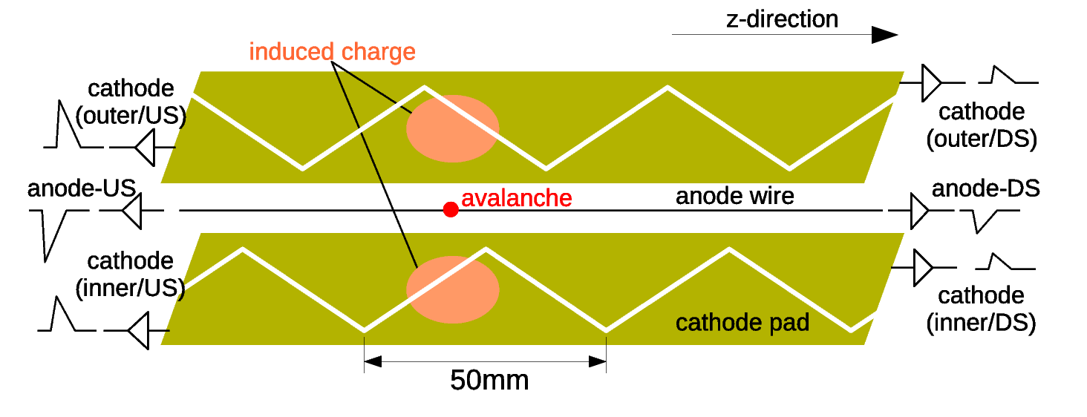
Introduction
The COBRA spectrometer
COBRA magnet : fast sweeping low momentum e+ and get uniform angular response for signal e+
Drift chamber : e+ tracking, low mass materials to reduce the production of background gamma ray
Vernier pattern method
Waveform data acquisition
Timing counter : e+ timing, bar counters (φ measuring) + fiber counters (z measuring)

Slide 7
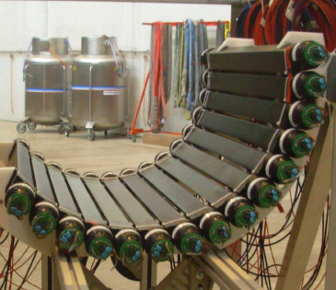
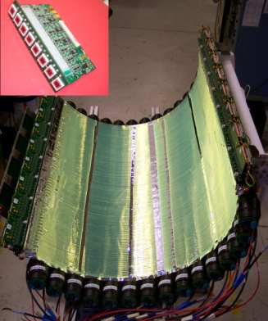
Introduction
The COBRA spectrometer
COBRA magnet : fast sweeping low momentum e+ and get uniform angular response for signal e+
Drift chamber : e+ tracking, low mass materials to reduce the production of background gamma ray
Vernier pattern method
Waveform data acquisition
Timing counter : e+ timing, bar counters (φ measuring) + fiber counters (z measuring)

Slide 8
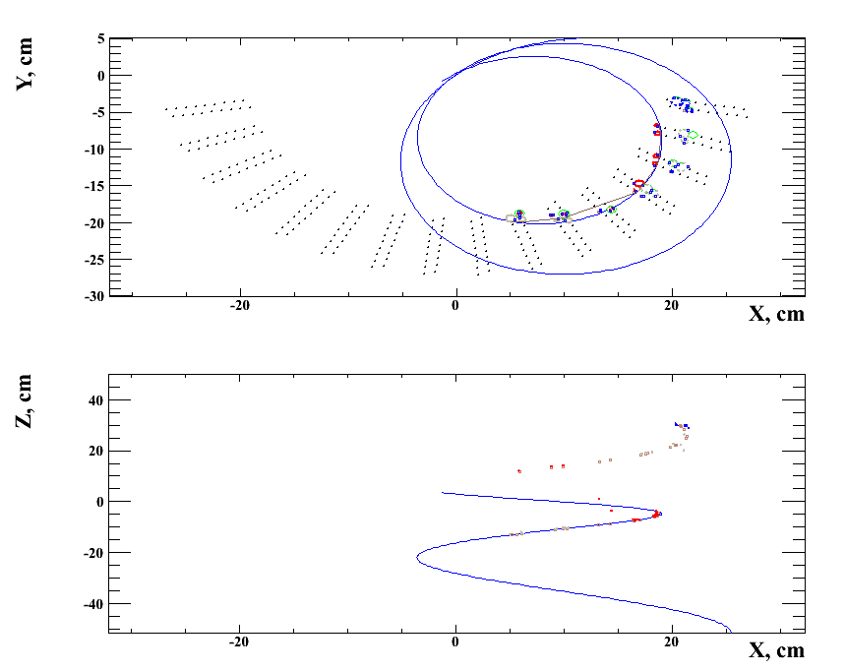
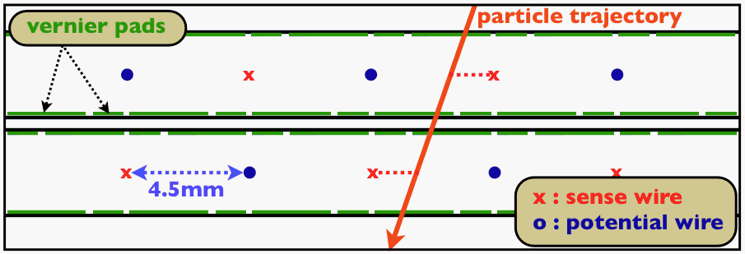
Introduction
e+
Positron measurement
Coordinate system
Hit reconstruction
R → time reading edge
Z → charge division w/ Vernier pad
Track reconstruction
Kalman filter
e+
y
θ
φ
z
(Beam axis)
z
◉
x
R

Slide 9
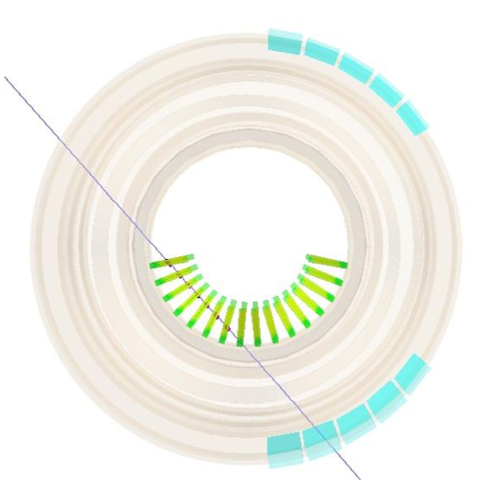
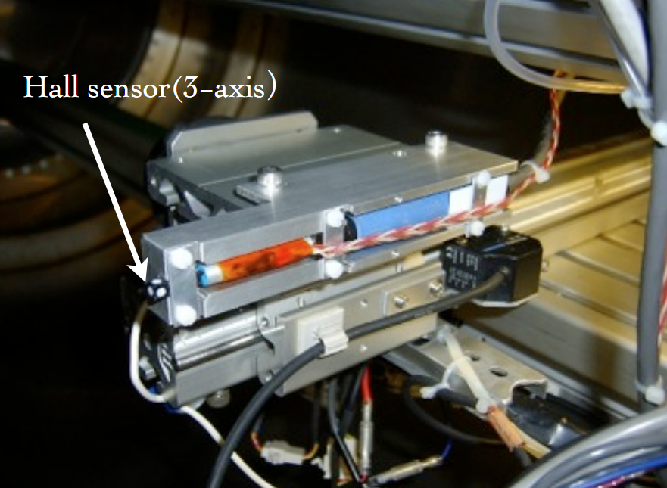
Run 2009 & 2010
Run and analysis summary of 2009 and 2010
Drift chamber alignment
→ Millipede using cosmic rays
COBRA Magnetic field
→ reconstructed field
B_{φ} and B_{r} are corrected a possible misalignment of hole probe to conserve the Maxwell’s equations from measured B_{z}
All APDs off because of noise problem
Drift chamber waveform in 2010 was a little noisier than in 2009 (σ of pedestal : ~1.8 mV → ~2.0 mV)

Slide 10
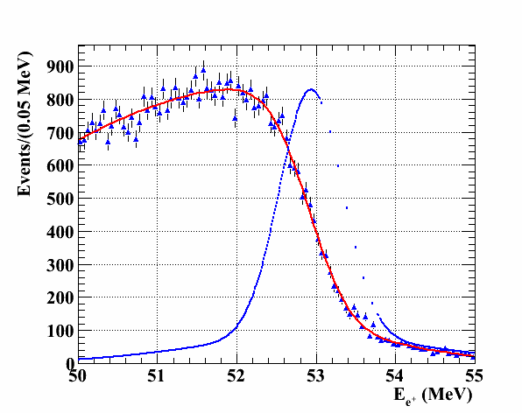
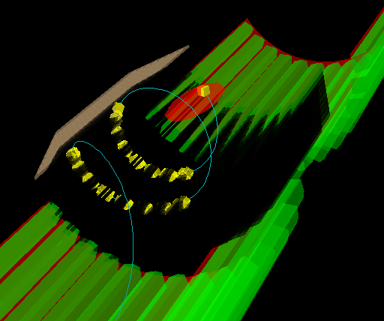
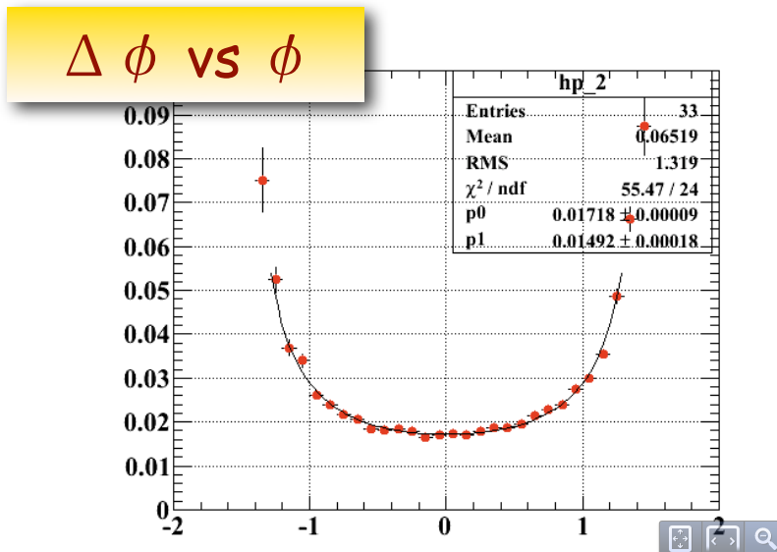
Run 2009 & 2010
Performance estimation
Momentum resolution : Michel edge fitting and double turn events
Angular & vertex resolutions : Double turn events
Efficiency : count #of MD
Correlations : sideband data
Here
ν
ν
μ
e
Michel

Slide 11
Run 2009 & 2010
All performance of the e+ spectrometer are estimated by data itself (radiative decay events, Michel decay events, and so on)
 | 2009 | 2010
E_{e} | 330 keV (core 82 %) | 330 keV (core 79 %)
φ (at φ=0) | 6.7 mrad | 7.2 mrad
θ | 9.4 mrad | 11.0 mrad
Z | 0.15 cm | 0.20 cm
Y | 0.11 cm (core 87 %) | 0.11 cm (core 85 %)
T_{eγ} (RMD) | 150 psec | 130 psec
ε_{Michel} | 40 % | 34 %

Slide 12
Run 2009 & 2010
All performance of the e+ spectrometer are estimated by data itself (radiative decay events, Michel decay events, and so on)
Noise
+
increased dead channels
 | 2009 | 2010
E_{e} | 330 keV (core 82 %) | 330 keV (core 79 %)
φ (at φ=0) | 6.7 mrad | 7.2 mrad
θ | 9.4 mrad | 11.0 mrad
Z | 0.15 cm | 0.20 cm
Y | 0.11 cm (core 87 %) | 0.11 cm (core 85 %)
T_{eγ} (RMD) | 150 psec | 130 psec
ε_{Michel} | 40 % | 34 %
Better DRS clock
Increased dead channels

Slide 13
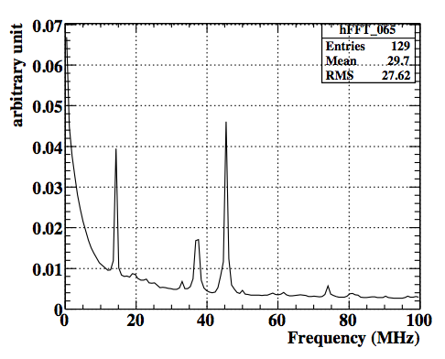
Status of 2011
April | May | June | July | Aug. | Sep.
Detector installation
Calibration
Detector check
Physics run
CEX
7 drift chamber modules were replaced because of increased remaining current or frequent trip
Physics data taking started at the end of June
In 2009 and 2010, only 14 MHz noise is dominant
→ reduced by adjusting charge integration time
other noise components appeared (>30 MHz from APD fiber counters)
Working of hardware noise reduction was done in the middle of July
Change HV module for drift chambers and turn off noisy APD channels
14 MHz

Slide 14
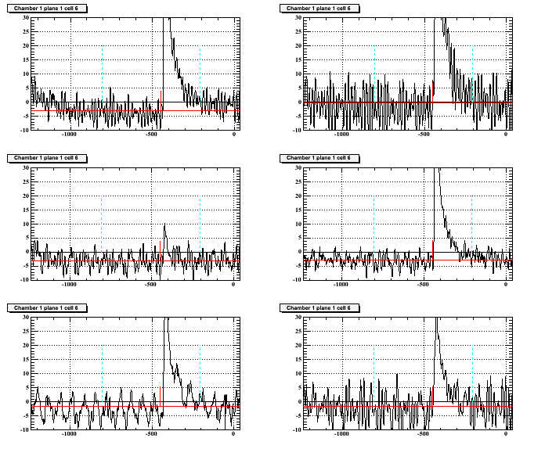
Status of 2011
At the beginning of 2011 run, noise situation was the worst…
But

Slide 15
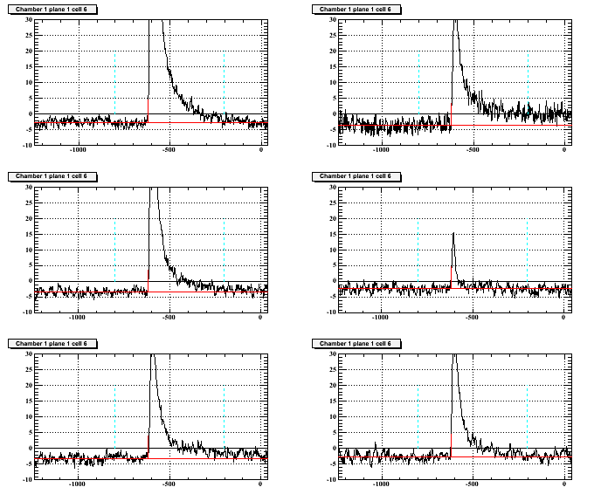
Status of 2011
At the beginning of 2011 run, noise situation was the worst…
After hardware modifications, the lowest noise condition realized !
The APD fiber counters are partially operational now (not all)
Data quality to be checked

Slide 16
Noise reduction
Performance of noisy runs and low noise runs
compare 2 condition by checking single hit resolutions (residuals between reconstructed wire hit and reconstructed track)
Single hit resolutions are estimated from double Gaussian fitting
Give up noisy data to improve ? → OF COURSE NO !
Filtering
Low pass filter → small contribution
High pass filter → distort the shape of signal pulse
FFT
~ 1 month data taking
 | 2010 | 2011 (noisy) | 2011 (low noise)
Intrinsic Z (um) | 668 (core 56 %) | 758 (core 52 %) | 710 (core 56 %)
Intrinsic R (um) | 209 (core 66 %) | 233 (core 66 %) | 197 (core 67 %)

Slide 17
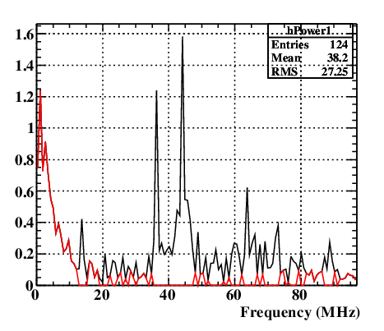
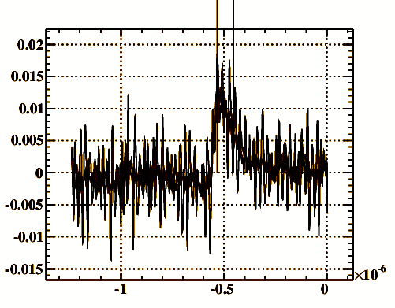
Noise reduction
Large periodical noises are eliminated in FFT power spectrum from DCH waveform
After that, filtered spectrum is transformed inverse to the waveform
Charge integration done for filtered waveform
FFT

Slide 18
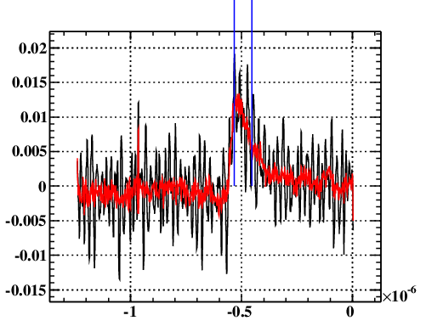
Noise reduction
Large periodical noises are eliminated in FFT power spectrum from DCH waveform
After that, filtered spectrum is transformed inverse to the waveform
Charge integration done for filtered waveform
inverse

Slide 19
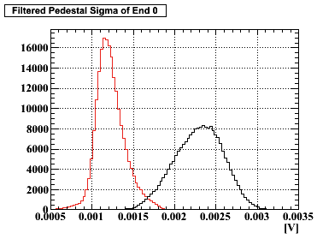
Noise reduction
Thanks to offline noise filtering, twice better σ of pedestal realized (2.4 mV→1.2 mV)

Slide 20
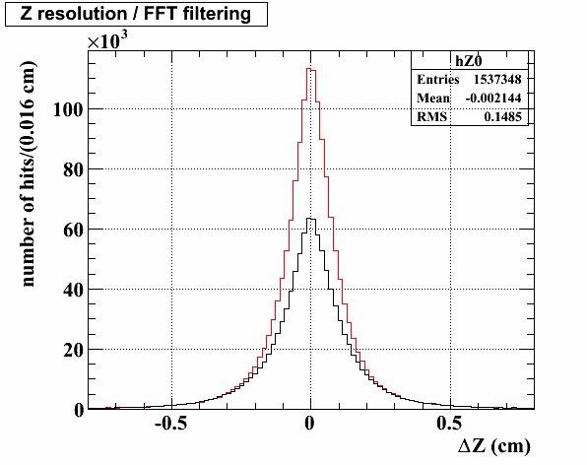
Noise reduction
Thanks to offline noise filtering, twice better σ of pedestal realized (2.4 mV→1.2 mV)
Single hit Z resolution improved !!
758 → 664 um, #of hits increased

Slide 21
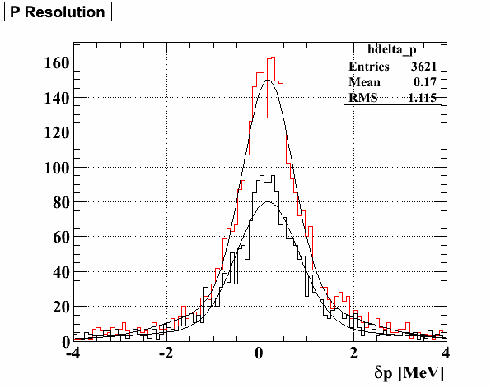
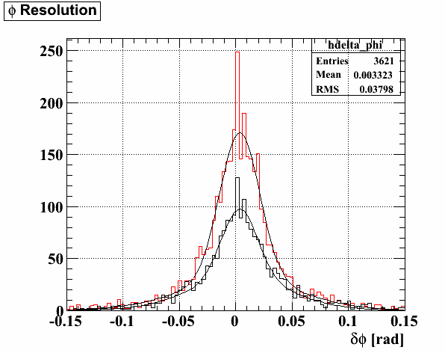
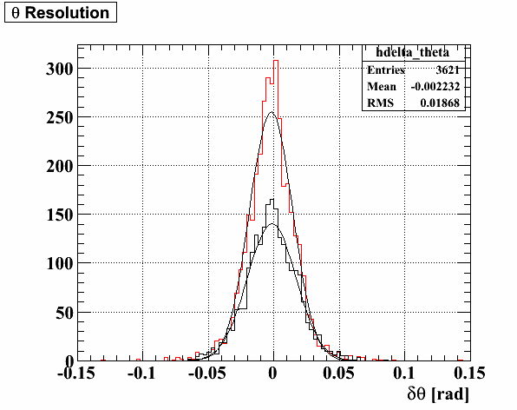
Noise reduction
Thanks to offline noise filtering, twice better σ of pedestal realized (2.4 mV→1.2 mV)
Single hit Z resolution improved !!
758 → 664 um, #of hits increased
Efficiency & resolutions
Very good !
432 keV (80 %)
→ 380 keV (79 %)
11.7 mrad (68 %)
→ 12.4 mrad (78 %)
13.1 mrad
→ 11.6 mrad
Ep
φ
θ

Slide 22
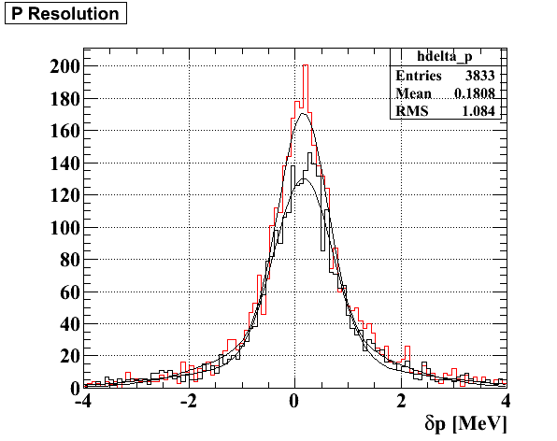
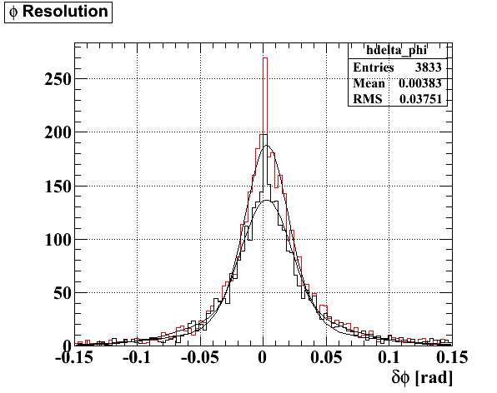
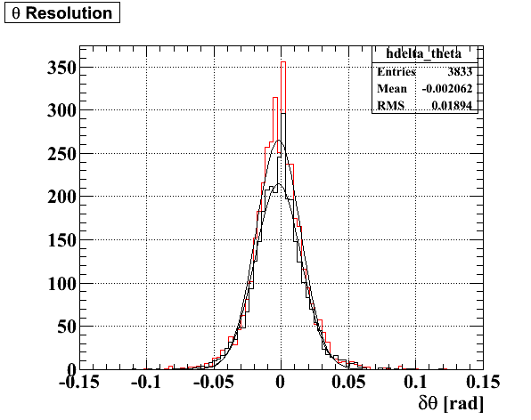
Noise reduction
Filtering for waveform in low noise condition
What happen if FFT filtering used in low noise condition ?
Single hit Z resolution
Only a few % better (710 → 697 um)
#of hits increased
Efficiency and resolutions improved, too
390 keV (82 %)
→ 321 keV (75 %)
14.4 mrad (84 %)
→ 11.4 mrad (76 %)
12.0 mrad
→ 11.7 mrad
Ep
φ
θ

Slide 23
Performance summary
2011 performance summary (Preliminary)
Only parts of data were analyzed
Correction for resolutions in 2011 not yet done
Calibrations still ongoing
Preliminary !
 | 2010 | 2011 noisy | 2011 low noise
Intrinsic Z (um) | 668 (core 56 %) | 664 (core 57 %) | 697 (core 56 %)
Intrinsic R (um) | 209 (core 66 %) | 237 (core 65 %) | 201 (core 68 %)
E_{e} (keV) | 330 (core 79 %) | 380 (core 79 %) | 321 (core 75 %)
φ (mrad) | 7.2 (core, φ=0) | 12.4 (core 78 %) | 11.4 (core 76 %)
θ (mrad) | 11.0 | 11.6 | 11.7
#of 2 turn e+ | - | 2499 → 4019 | 3184 → 3833

Slide 24
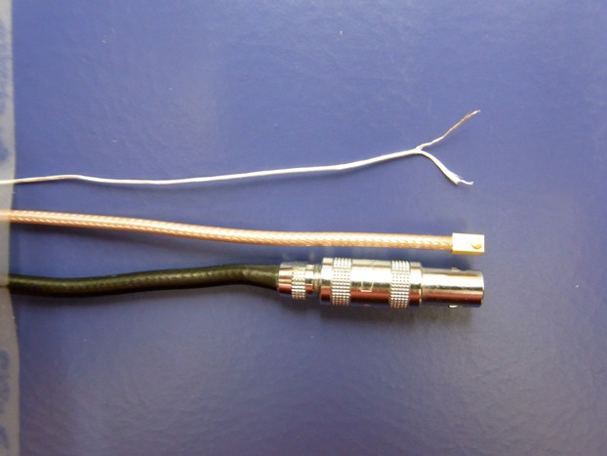
Summary and prospects
Summary
Thanks to FFT noise filtering, data quality of noisy runs achieved to the level of low noise situation !
Further check needed
Transformation accuracy
Check with more data
Single hit R resolution
Prospects
Calibrations for the spectrometer in preparation now
Better resolutions and efficiency expected
Monochromatic calibration source for the spectrometer
Mott scattering with e+ beam (energy tunable)
Hardware improvement for ε_{e} (≒ reduce materials between DC and TC)
Readout cable exchange to thinner one (40 % → 50 + x %)
According to changing cables, the support structure system for drift chambers will be updated
Future candidate
current

Slide 25
backup

Slide 26
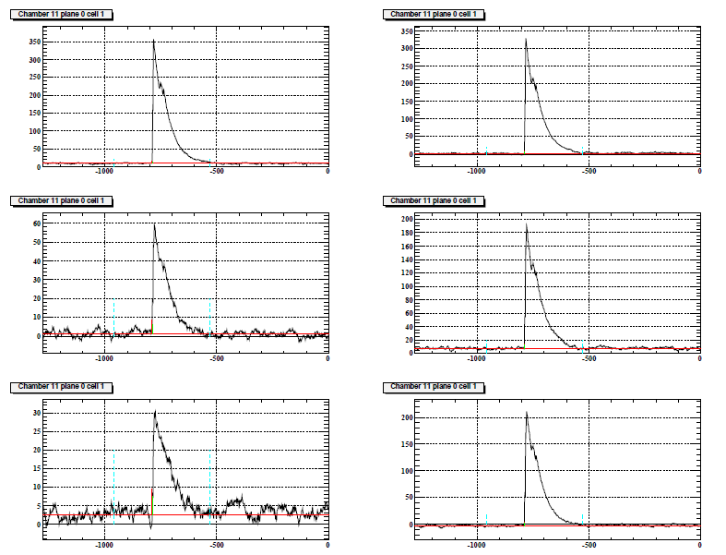
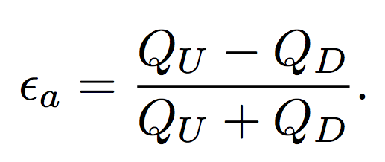
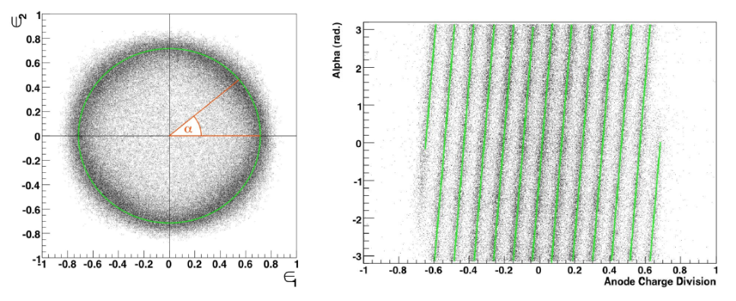
Vernier method
Vernier α is defined as
where
Compare α to reconstructed z position, we can decide z more precisely
Vernier α
wire z

Slide 27
Positron correlations
Correlations
Case : E^{meas} < E^{true}
Y^{meas} < Y^{true}
φ^{meas} > φ^{true}
…
true
reconstructed

Slide 28
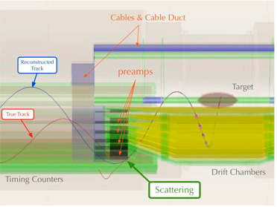
Efficiency
Material between drift chambers and timing counters make lower efficiency because of multiple scattering

Slide 29
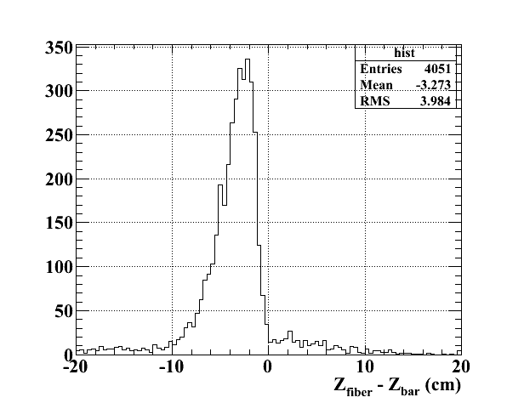
Check for APD data
Quality check for APD outputs
First step
Matching between hit z at fiber and e+ track at timing counter bars
Only downstream of APDs are working now
MC
e+
z

Slide 30
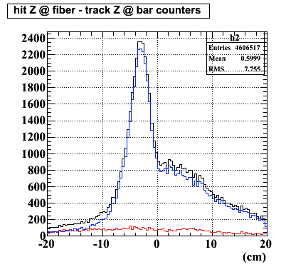
Check for APD data
Quality check for APD outputs
First step
Matching between hit z at fiber and e+ track at timing counter bars → peak position is same, but large tail found
Only downstream of APDs are working now
Data
MC
ー DS
ー US
Multiple scattering ?
e+
z

