Slide 1
SiPMを用いたシンチレーションカウンターによる
細分化ポジトロン時間測定器のビーム試験結果
西村美紀 (東大)
内山雄祐（素セ）、大谷航（素セ）、
M. de Gerone（Genova Univ.）、Flavio Gatti(Genova Univ.)、調翔平（九大）
他 ＭＥＧコラボレーション
日本物理学会 2013年秋季大会
高知大学

Slide 2
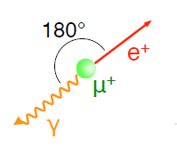
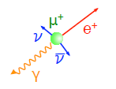
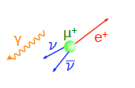

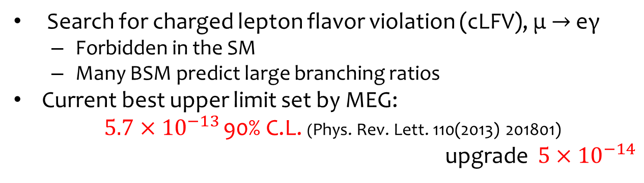
μ → eγ
Search for charged lepton flavor violation (cLFV), μ $→$ eγ
  Forbidden in the SM
  Many BSM predict large branching ratios
Current best upper limit set by MEG:
$5.7×{10}^{−13}$ 90% C.L. (Phys. Rev. Lett. 110(2013) 201801)
upgrade $5×{10}^{−14}$
Dominant
at rest
Physics BG
(radiative muon decay)
<52.8MeV
Any angle
Time coincidence
Accidental BG
<52.8MeV
Any angle
Random
Signal
52.8MeV
Back-to-back
Time coincidence

Slide 3
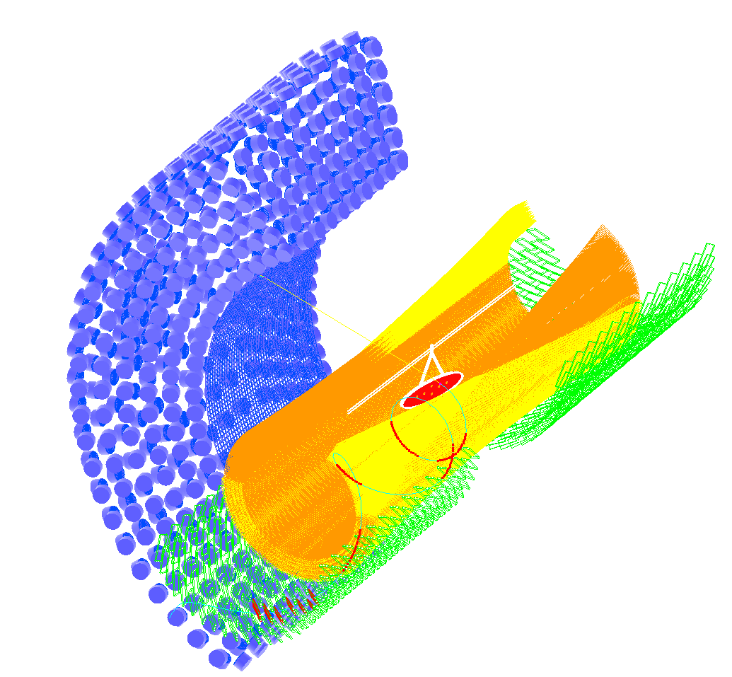


(detail of MEG upgrade; arXiv:1301.7225)
液体キセノンガンマ線検出器
µ
立体交差ワイヤーポジトロン飛跡検出器
γ
e
upgrade $5×{10}^{−14}$
細分型ポジトロン時間測定器

Slide 4
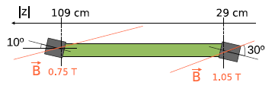
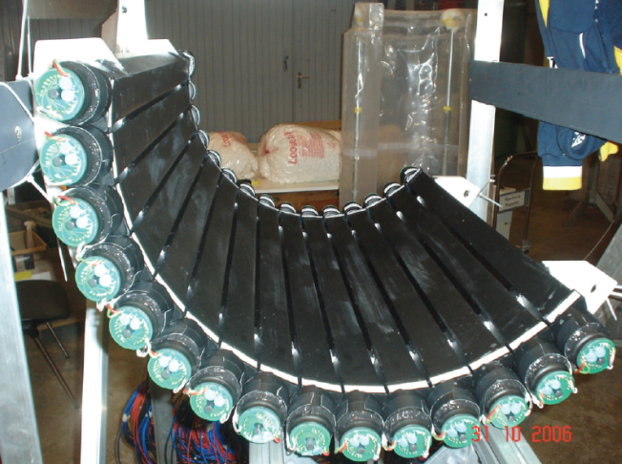
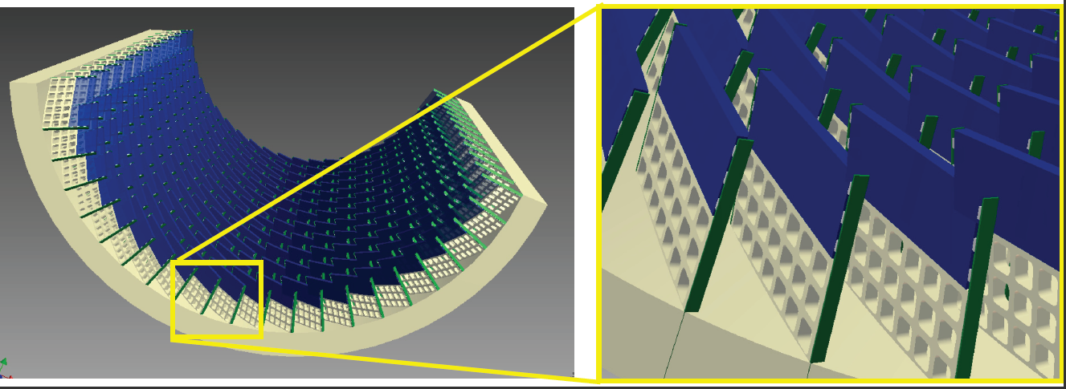
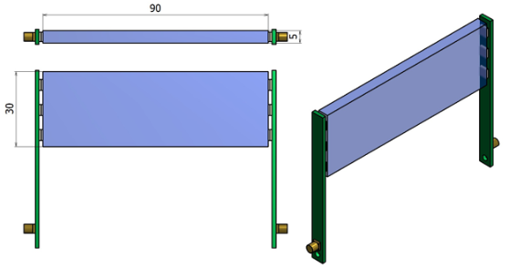
Pixelated Timing Counter for MEG upgrade
Scintillator
~250 counters $×2$ (upstream, downstream side)
PMT
present
upgrade
For good time resolution
Pixelated TC is employed.
90 mm
5
small counter with SiPM
  A good timing resolution
  Less pileup
40
3 SiPMs
series connection
Plastic
scintillator
a higher level of segmentation
  Using multiple hit time
  Flexible detector layout
PCB

Slide 5
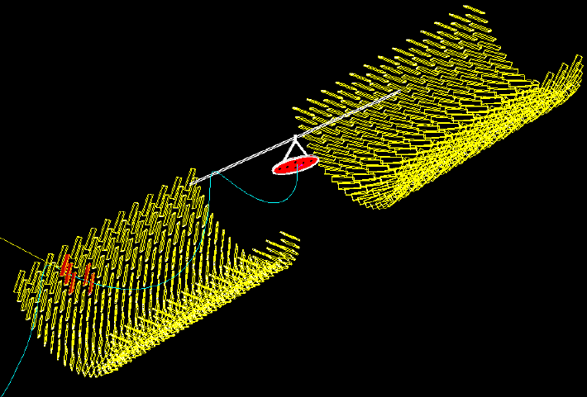
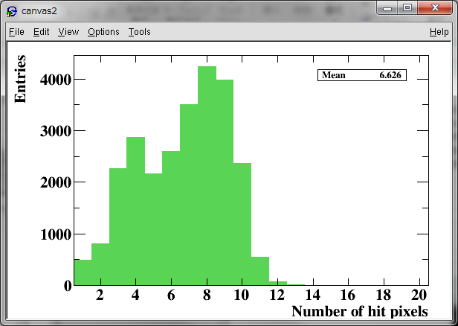

MC simulation
5-8 counter hit
Signal positron
Number of hit counters (MC)
Average # of hit
6.6
$$N_{hit}$$

Slide 6
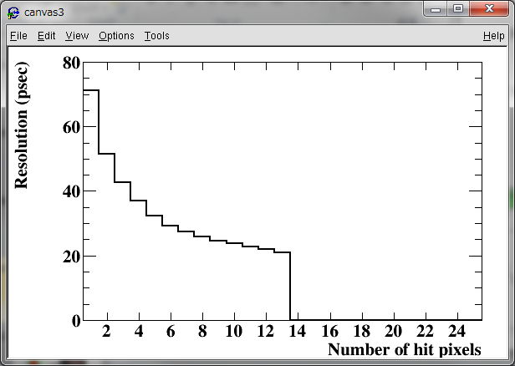
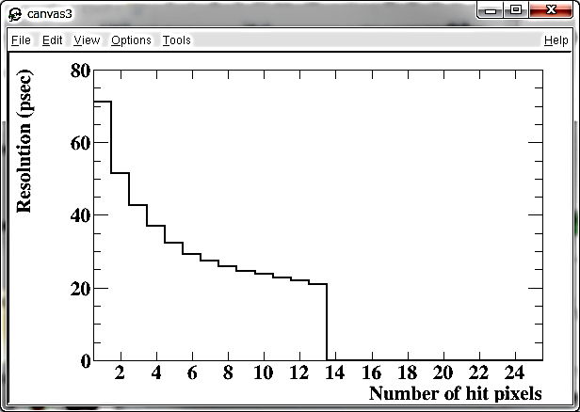



Multiple hit scheme
Resolution vs. # of hit counters (MC)
Overall timing counter resolution is
$${σ^{2}}_{total}^{}\left(N_{hit}\right)=\frac{{σ^{2}}_{single}^{}}{N_{hit}}+\frac{{σ^{2}}_{inter−counter}^{}}{N_{hit}}+{σ^{2}}_{MS}^{}\left(N_{hit}\right)$$
30-40 ps
~5ps
Resolution (psec)
Requirement
Good single counter resolution
Single counter R&D (Uchiyama’s talk)
smaller counter
Hit many counters
optimization counter assembly with MC
larger counter
$$N_{hit}$$

Slide 7
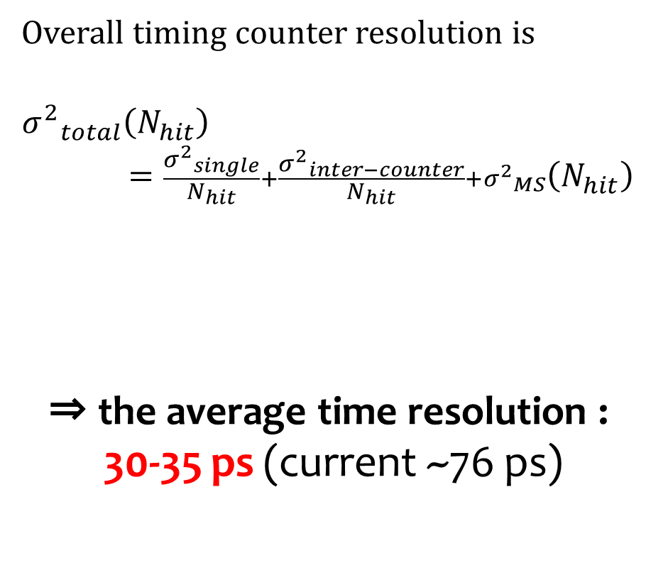

Multiple hit scheme
Resolution vs. # of hit counters (MC)
Overall timing counter resolution is
$${σ^{2}}_{total}^{}\left(N_{hit}\right)=\frac{{σ^{2}}_{single}^{}}{N_{hit}}+\frac{{σ^{2}}_{inter−counter}^{}}{N_{hit}}+{σ^{2}}_{MS}^{}\left(N_{hit}\right)$$
⇒ the average time resolution :
30-35 ps (current ~76 ps)
30-40 ps
~5ps
Resolution (psec)
~70 ps
90x40x5 mm scintillator
$$N_{hit}$$
Number of hit counters (MC)
Average # of hit
6.6
$$N_{hit}$$

Slide 8
R&D plan
done
Single counter R&D
  Make prototype
  Basic characteristics
  Counter geometry optimization
Uchiyama’s talk
Multi counter prototype
  Prove multiple hit scheme by beam test
  Electronics test
  Calibration R&D
Timing counter layout study
  Size optimization with MC
  Optimize counter layout
Construct

Slide 9
Counter Size Optimization
Average # of hit counters (MC)
Single resolution at 1MeV
Counter height (cm)
9
Counter height (cm)
Average number of hit increase with taller counter.
Single counter resolution is better with lower counter.
3 SiPMs
series connection
Plastic
scintillator
PCB

Slide 10
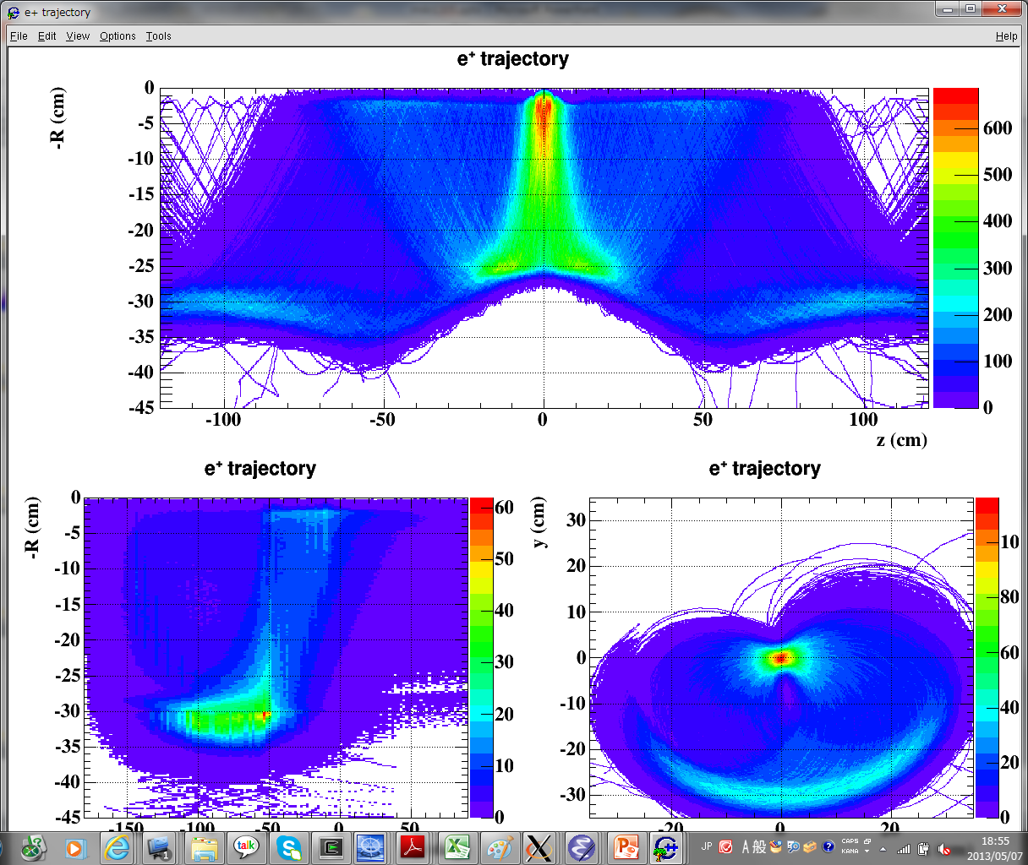
Counter Size Optimization
target
Signal positron
4 cm
5 cm
beam
4 cm for positrons concentrating region.
5 cm for the other region.

Slide 11
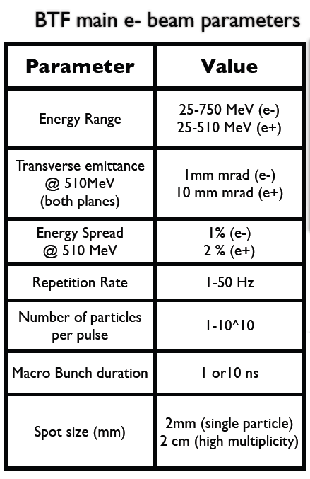
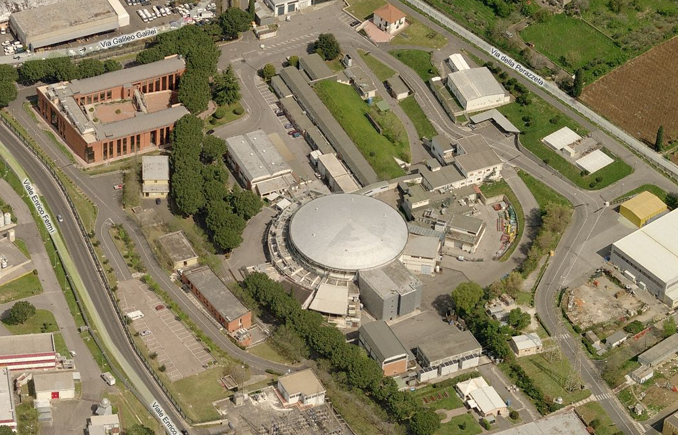
Beam Test in Frascati
Collider DAFNE
Linac
BTF
Damping ring

Slide 12
Beam test configuration
Counters
3 cm
1~3 e⁺
Lead-glass Calorimeter
9.5 cm
Reference counter
Black box
Beam
48 MeV Positrons (1-3/bunch), bunch width of 10 ns
Inside the black box
Counters (90x40x5 mm, BC418)
  8 counters with HAMAMATSU (S10943-2547(X), 3x3 mm2, 50μm-3600 pixels) SiPMs
  6 counters with AdvanSiD SiPMs
Reference counter (5x5x5 mm, BC422, 1 HAMAMATSU SiPM) for time reference & trigger
Lead-glass Calorimeter for monitoring the beam
Electronics
Long cable
6 DRS (digitizer)

Slide 13
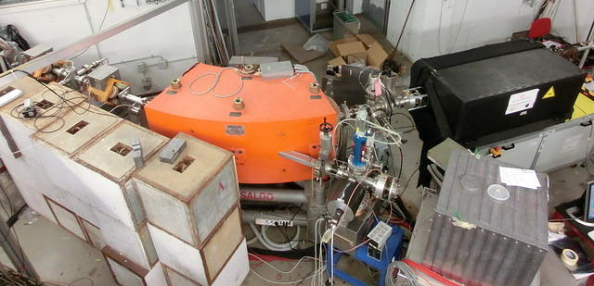
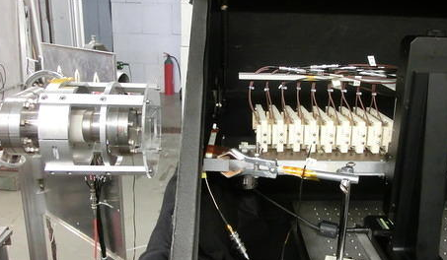
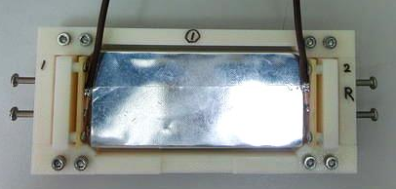
Linac
Magnet
Black box
counters
Beam line
Single counter
Reference counter

Slide 14
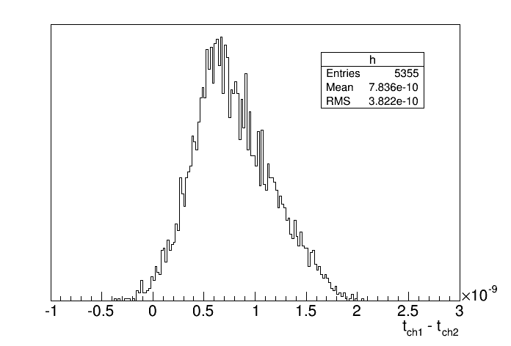
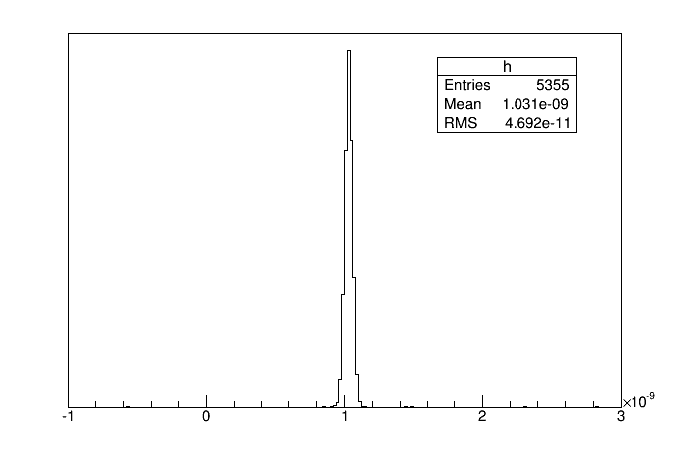
DRS synchronization
Before
σ=377 ps
After
t_{ch1}-t_{ch2}
t_{ch1}-t_{ch2}
synchronize many different channels with common clock.
Time jitter among counters 23-26 ps

Slide 15
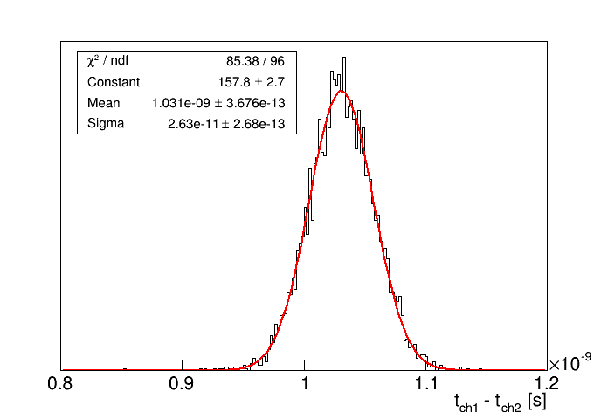
DRS synchronization
Sigma 26.3 ps
Before
σ=377 ps
After
t_{ch1}-t_{ch2}
t_{ch1}-t_{ch2}
synchronize many different channels with common clock.
Time jitter among counters 23-26 ps

Slide 16
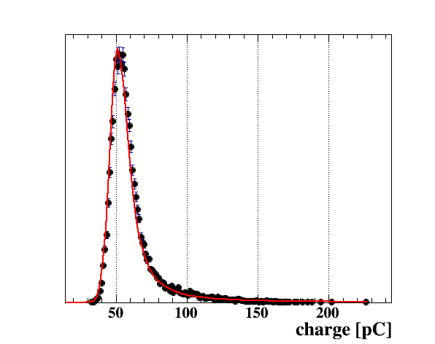
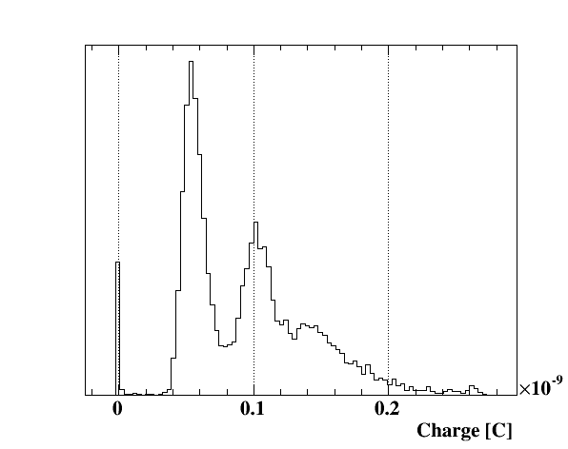
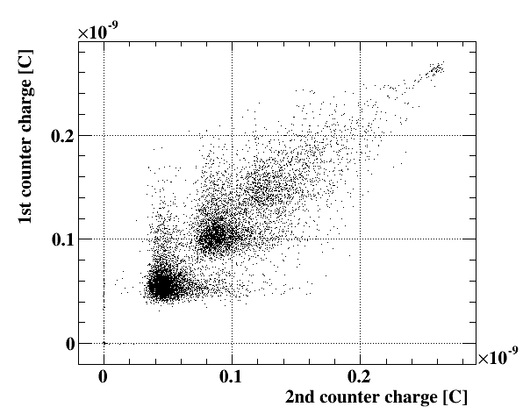
Selection
Charge distribution of 1st counter
1e⁺ beam
2e⁺
3e⁺
Cut
After cutting the 2 or more positrons events, Landau shape charge distribution is obtained.
3e
2e
1e⁺
Select 1 positron events

Slide 17
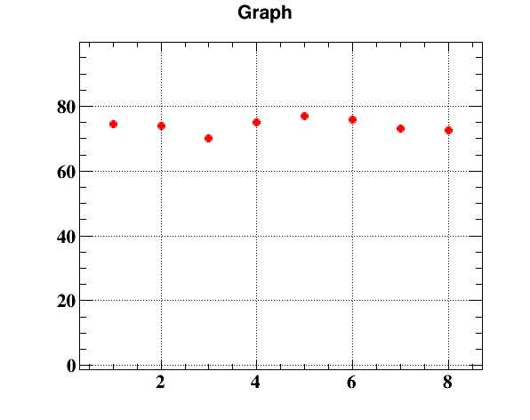
Single counter performance
Resolution (psec)
t_{counter} -t_{ref}
Counter #
Single counter resolution is consistent one with Sr source in the lab.
All counter have the similar resolution ~75 ps

Slide 18
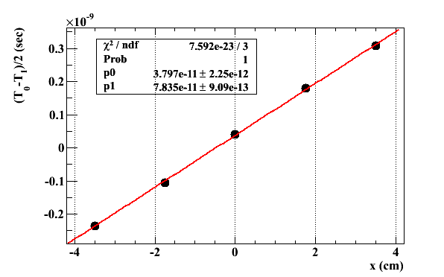
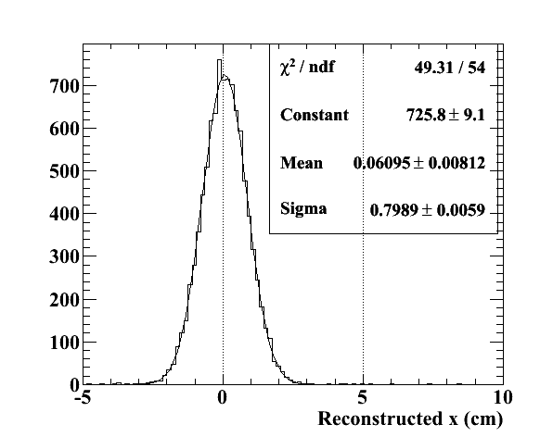
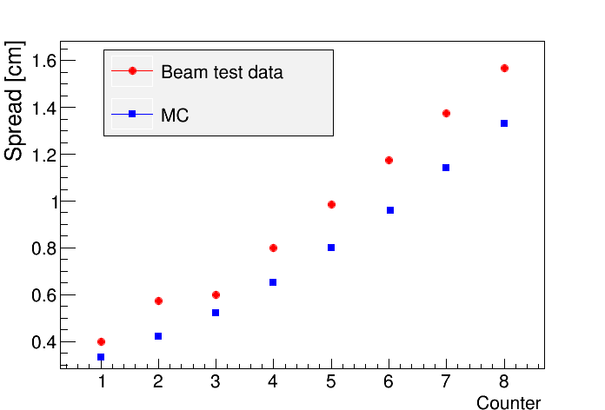
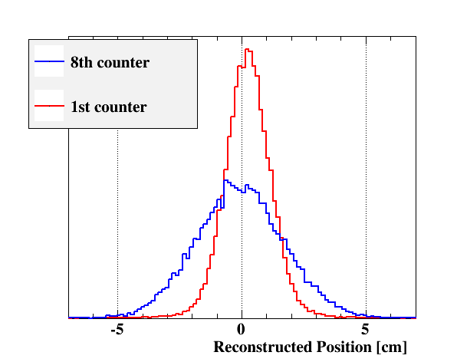
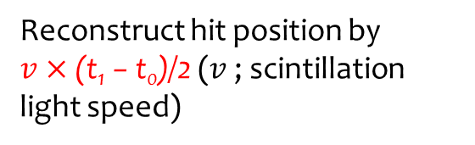




Multiple Scattering
e
$$x$$
Measurement with source
$$t_{0}$$
$$t_{1}$$
$$x=v×\frac{t_{1}−t_{0}}{2}$$
resolution
~8mm
Reconstruct hit position by $v×\text{(}\text{t}\text{1}\text{ − }\text{t}\text{0}\text{)/2}$ ($v$; scintillation light speed)
Beam spot size

Slide 19
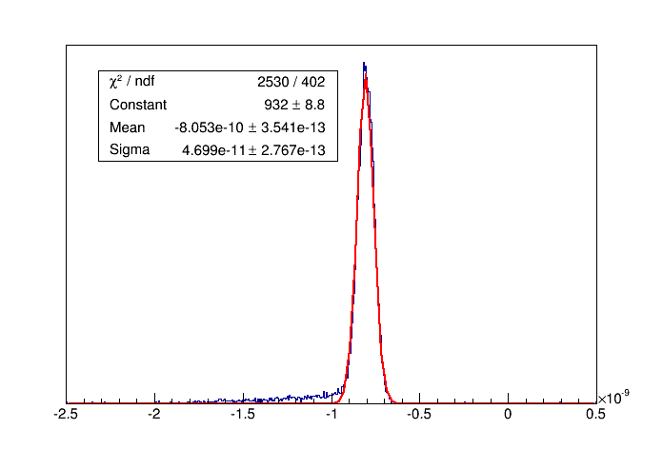
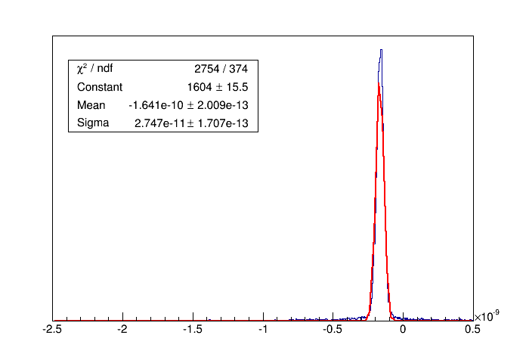
multiple counter resolution
t_{counters} -t_{ref}
(t_{odd} –t_{even})/2
-2.5 -2 -1.5 -1 -0.5 0 0.5
(ns)
-2.5 -2 -1.5 -1 -0.5 0 0.5
(ns)
From ( even counter average time - odd counter average time ), resolution with 8 counters of 27.5 ps can be obtained.
we can obtain the resolution of 47.0 ps with 8 counters and reference counter.

Slide 20
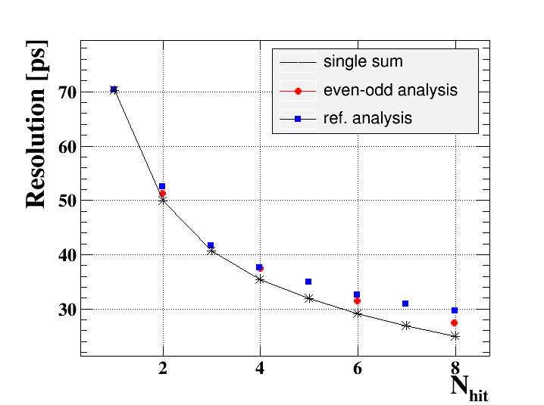
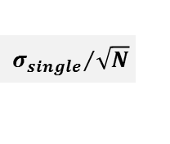
Multiple hit resolution
$${σ_{single}}/{\sqrt{N}}$$
ref. analysis
Subtract reference resolution and DRS jitter which is not similar our experiment.
Multiple hit scheme works.
We obtained the better resolution with 8 counters.

Slide 21
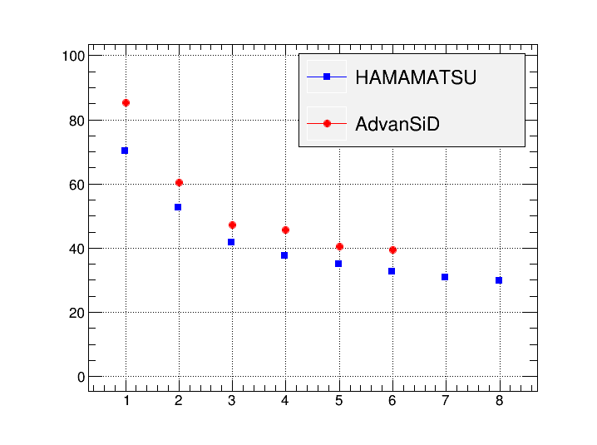
SiPM comparison
HAMAMATSU: high PDE
AdvanSiD: stable with temperature
Jitter reduction from multiple hit does not depend on SiPM.
We must employ the counter which single resolution is better.

Slide 22
Summary and Prospects
Pixelated TC is employed for MEG experiment upgrade
  5-8 hits pixels information gives good resolution of 30-35 ps.
Beam test with 8counters in Frascati.
  obtain better resolution of ~30 ps with 8 counter
  Multiple hit scheme is confirmed.
Prospect
2013 Counter assemble optimization
2014 Calibration R&D
2014 Construct

Slide 23
Back up

Slide 24
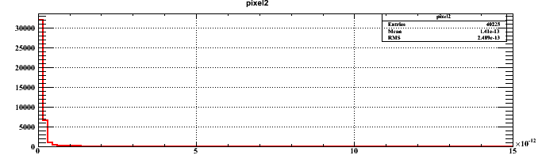
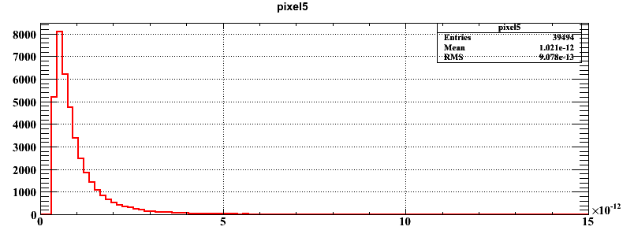
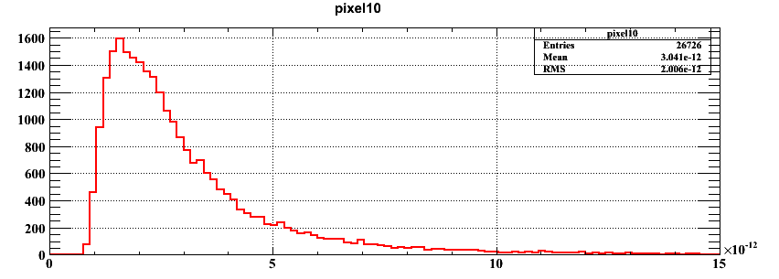
TOF pixel dependence(MC)
Time difference is ~5ps.
(without effect of support structure)
Time difference

Slide 25
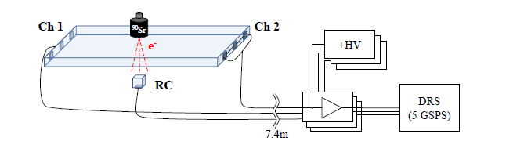
Single Pixel Study
Test Counter
  SiPM
    HAMAMATSU MPPC (S10362-33-050C, 3x3 mm2, 50μm-3600 pixels)
  Fast plastic scintillator
    90x30x5mm, BC422
  glued with optical grease (OKEN6262A)
Source Sr90 (<2.28MeV, β-ray)
Reference counter
  5×5×5 mm scintillator BC422
  Readout by a MPPC
  Trigger, Collimate
Waveform digitizer sampling (DRS developed at PSI) @5GSPS
Voltage amplifier developed by PSI (Gain~20, 600 MHz bandwidth)
Shaping with high-pass filter & pole-zero cancellation
Long cable (7.4m) before amplifier
KEITHLEY Pico ammeter for MPPC bias (HV), Bias 218V~222V (for series connection)
3 or 4 SiPMs
Series connection

Slide 26
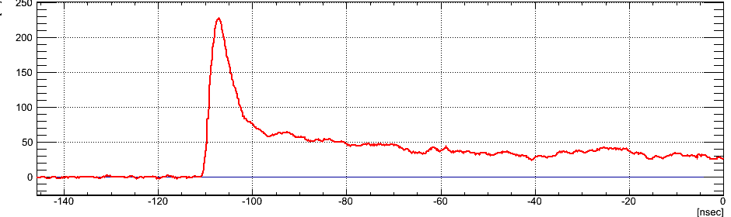
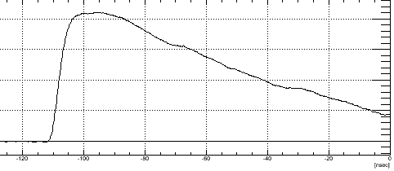
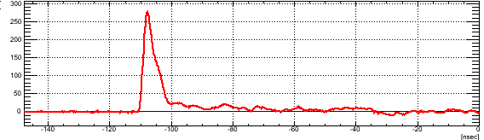
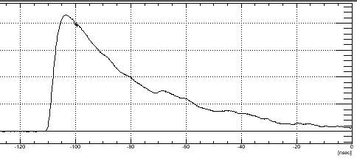
waveform
Parallel connection
200
  Capacitance is larger
  ->waveform wider
100
0
[mV]
-120
-60
0
[ns]
Before shaping
After shaping
Series connection
300
  Waveform is sharper.
  We can obtain good resolution.
200
100
0
[mV]
-120
-60
0
[ns]

Slide 27
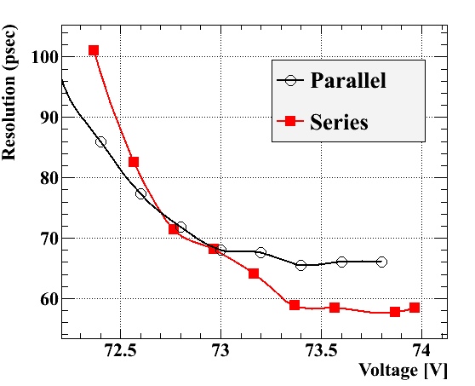
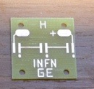
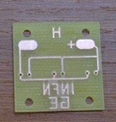
Series vs. parallel connection
Parallel
  We can’t apply bias voltage to each MPPC. We should choose MPPCs which have the same characteristic.
  Capacitance ↑
  -> waveform wider
Series
  Automatically bias voltage is adjusted.
  Waveform is sharper.
Series connection gives us better results.

Slide 28
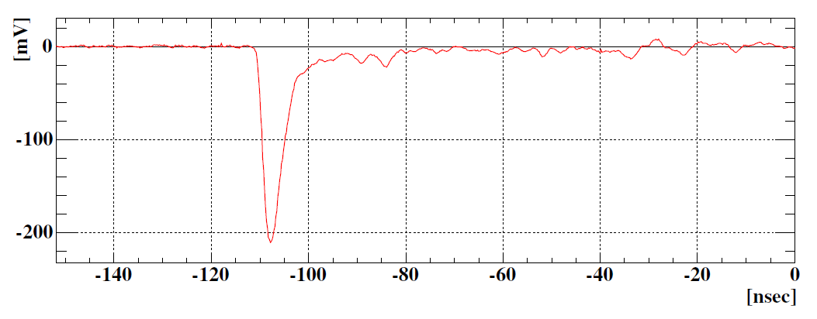

Analysis
Signal time is picked-off by Constant-Fraction method (~10%)
  very leading-edge is relevant to precise timing
e hit time is reconstructed by the average of times measured at the both ends
Resolution of test counter is evaluated from (t₀ + t₁)/2 – t_{ref}
Reconstruct hit position by $v×\text{(}\text{t}\text{1} \text{−} \text{t}\text{0}\text{)/2}$ ($v$; scintillation light speed)
baseline restoration by the
pole-zero cancellation @ preamp
t_{rise}~1.7 ns

Slide 29
Single Pixel R&D
Position scan
Optimization
  Size
    length(60-120mm), width(3.5-5 mm), height(30, 40 mm)
  Scintillators
    BC422, BC420, BC418
  Manufacture of SiPM
    HAMAMATSU, KETEK, AdvanSiD
  Reflector
    Aluminized Mylar, Teflon tape, 3M radiant mirror
Single Pixel R&D with source is almost done!!
We could obtain the satisfying result about single pixel.

Slide 30



$t_{eγ}$ resolution
COBRA
present
DC
track length: 75 ps→ 11 ps
gamma side: 67 ps →76 ps
Timing counter: 76ps → 30-35ps
$σ_{eγ}=$130 ps → 84 ps (35% ↓)
TC
upgrade

Slide 31

Resolution and efficiencies for MEG upgrade

Slide 32

Upgrade summary

Slide 33



Manufacture of SiPM
(Preliminary)
HAMAMATSU
AdvanSiD
Best resolution ~ 58 ps
~ 65 ps
HAMAMATSU SiPMs give us the best resolution.
KETEK
~ 75 ps

Slide 34

Scintillator Type
Test BC418, 420, and 422 which is 90x40x5mm with 4MPPCs
Properties of ultra-fast plastic scintillators from Saint-Gobain
Scintillator Type | Single Resolution (ps)
BC422 | 51.2
BC420 | 57.7
BC418 | 55.8

Slide 35

Waveform
signal ->
sine wave ->

Slide 36

Size Optimization
3cm height
measured
MC
Single resolution is worse with larger pixel.
However # of hit pixel increases with larger pixels.

Slide 37

Result of size optimization
better
MC
Larger pixel is better.
(Effect of high rate is not included.)

Slide 38



Counter Height
Pixels; z 21-120
=> Change pixel height 3 cm – 5 cm
3 cm
4 cm
5 cm
Pixel height affects small z hit number.
=> It is good to change the counter height with z position.

