Slide 1
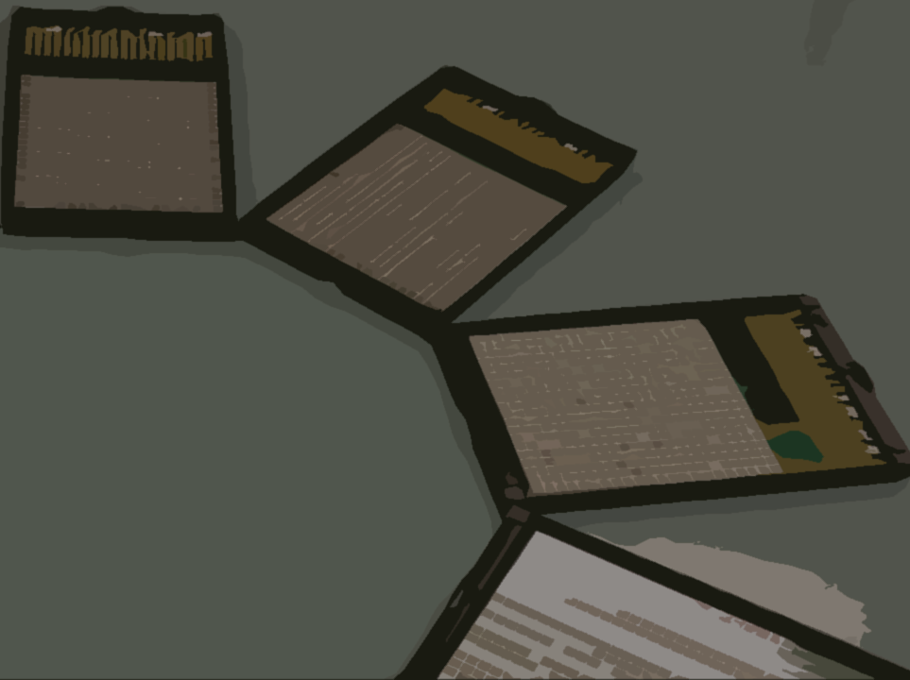
MEG II実験 液体キセノン検出器の建設状況
家城 佳
for the MEG II collaboration
物理学会第71回年次大会

Slide 2
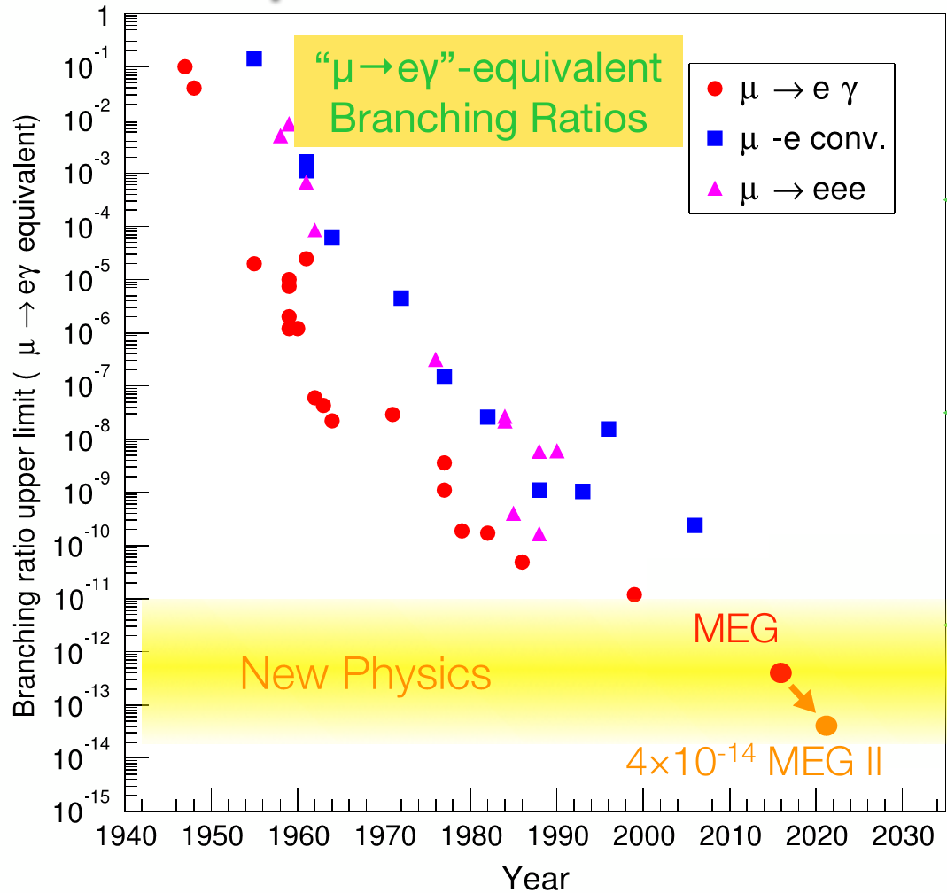
$μ→eγ$ search
$μ→eγ$ is the good probe for new physics.
γ
μ⁺
γ
e⁺
New!
$$\tilde{μ}$$
$$\tilde{e}$$
MEG
$$4.2×{10}^{−13}$$
(金子19aAH3)
μ⁺
e⁺
BSM
(ex. SUSY)
MEG II will search for $μ→eγ$ with 10 times better sensitivity!

Slide 3
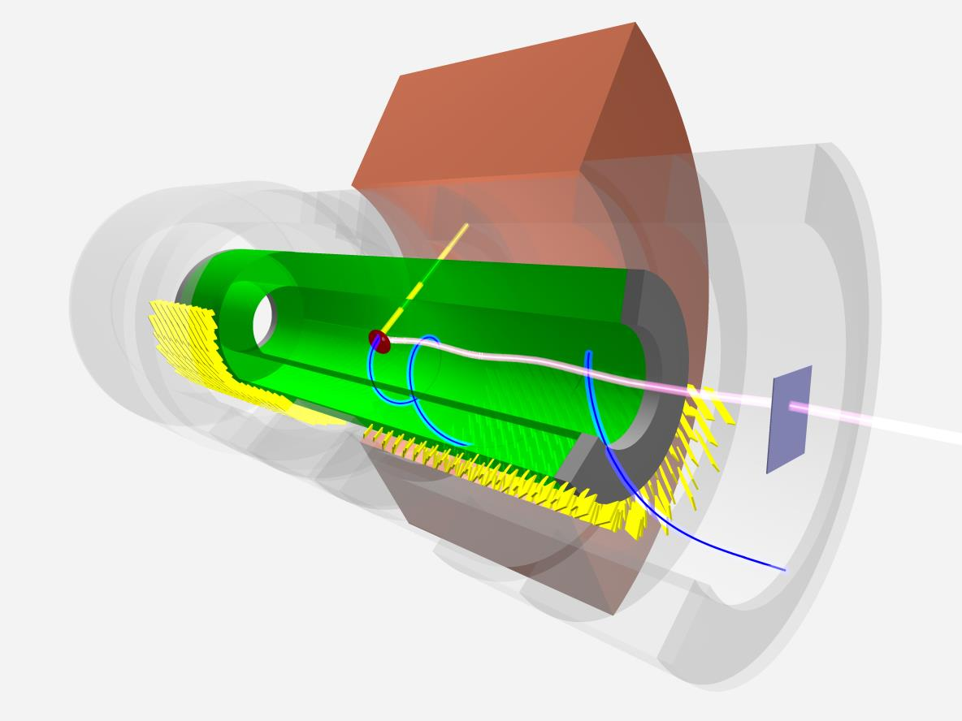
MEG II experiment
LXe γ detector
家城、小川22pAN-3,4
Additional detector (RDC) to identify BG
中浦、岩井
19aAH-10,11
all resolutions
$×$2
$×$2
efficiency
γ
e⁺
e⁺ drift chamber
& timing counter
吉田、西村、中尾
19pCA-1,2,3
μ⁺ beam
intensity $×$2 7x10⁷μ/s
Physics data taking will start from 2017!

Slide 4
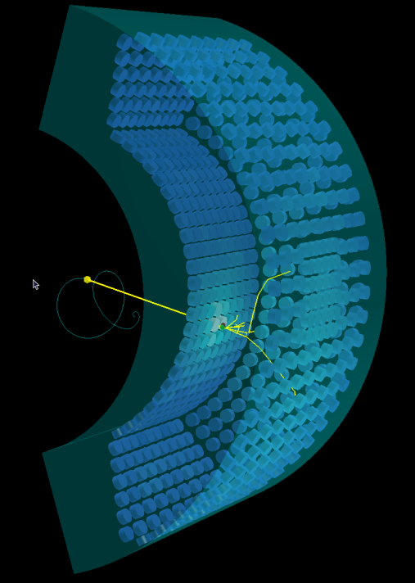
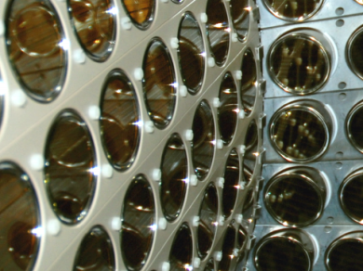
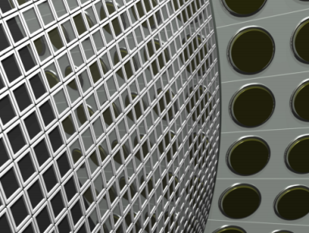
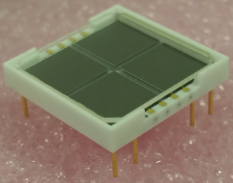
Liquid Xe detector upgrade
900l liquid Xe
upgrade!
(CG)
inner face
2inch PMT× 216
12x12mm² MPPC × 4092
Granularity & uniformity will improve
→ γ energy resolution & position resolution expected to improve by a factor of 2!
1m
VUV-light sensitive large area
MPPC is newly developed in
collaboration with Hamamatsu.
12mm
S10943-4372

Slide 5
Detector construction status
now
2016 summer ~
→
Production
Installation
Commissioning
4092 MPPCs
186 PCBs for MPPCs
Feedthrough + cables
Modified PMT holders
Refrigerator
…
LXe liquefaction
Operation test
LXe purification
Commissioning run
Simulation study in the next talk
Status report in this talk

Slide 6
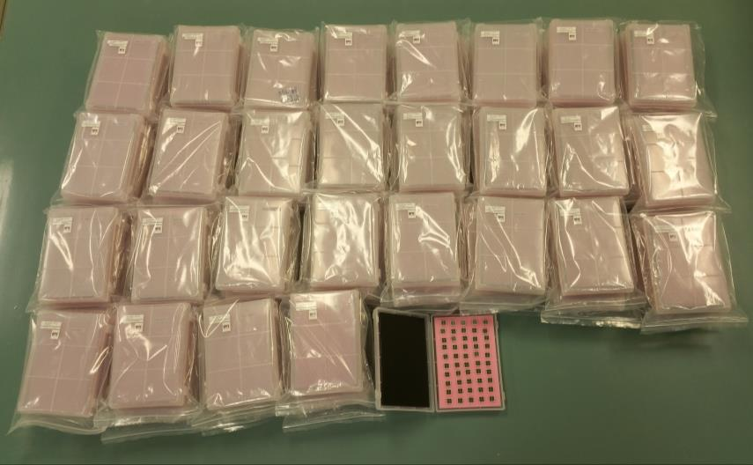
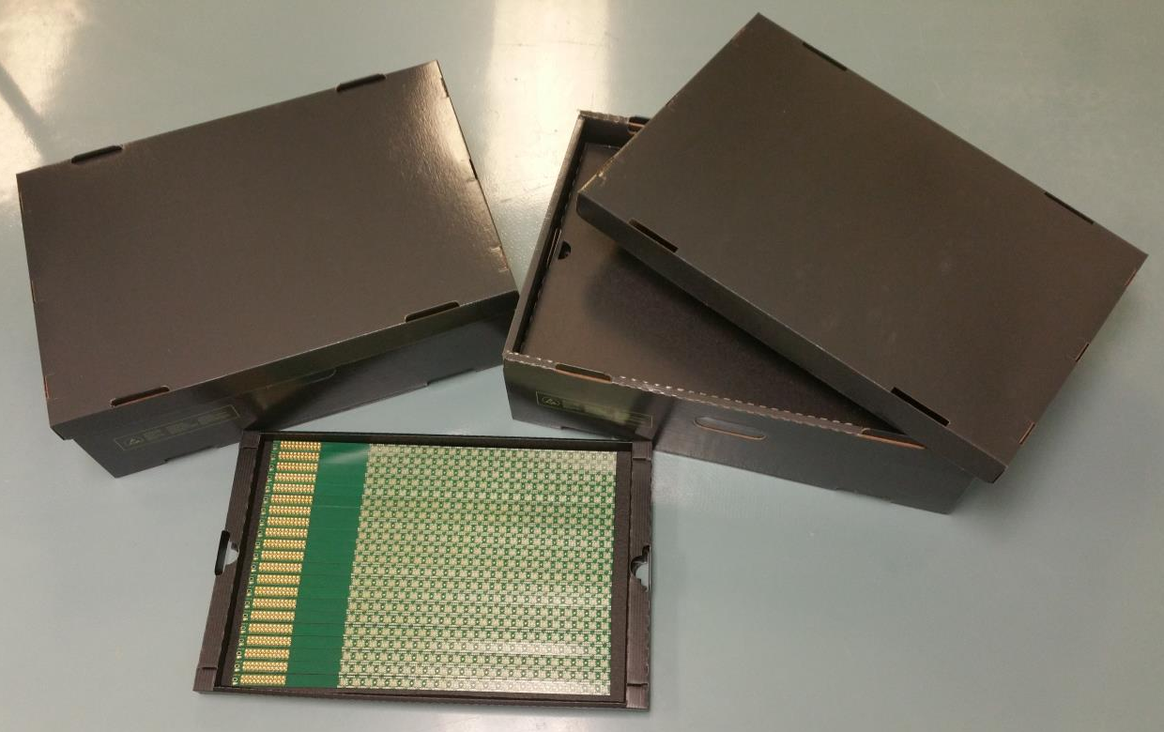
All PCBs and MPPCs are ready
4092 MPPCs (+ spare)
186 PCBs (+ spare)
All of the MPPCs are already tested.
We mounted all the MPPCs on PCBs, and tested all the PCBs!

Slide 7
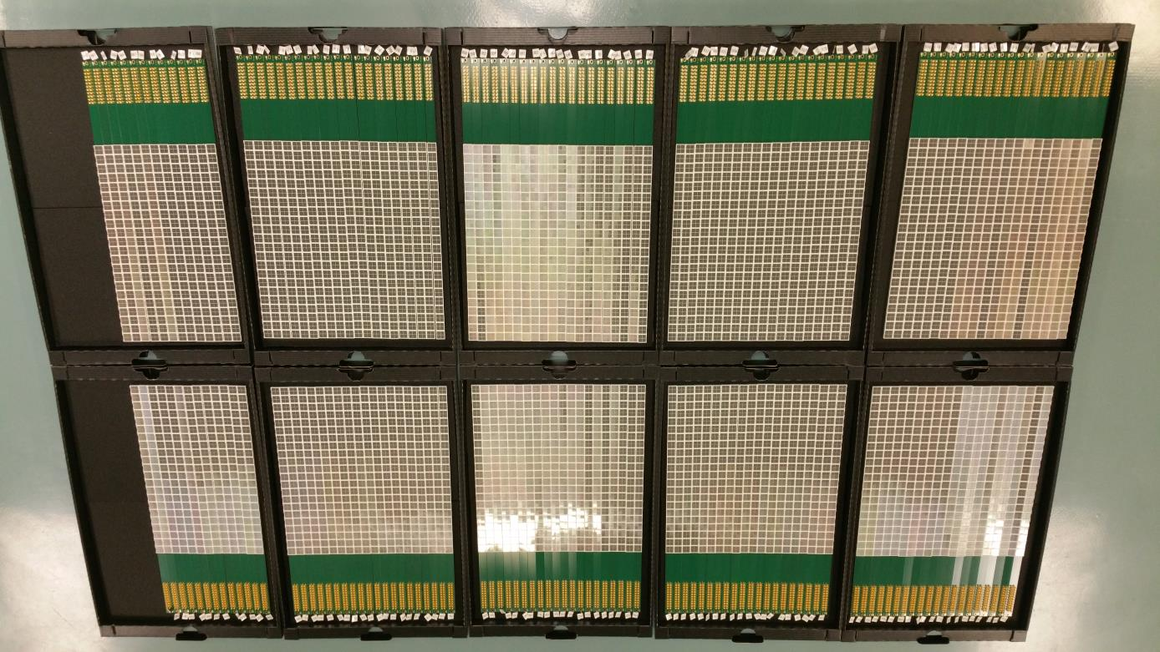
4092MPPCs on 186 PCBs!
33cm

Slide 8
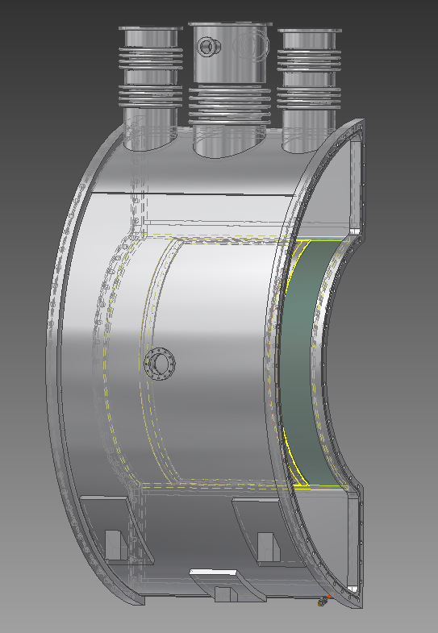
4092MPPCs on 186 PCBs!
33cm
to be installed

Slide 9
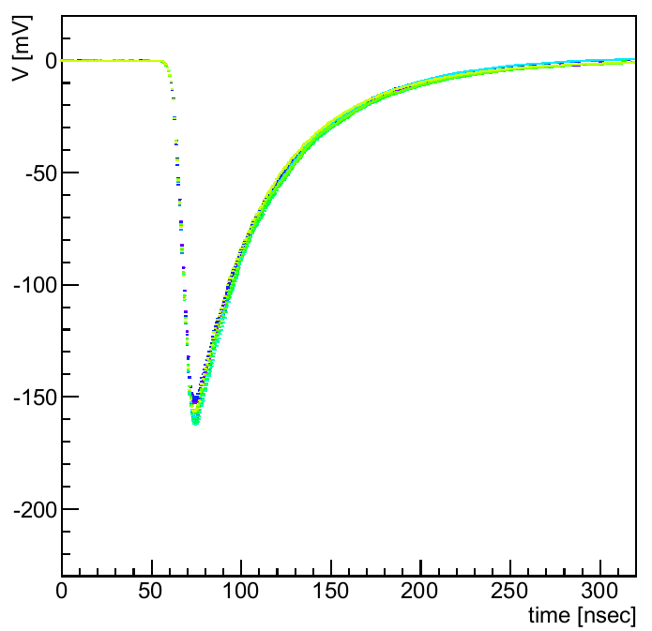
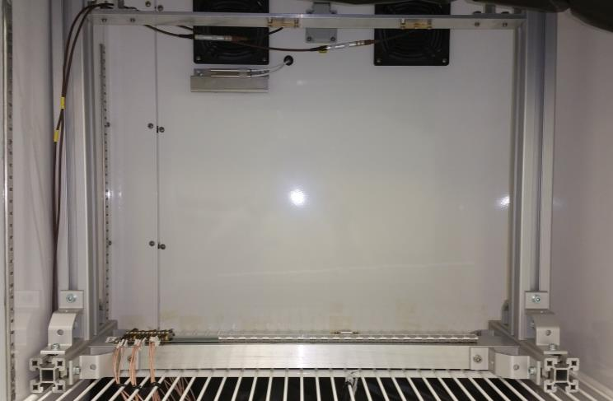
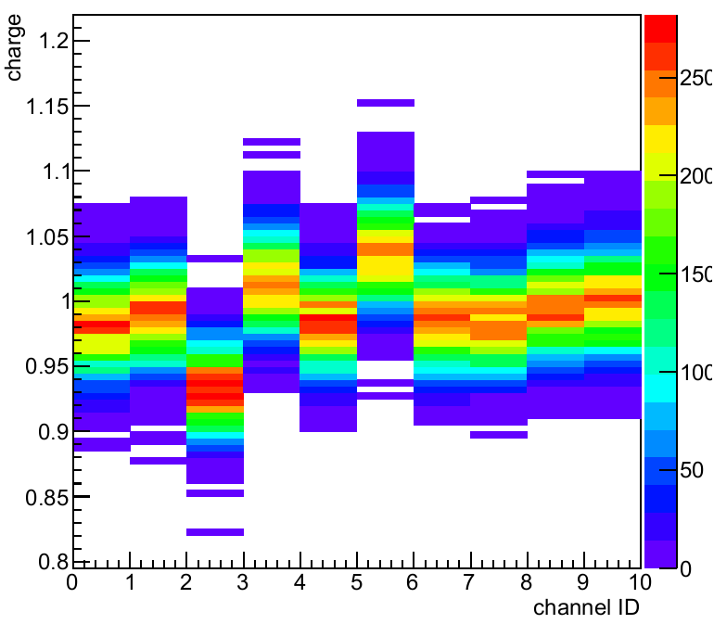
Mass test
V [mV]
-100
LED0
Averaged waveforms
LED1
-200
0
100
200
time [ns]
Charge
reference ch
1
Data taking with strong LED light @ T= 20 degrees
V=V_{hama} (operation voltage from spec. sheet, V_{over}~5V)
0.9
Charge vs. ch
0.8
0 1 2 …
channel ID
MPPC mounting + test = ~15min/PCB
186 PCBs → ~47hours in total
Waveform and charge were measured for all ch in every PCB.

Slide 10
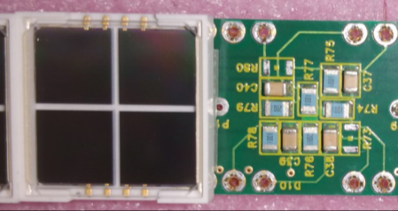
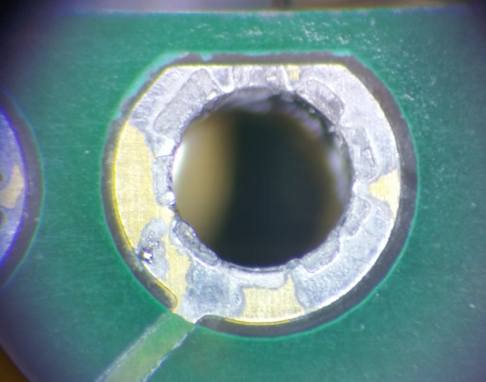
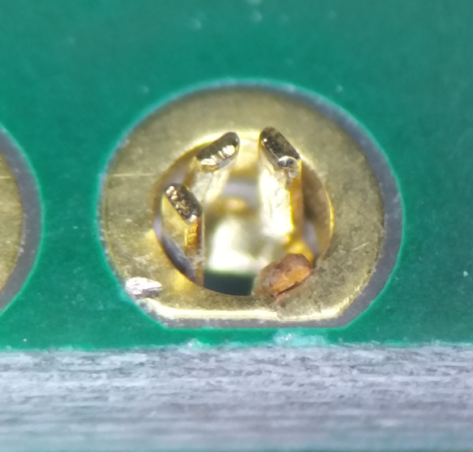
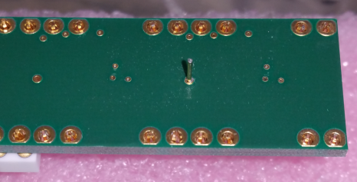
Bad PCB channels
Two bad channels were found on PCB, associated with damaged sockets.
200mV
Normal ch
20mV
Bad ch
MPPC sockets
Bad PCBs are replaced with spare. → All channels are good after replacement.

Slide 11
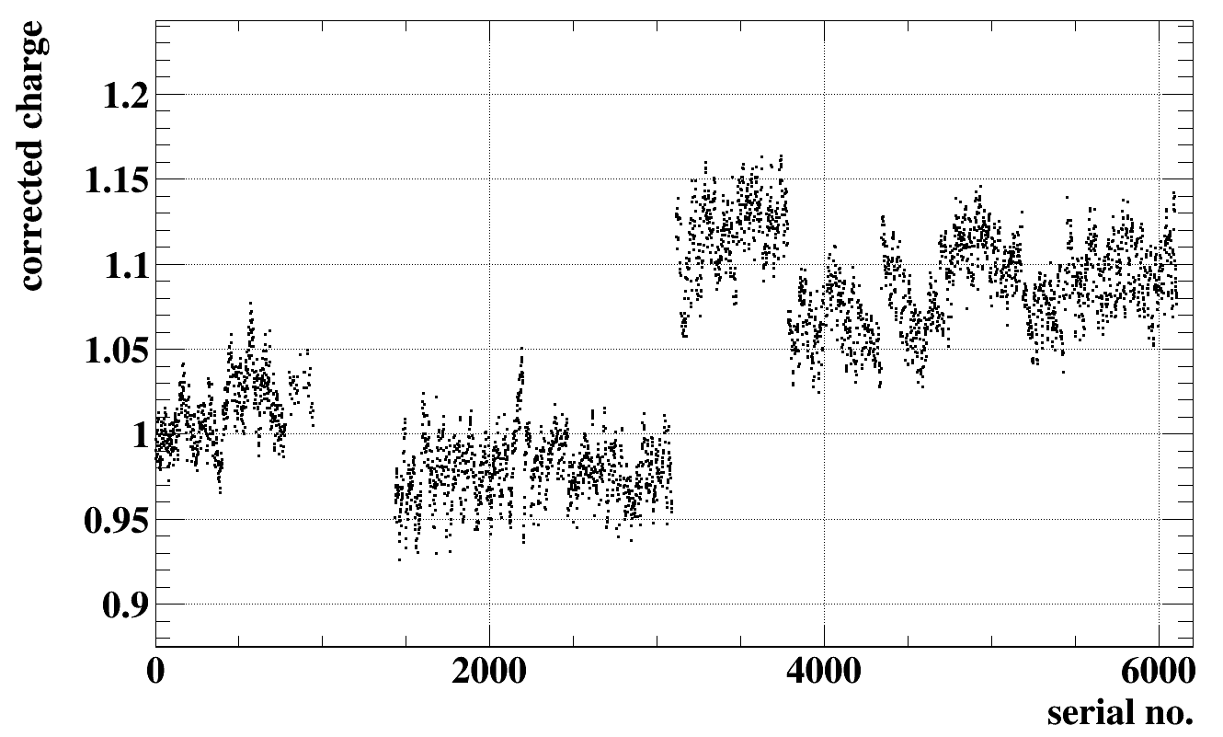
Charge of all MPPCs
Vertical axis is charge normalized by charge of a MPPC in batch A.
C
D
Batch A
B
All channels are good.
Batch by batch difference possibly due to crosstalk & afterpulse.

Slide 12
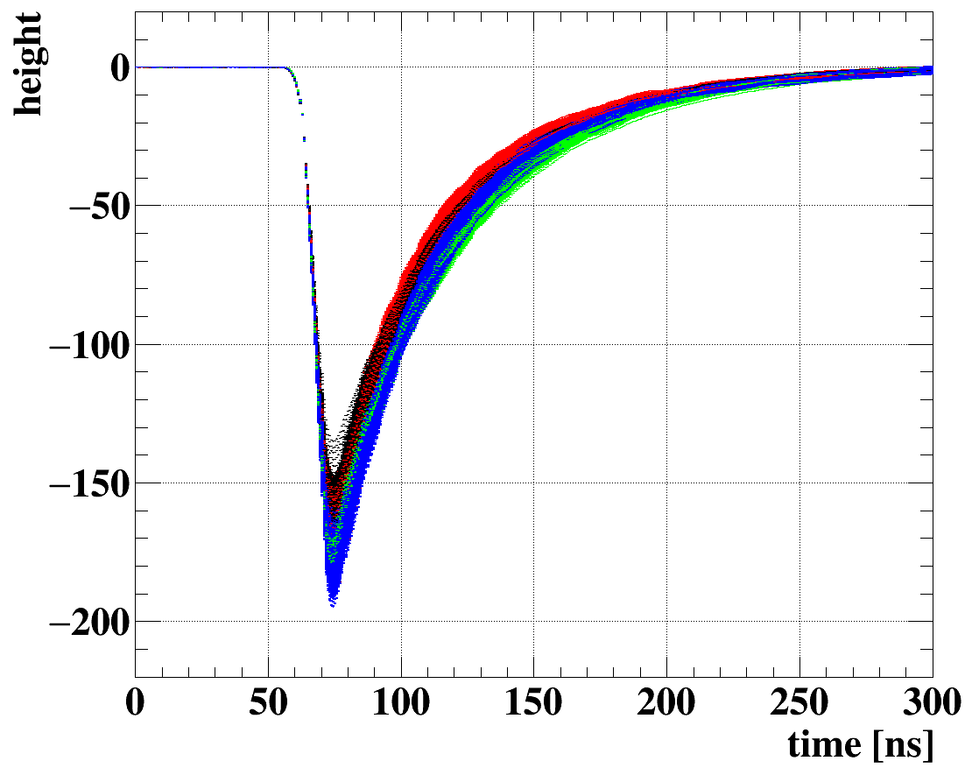
Waveforms of all MPPCs
Waveform of 4092 MPPCs overlaid.
Batch A
B
C
D
All channels are good.
→ Ready for installation!

Slide 13
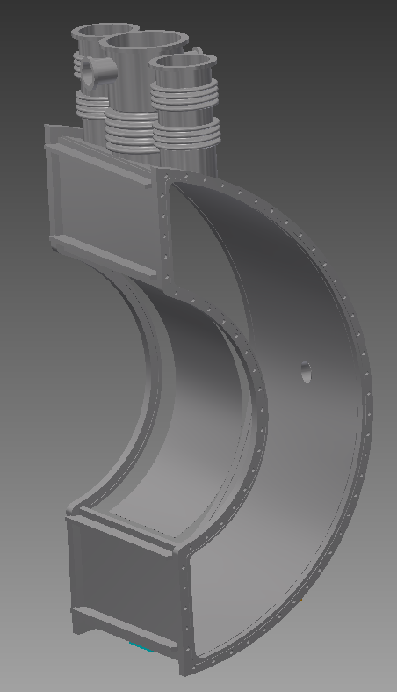
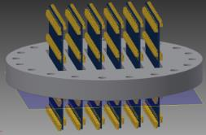
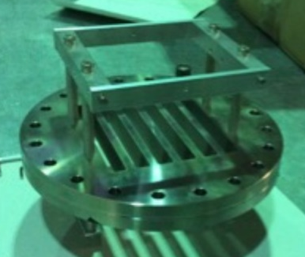
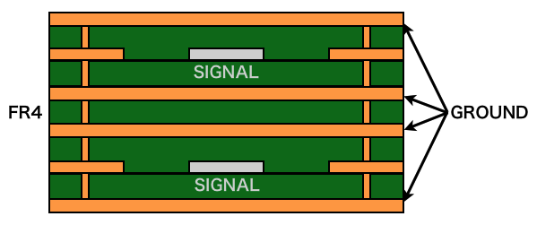
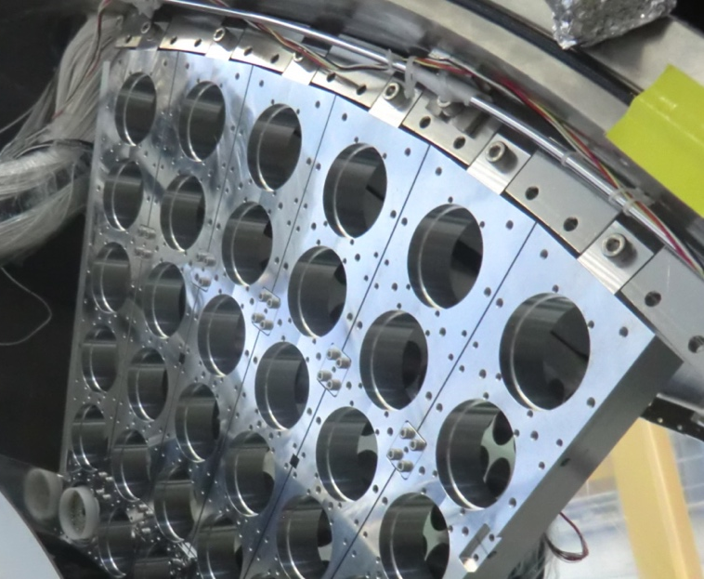
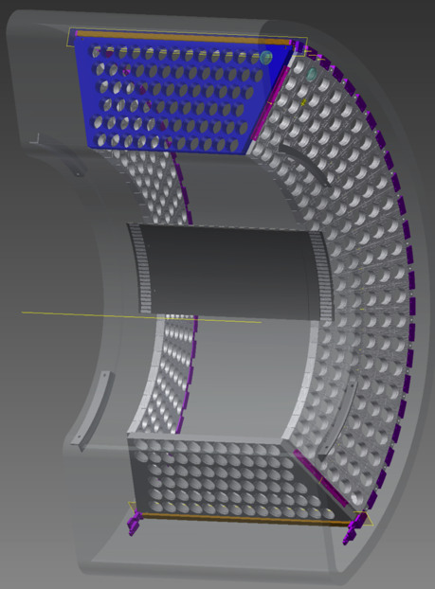
Feedthrough & PMT holders
MPPC signal feed-through is being constructed.
PCB-based design
first flange
co-axial like signal line in PCB
PMT holders (with improve geometry) are ready to install.
drawing
installation test

Slide 14
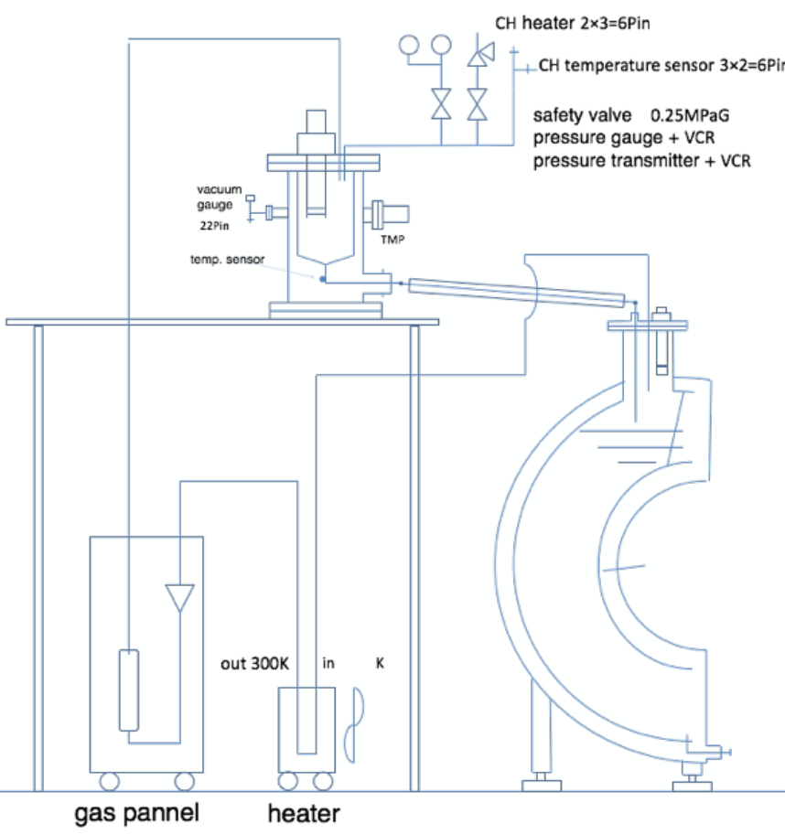
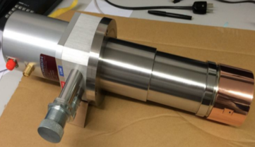
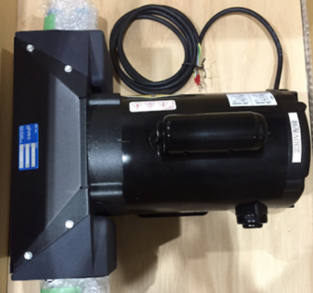
LXe refrigerator & purification
Upgraded cryogenics system is being constructed to cope with increased heat flow from 4000 MPPCs.
Sufficient power (430W @ 160K) of new GM refrigerator is confirmed.
Additional GM refrigerator
will be placed far from cryostat to prevent from noise
liquefaction
external stage
for GM refrigerator
pulse-tube
refrigerator
new pump
getter (purification)

Slide 15
Summary
All of the MPPCs are assembled on PCBs and tested.
Two bad PCBs are found and replaced. After replacement, all the channels are good.
Feedthrough, PMT holders and the cryogenics are also being prepared.

Slide 16
Backup

Slide 17
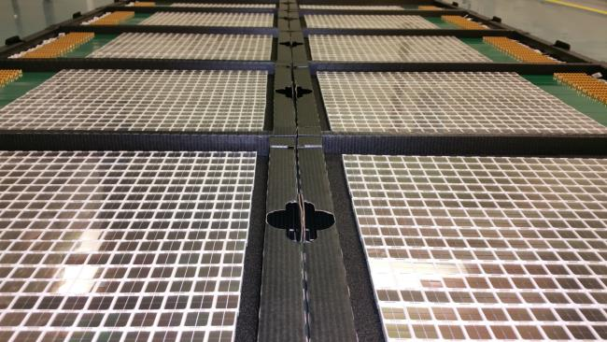
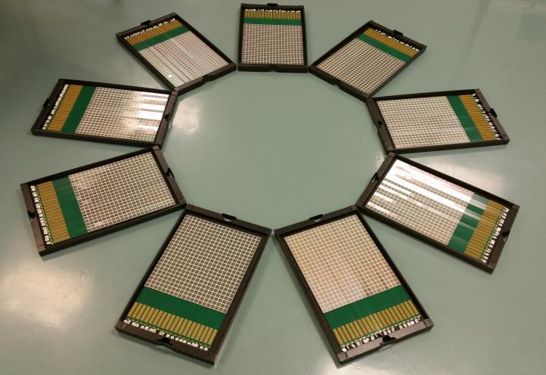
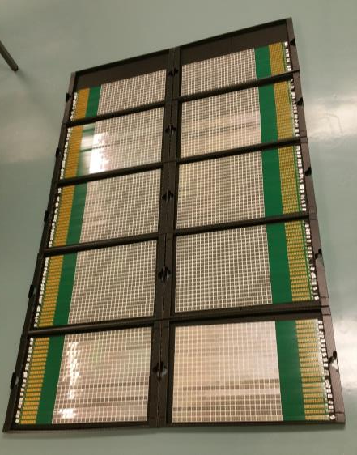
186 PCBs!

Slide 18
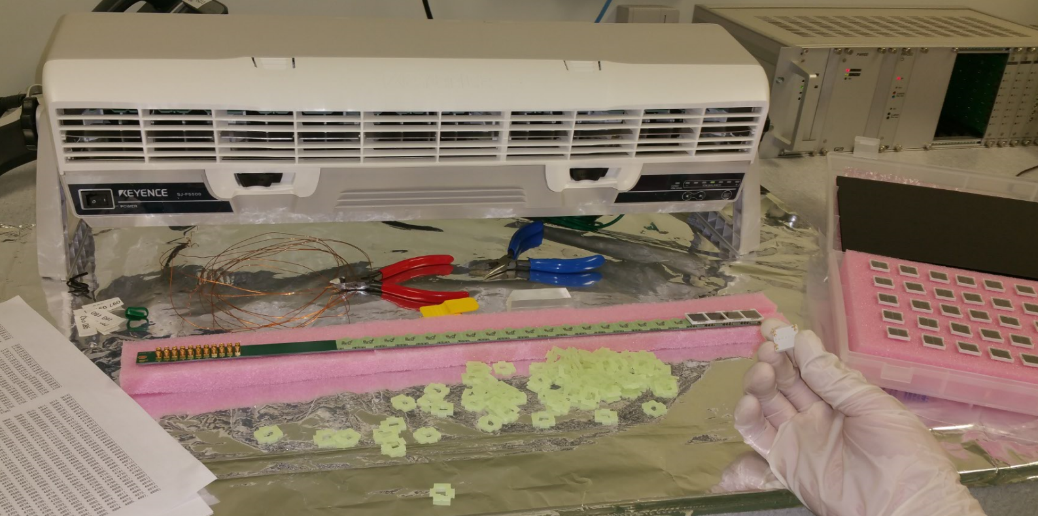
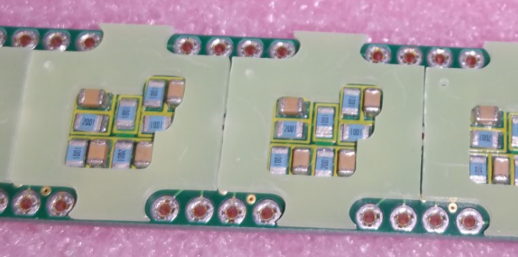
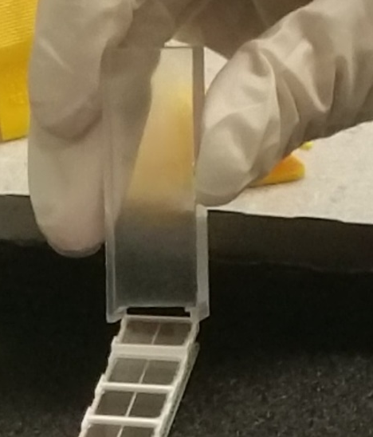
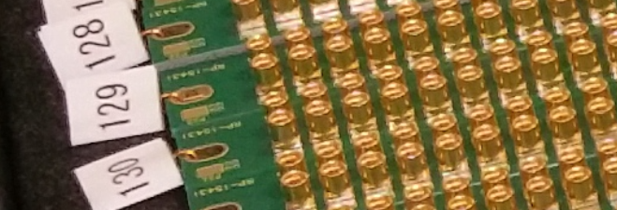
Mounting MPPCs on PCB

Slide 19
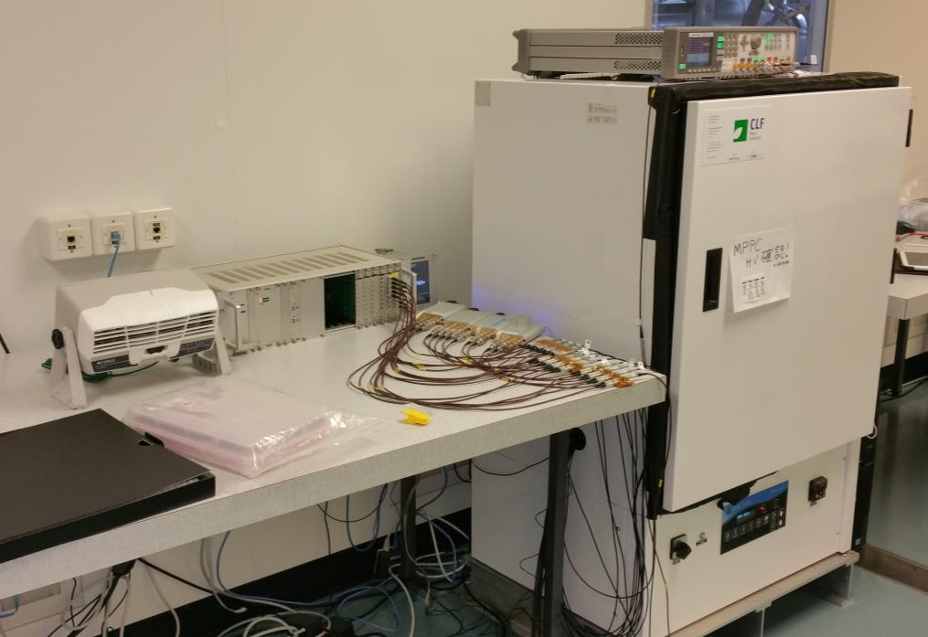
Setup for PCB+MPPC test
LED pulser
LED1
LED0
HV
DRS
(12 ch)
T=20 deg
MPPC assembly area
PCB+MPPC
reference ch
We measured the charge and waveform of the LED light.

Slide 20
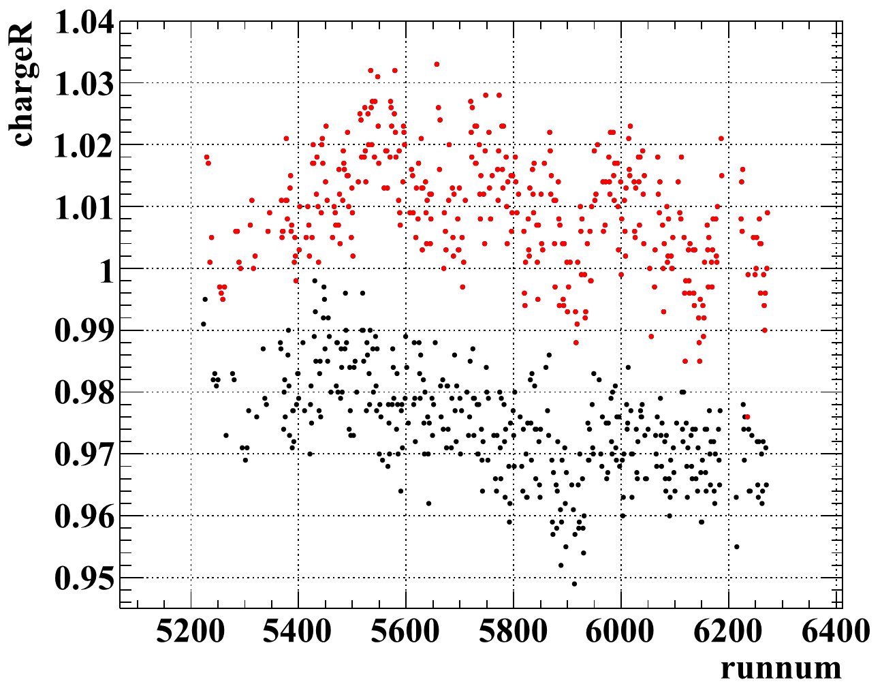
Stability of the LED and temperature
Charge of the reference MPPC was measured in all the runs.
LED1
LED0
LED light and the temperature were stable over all period.

Slide 21
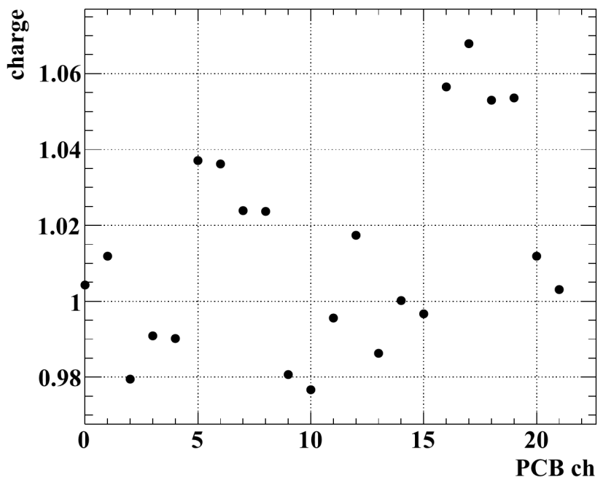
PCB ch dependence
The measured charge may depend on the PCB channel, due to the non-uniformity of the LED light and the imperfect calibration of electronics.
We checked this by putting #00004 at ch0~21.
LED0
LED1
PCB ch dependence is corrected in the analysis.

Slide 22
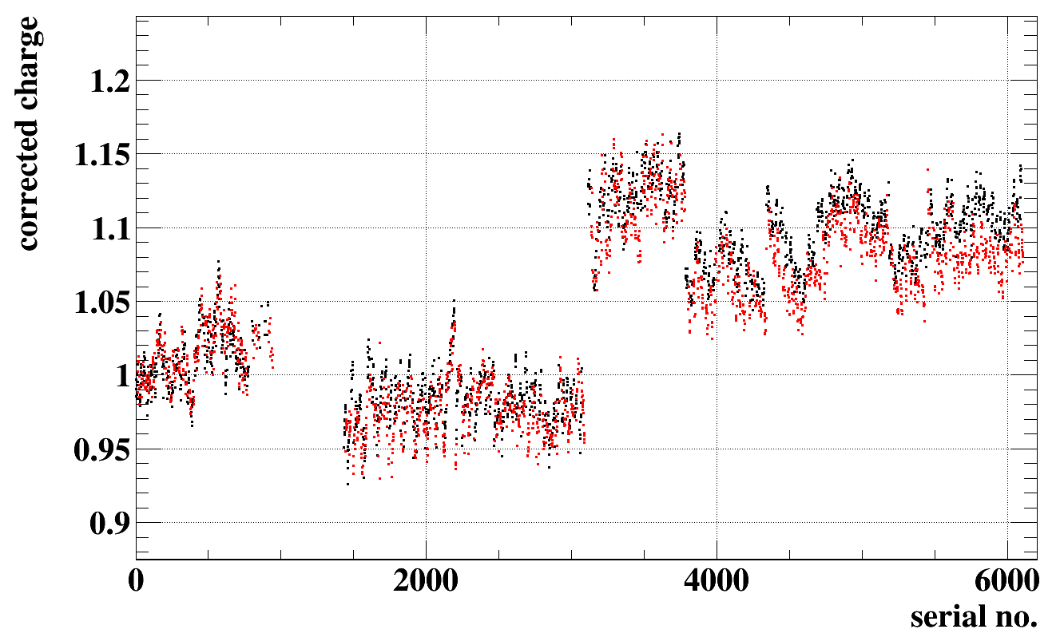
Charge vs. serial
LED0 (PCB ch0~10)
LED1 (PCB ch11~21)
Systematic difference is seen for two LEDs.
Reference MPPC shows different behavior.

Slide 23
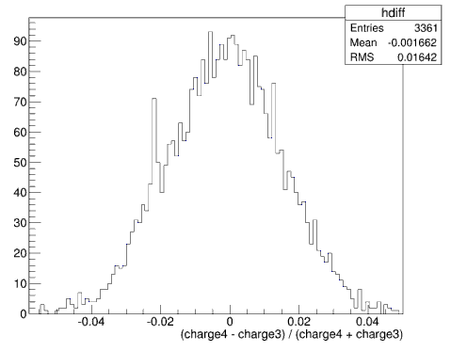
Charge resolution
For each run, I selected two MPPCs and checked the resolution.
resolution = RMS of (charge of ch4 – charge of ch3) / (charge of ch4 + charge of ch3)
Resolution vs. serial no.
example of charge diff histogram
Batch by batch difference is small.

Slide 24
Charge vs. HV
Batch A
B
C
D
V_{hama} – 2V
V_{hama}
V_{hama} + 2V
For batch C and D, charge increases much at higher V probably because the CTAP factor is large. (charge ∝ gain x CTAP )

Slide 25
CTAP meas. in room temp
CTAP probability is measured for some of the MPPCs in room temperature.
Batch A
B
C
D

Slide 26
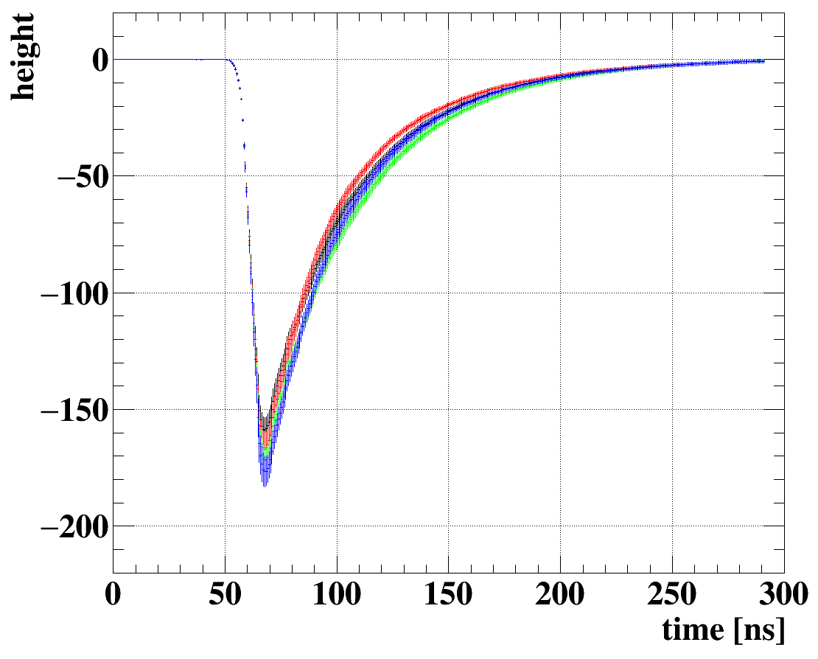
Averaged waveforms
Profile histograms for four batches. Error bar is RMS of each bin.
Batch A
B
C
D

Slide 27
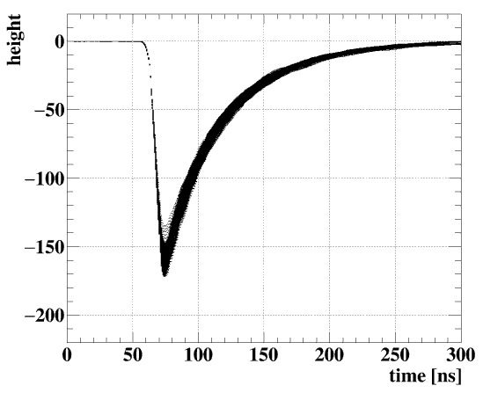
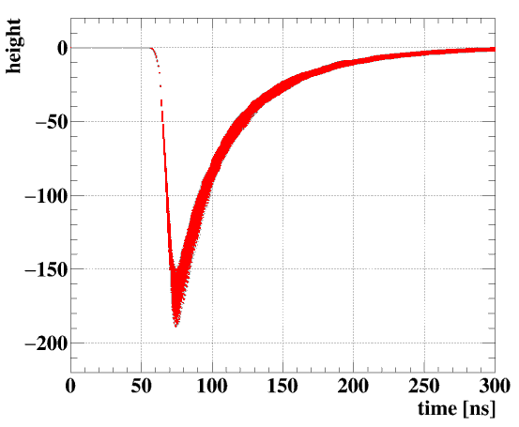
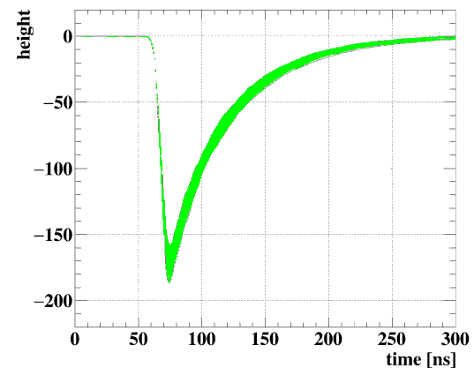
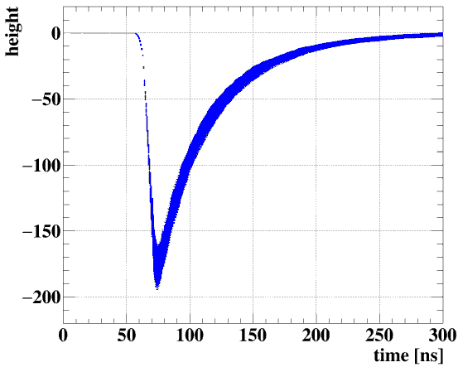
All waveforms
Batch A
B
C
D

Slide 28
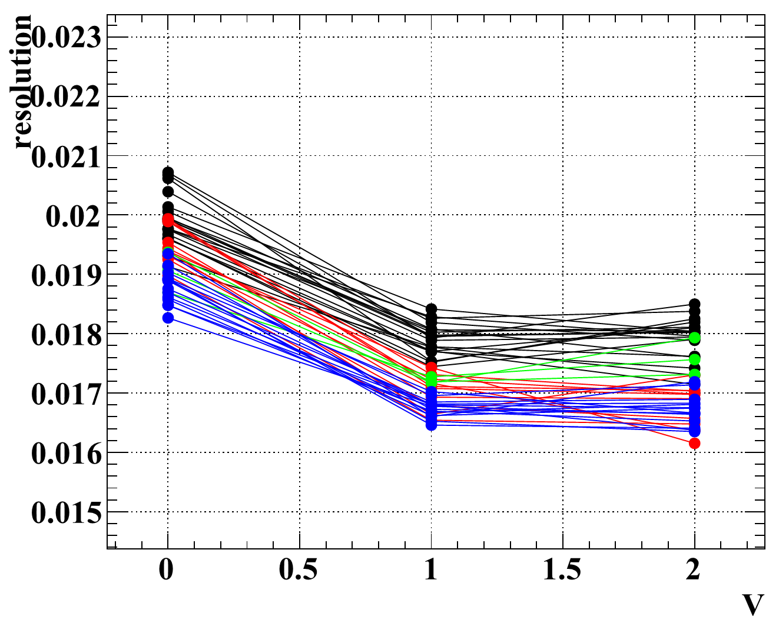
Charge resolution vs. V
Batch A
B
C
D

