Slide 1



MEG II 実験液体キセノンガンマ線検出器における取得データサイズ削減手法の開発
Development of the data size reduction method for MEG II liquid xenon detector
小川真治、 他MEG IIコラボレーション
@日本物理学会 第72回年次大会
2017.03.19

Slide 2
Table of contents
Introduction
2. Data size reduction of LXe detector
3. Summary and prospect

Slide 3
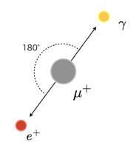
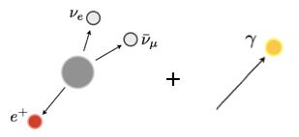
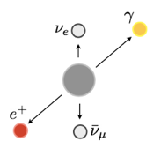
μ→eγ search
We search for charged lepton flavor violating decay of muon, μ->eγ.
Prohibited in SM, detectable branching ratio in some BSM model
Main background is the accidental background.
Detector resolutions, especially energy resolution of γ-ray,
are important to effectively distinguish the signal event
from the accidental background.
Signal
Background
Signal decay
Accidental background
Radiative muon decay
E=52.8MeV
back-to-back
coincident
Dominant background
E < 52.8MeV
not back-to-back
E<52.8MeV
not back-to-back
coincident

Slide 4
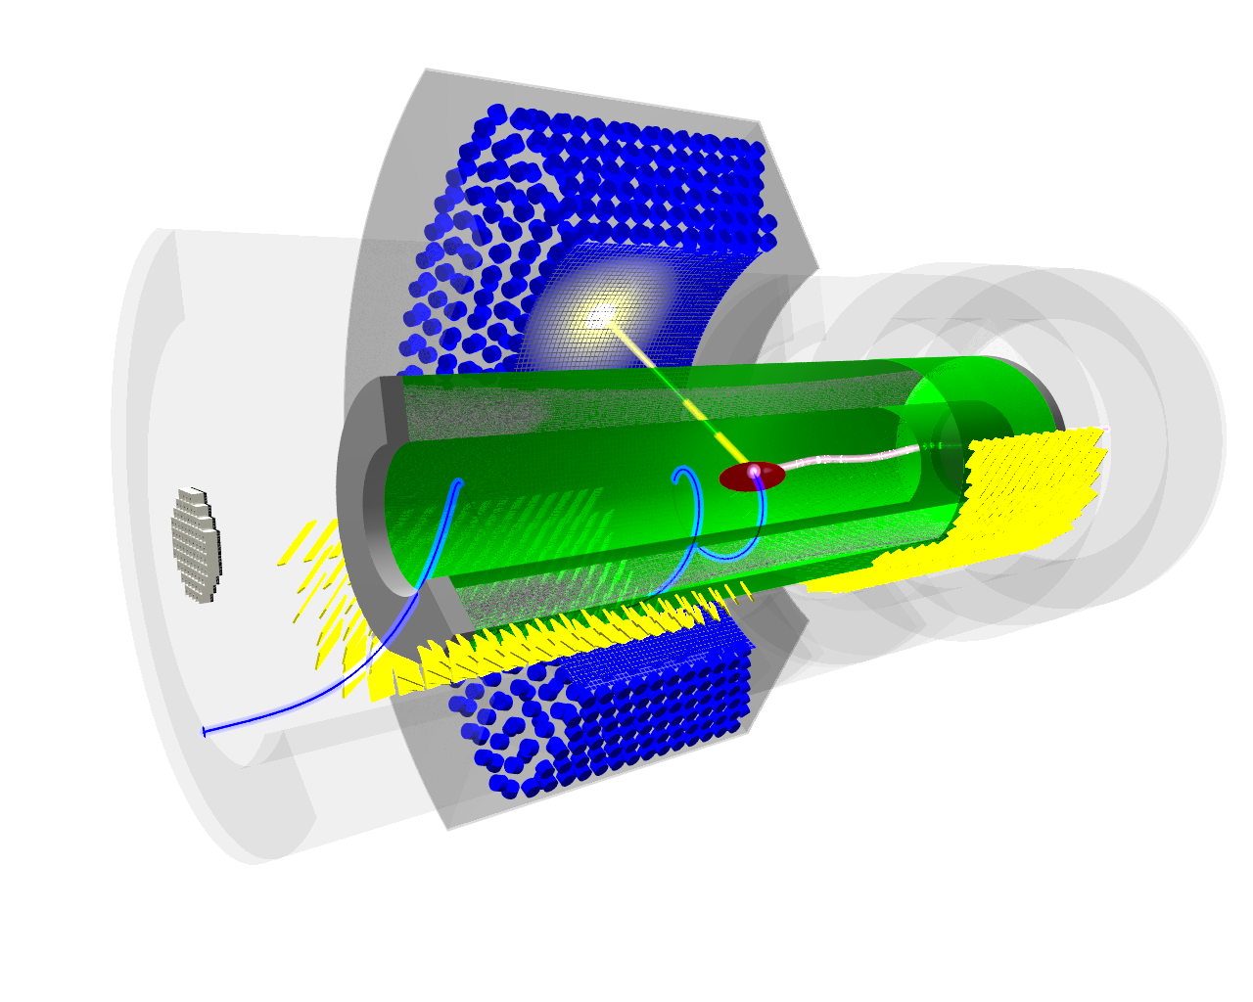
MEG II experiment
Upgrade of MEG experiment
μ⁺ stopping rate will be doubled
  3×10⁷ μ/s → 7×10⁷ μ/s
Detection efficiency will improve.
Resolutions of all detectors will become half.
New detector for background tagging will be introduced
Expected sensitivity: 4×10⁻¹⁴
One order of magnitude better than MEG
Liquid Xe
γ-ray detector
Gradient magnetic field
^{γ}
e⁺ drift chamber
μ⁺ beam
e⁺
e⁺ timing counter
2017
2018
DAQ with
muon beam
Engineering run

Slide 5
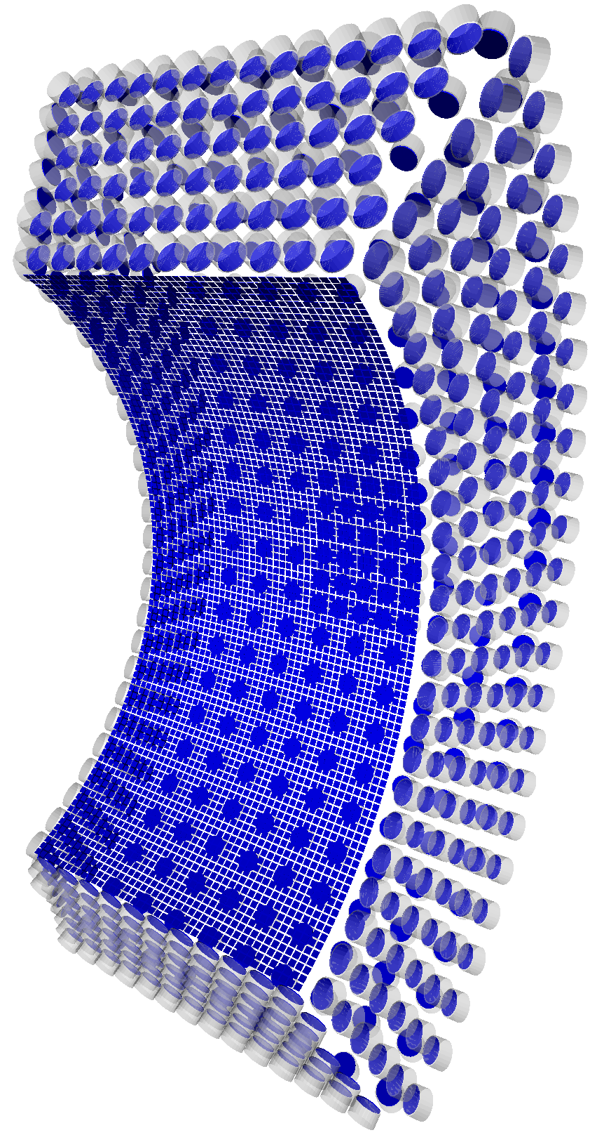
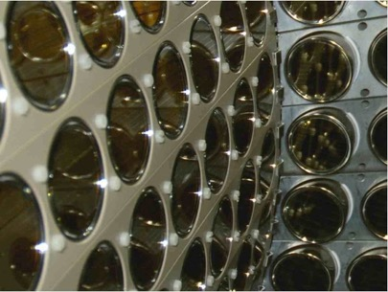
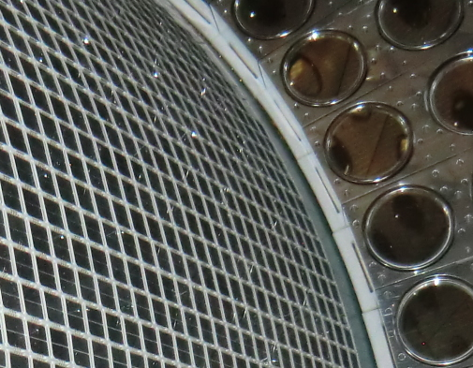
LXe detector upgrade
We are upgrading LXe detector for MEG II to significantly improve the performance.
top
MEG
MEG II
outer
γ
γ
2 inch
PMT
lateral
(DS)
12×12 mm²
MPPC
We will replace 216 2-inch PMTs
on the γ-entrance face
with 4092 12×12 mm² MPPCs.
  Better granularity
    Better position resolution
  Better uniformity of scintillation readout
    Better energy resolution
  Less material of the γ-entrance face
    Better detection efficiency
lateral (US)
inner
bottom

Slide 6
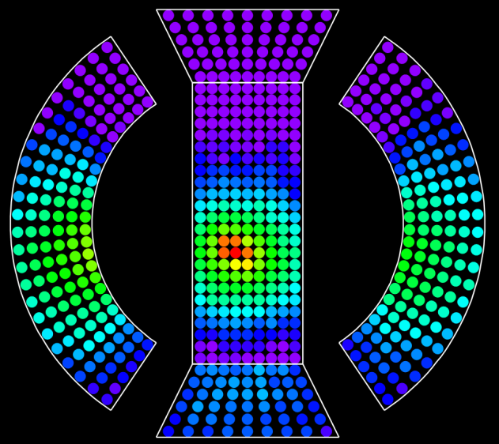
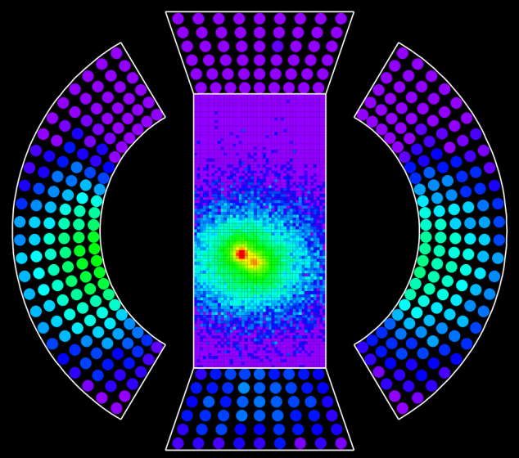
Expected performance
Significant improvement of all resolutions and efficiency are expected.
MEG
Detector performance for signal γ-ray
 | MEG (measured) | MEG II (simulated)
Efficiency | 65% | 70%
Position | ~5 mm | ~2.5 mm
Energy | ~2% | 0.7 - 1.5%
Timing | 67 ps | 40 - 60 ps
log scale
Imaging
power
improves
MEG II
log scale

Slide 7
Table of contents
Introduction
2. Data size reduction of LXe detector
3. Summary and prospect

Slide 8
日本物理学会 (2016年秋季大会), 21aSE-1, 内山 雄祐 より

Slide 9
Online data reduction
Detector
Several possibilities for data size reduction is being discussed.
  More efficient trigger.
  Online data reduction
  Additional software trigger
Online data reduction.
  Goal : 3M byte /event including all detector
  This study focus on the XEC whose number of channels increases by a factor of 5.
  Online data reduction algorithm has to be prepared not to affect the performance of the detector.
  -> Study by using MC simulation.
Electronics
Analog waveform
WaveDream board
Trigger concentrator board
1st level trigger
DAQ concentrator board
2nd level trigger
Digitized waveform
DAQ backend PC
Online data
reduction
Compressed waveform
Software trigger PC
3rd level trigger
On site
Offline cluster
Tape archive

Slide 10
Data reduction method No.1:
Rebin of the waveform
Also used in MEG.
Reduce the number of sampling point of the waveform.
Keep the maximum sampling speed only around the triggered pulse region.
  Necessary for precise timing information.
Waveform information of time region far from triggered is “rebined”.
  1024 points → 320 points (# of p.e. > 40 p.e.)
  1024 points -> 128 points (# of p.e. < 40 p.e.)
V
V
μs
triggered pulse
region
μs
rebin region

Slide 11
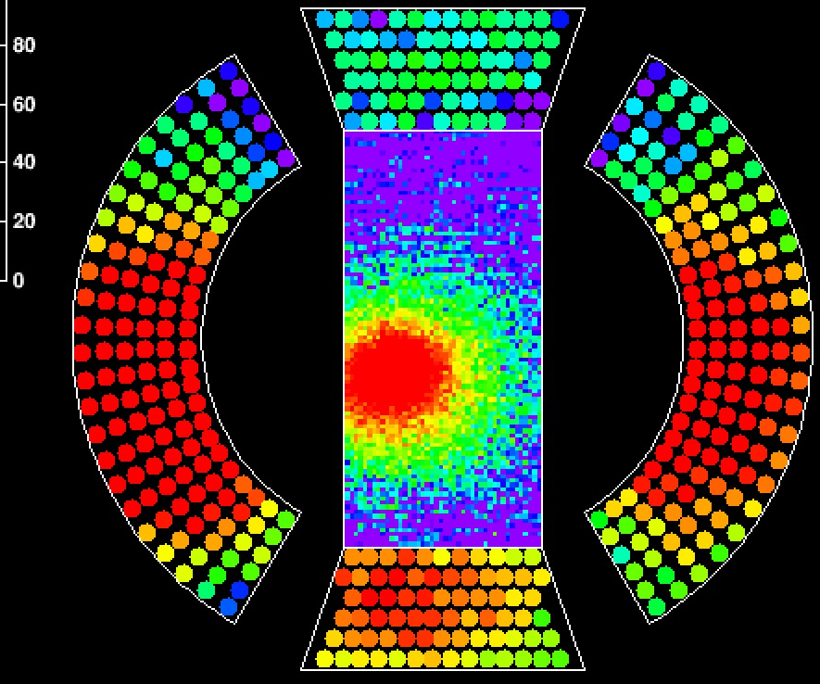

Data reduction method No.2:
Online waveform clustering
New for MEG II
Reduce the number of channel (i.e. granularity) of the readout.
Keep the granularity of the channels only around triggered gamma.
  MPPCs on the inner face are divided in a unit of 4×4 channels.
  If the pulse height is smaller than a given threshold, waveform from these 16 channels will be summed up and saved as one channel.

Slide 12
Performance of data reduction
Data size after compression (arbitrary unit)
Performance of the data
reduction has been checked.
Data size
  Data size reduction by a factor
  of 6 has been achieved.
  0.54 Mbyte / event with data reduction. (+only 25% from MEG.)
  Sufficiently small to achieve
  the goal in MEG II
  (3 Mbyte /event).
Resolutions of reconstructed variables.
  Confirmed to be the same between
  w/ and w/o data reduction.
  Parameter for data reduction
  was set not to affect single
  gamma reconstruction.
 | w/o waveform clustering | w/ waveform clustering
w/o rebin | 1.00
w/ rebin | 0.22 | 0.16
reconstructed energy (signal γ)
w/o data reduction
w/ data reduction
MeV

Slide 13
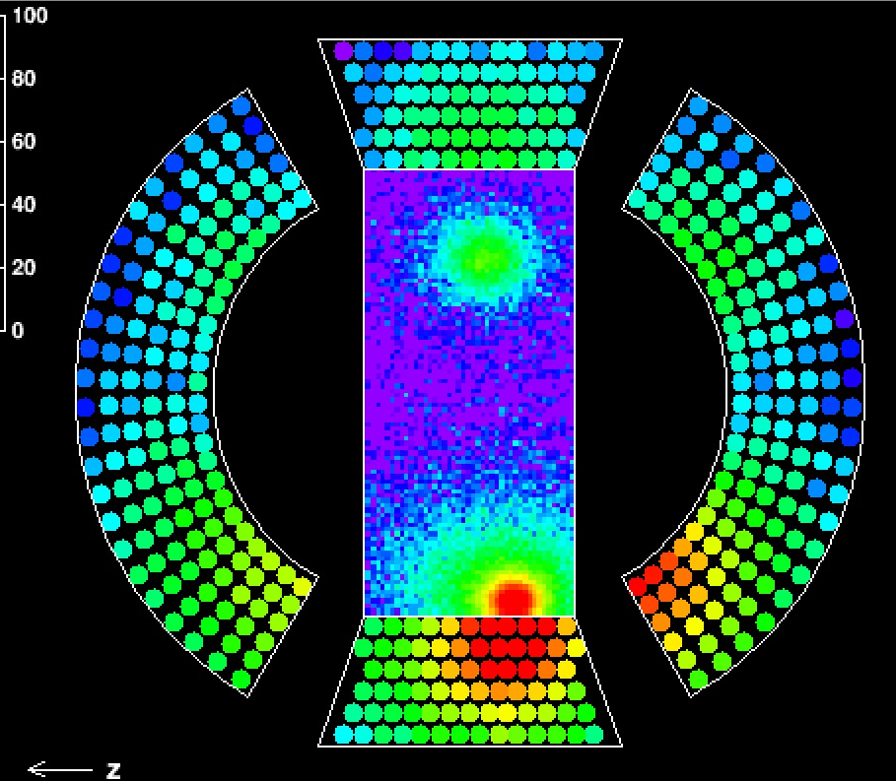
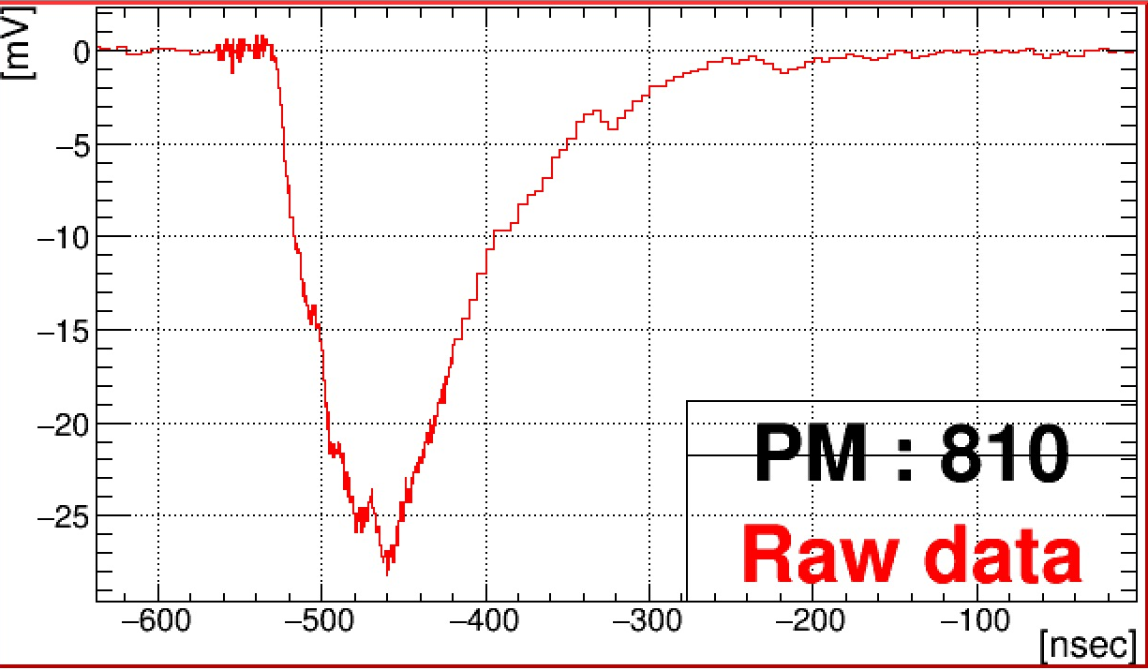
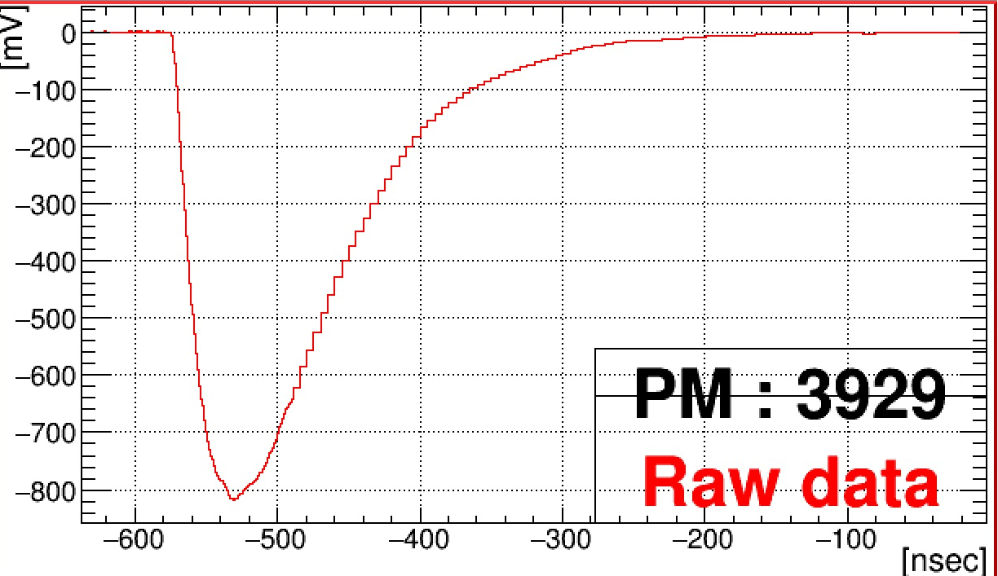
Pileup identification
Pileup γ has to be “identified” and effect to the reconstructed variables has to be “eliminated”.
Two methods will be used for identification of pileup γ.
  Number of photoelectron
  information.
  Search for a peak in light distribution.
  Timing information.
  Search for channels
  which have different timing.
multiple peaks found in light distribution
Difference of the
timing exists.
pileup γ
channel
near pileup γ
signal γ
channel
near signal γ

Slide 14
Effect of data reduction to pileup identification
Pileup identification performance can be affected by data reduction.
  Information from channels with small photoelectrons is necessary to find low energy pileup.
The degradation of the performance exists but limited.
Efficiency | w/o waveform clustering | w/ waveform clustering
w/o rebin | 69.8%
w/ rebin | 69.8% | 65.0%
※Inefficiency to signal event (w/o pileup)
: ~ 1% for all cases
energy distribution (incl. pileup γ)
signal γ
signal γ +
pileup γ (Found)
signal γ +
pileup γ (NOT found)
MeV

Slide 15
Summary and prospect
The MEG II experiment searches for μ->eγ decay with the sensitivity of 4×10⁻¹⁴.
Total data size among the whole experiment might become a crucial issue for MEG II experiment.
Two methods have been developed for data size reduction of LXe detector, and sufficient performance has been confirmed by using MC simulation.
These methods will be tested in pre-engineering run at the end of 2017.
  Implementation to the DAQ software will be needed.
  Optimization of the parameters of the data reduction can be done with real data.

Slide 16
backup

Slide 17
Data reduction strategy
There are two kinds of information which can be reduced
since they are not important for γ-ray reconstruction .
Time region far from triggered pulse.
Photo sensors which have the
small number of photoelectrons.
V
μs

Slide 18
aa
signal γ
signal γ + pileup γ (that are lost by the data reduction.)
signal γ + pileup γ (NOT found even w/o Data reduction)

