Slide 1
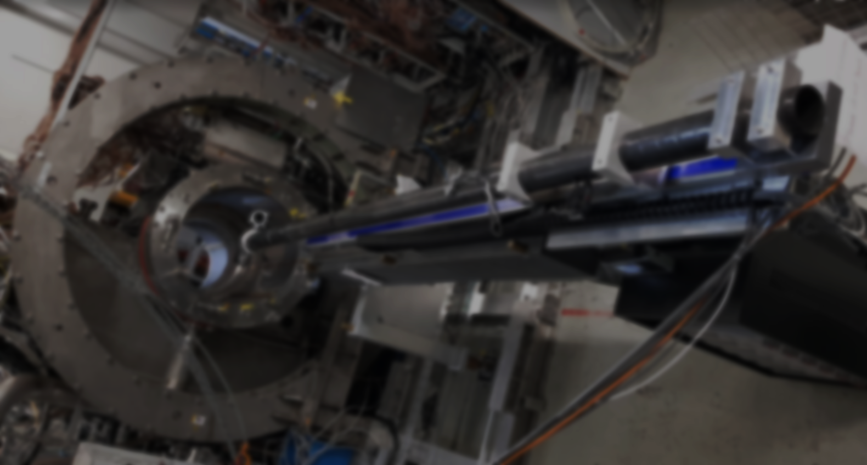
MEG II実験 陽電子スペクトロメータの 3次元磁場測定
家城 佳、他MEG IIコラボレーション
日本物理学会 2018年秋季大会

Slide 2
MEG II experiment
We search for cLFV decay, $μ→eγ$
Aimed branching ratio sensitivity: $6×{10}^{−14}$ (90% C.L.) ⇔ Prediction from bSM (e.g. SUSY-seesaw): $O({{10}^{−12}\sim 10}^{−14})$
$$γ$$
Discovery of $μ→eγ$ = Discovery of new physics!
μ⁺
Key concepts of the experiment:
- High intensity $μ^{+}$ beam ($7×{10}^{7}μ$/s) @ PSI
- High resolution detectors to distinguish signal from accidental BG
$$e^{+}$$
$μ→eγ$ signal
$E_{e}=E_{γ}=52.8$ MeV
back-to-back
same timing

Slide 3
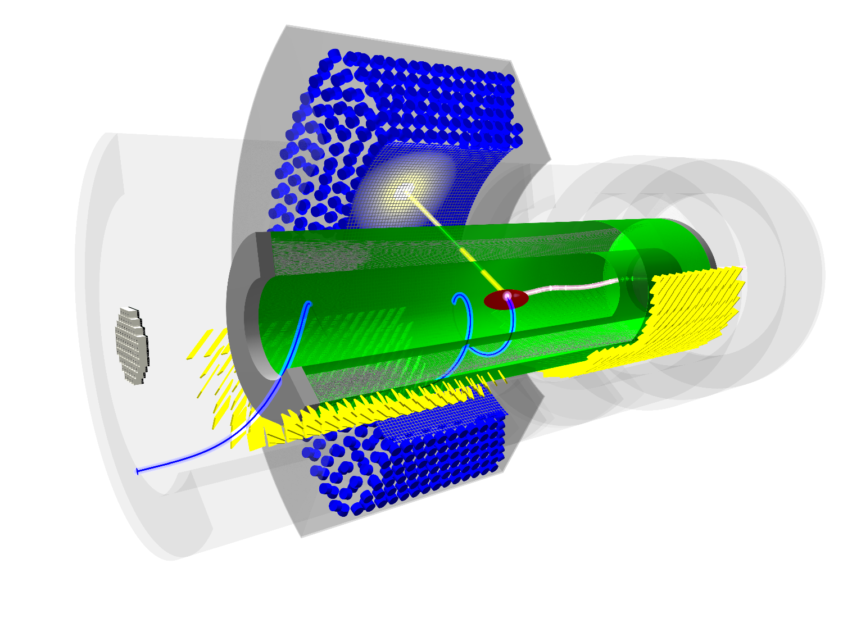
e⁺ spectrometer and COBRA magnet
e⁺ spectrometer =
Drift chamber
Timing counter
+ COBRA magnet
(reused from MEG)
COnstant Bending RAdius magnet
- Superconducting magnet, ~1.2 T at center
- Gradient field
$$γ$$
Same radius at different angles for same p_{e+}
e⁺ is swiped away quickly → hit rate reduces
e⁺
~2m

Slide 4
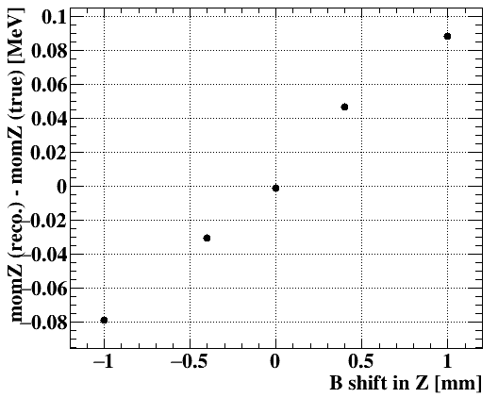
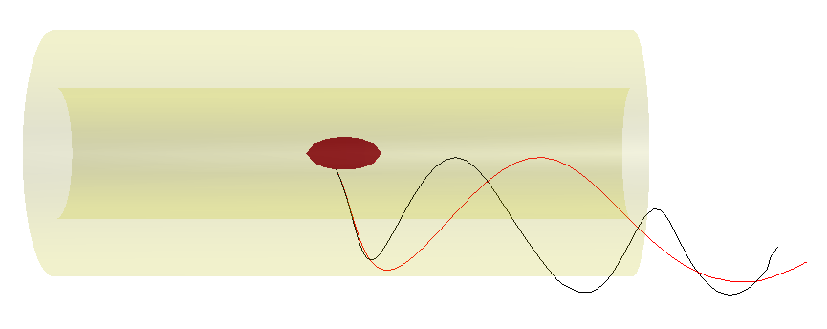
Requirement for B-field measurement
Resolution will improve in MEG II:
$Δp_{e}\sim 83 keV \left(0.16\%, was 0.7\% in MEG \right), Δz_{e}\sim 1.6 mm, Δy_{e}\sim 0.7 mm$
→ B-field uncertainty should be <~0.1%
Alignment of the sensor is important
→ e.g. If B-field map is shifted in Z by 0.5 mm, p_{z} is biased by ~40 keV, vertex Z is biased ~0.2 mm
Bias in p_{Z} vs. shift of B-map in Z
Example of signal positron track
Default
Shift B-field map by Z +10cm

Slide 5
Difficulties in gradient B-field measurement
Gradient B-field → Strength and direction of the B-field changes at different place.
Sensor position must be known well
Measure the field in 3 directions. → Angle misalignment makes a large effect
Position shift will make a bias in e⁺ reconstruction.
small effect
B_{z}
sensor Z
B_{z} → B_{z}$cosθ$
Some commercial sensors are too large
θ
e.g. NMR probe is usually too big
large effect
sensor X
0 → B_{z}$sinθ$

Slide 6
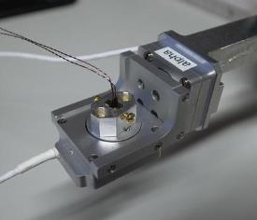
Previous measurements (for MEG)
A. Commercial 3D Hall sensor + moving wagon Angle error was large (9 mrad) → Only B_{Z} was used. B_{R} and B_{Φ} were calculated from Maxwell equations.
B. 1D Hall sensor + rotating stage + moving arms → Cancel out the effect of misalignment by rotating sensor.
→ Data taking time was long (~1 week).
It was also necessary to consider the
misalignment of the rotating stage
B
Hall sensor
+ rotators
Data points (XY view)
-B$sinθ$
Difference between measured and calculated field was ~0.2% (in RMS)
B$sinθ$

Slide 7
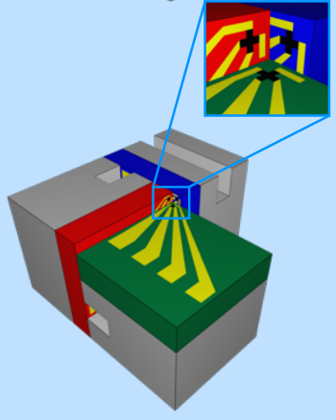
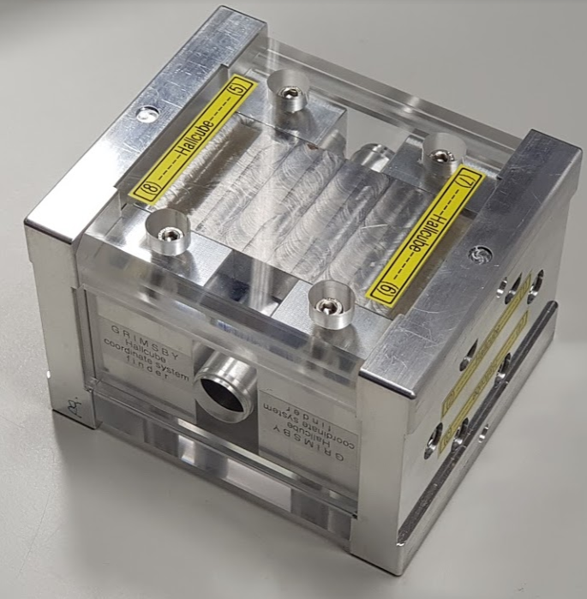
Improvements in new measurement
Use “Hall cube” sensor developed at PSI. - 6 Hall sensors to measure 3 directions (2 sensors for each direction) - Sensors are mounted in a small space (200 $μm$). - Cuboid structure makes the sensor orthogonal to each other.
Use a coordinate finding magnet to measure the sensor directions. It consists of Nd magnets which provide uniform field with known direction.
“Hall cube” sensor
Coordinate finding magnet
Hall sensor x6
4 mm

Slide 8
Hall sensor
Hall sensor - Simple, easy to use - Careful calibration is required (small non-linearity exists)
- Gain drift (by temperature etc.) → monitoring
- Planar Hall Effect (<0.2%) → cancel out by having two sensors in each direction with 90 deg. rotated.
Hall voltage
V
B
Hall effect
$$I$$
e⁻
B⊥
Planar Hall Effect (∝ $IB_{//}^{2}sin2α$ )
B
Minor issues with our sensor:
B//
Instability of one of our sensor was relatively large (<0.1%)
We broke one out of 6 sensor by accident. Fortunately, PHE for that sensor (Z) is expected to be negligible.
$$α$$
$$I$$

Slide 9
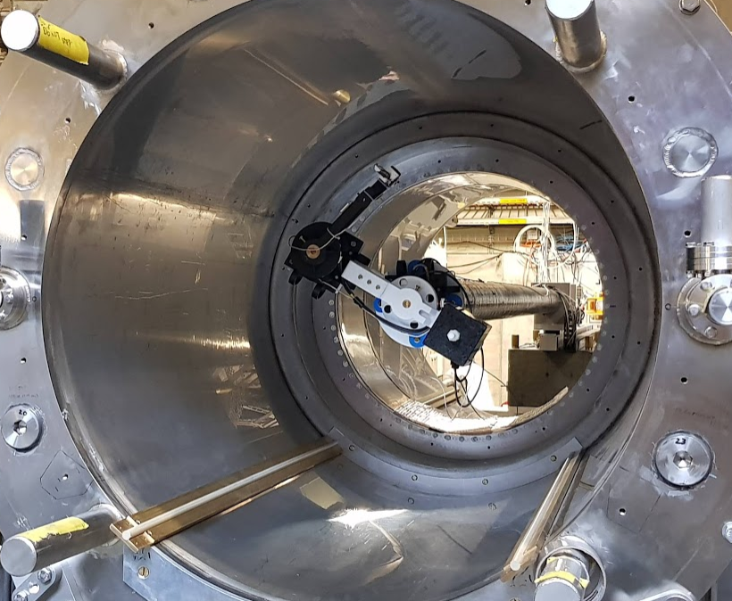
Measurement system
Two moving arms + encoders Supersonic motors (works in B-field) + 3D printed arms (reinforced w/ CFRP)
Z stage + encoder ~3m long, toothed belt Granite table (stable) + CFRP tube (light)
Sensor Hallcube + current source (Keythley 6221) + Digital voltmeter (Agilent)
Control system EPICS (multiple devices, real time)
Hallcube sensor
R arm
Φ arm
Z stage

Slide 10
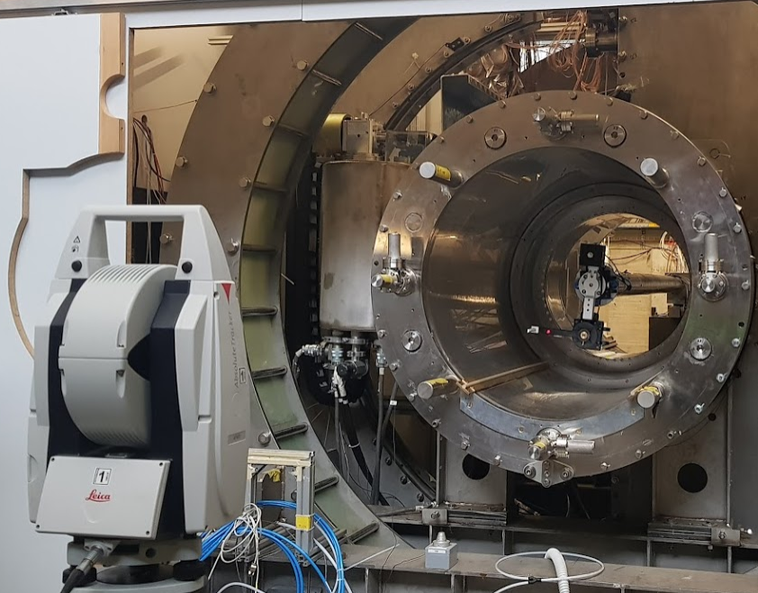
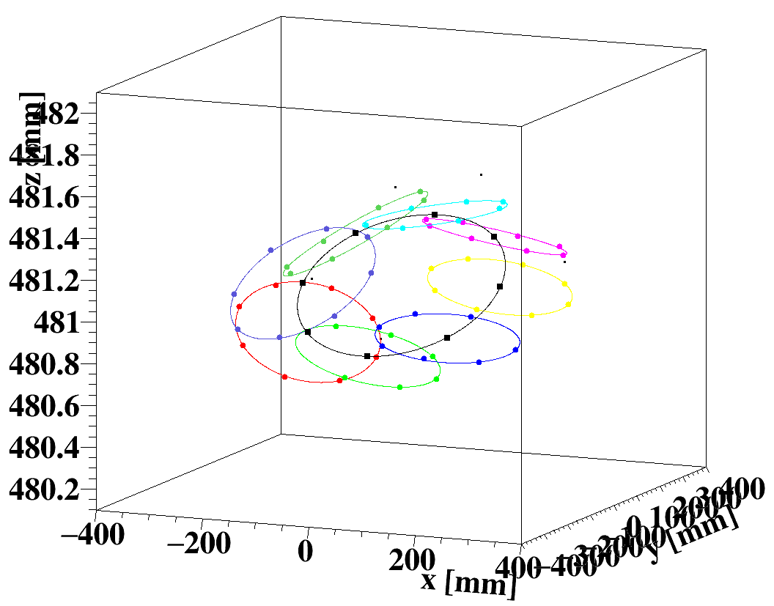
Survey of the mapping machine
Position and tilt of the arms are measured in laser survey.
Colored circles: R arm rotation
Black circle: Phi arm rotation (center of R circles)
laser marker
Z position is found to vary by ~0.5mm due to tilt, but we can correct this based on the tilt parameters obtained in this survey.

Slide 11
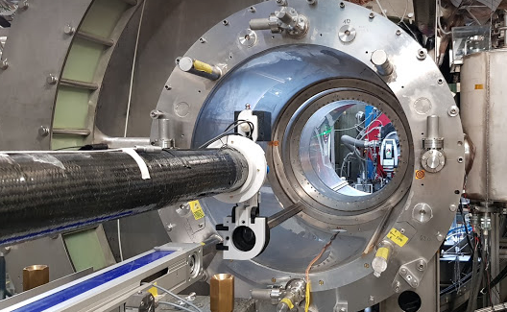
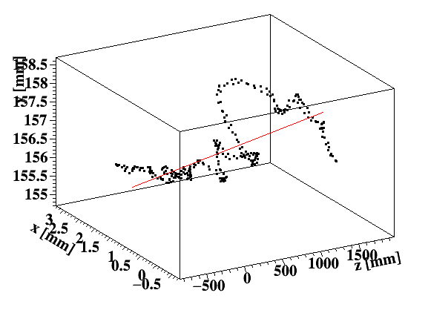
Survey of the mapping machine
Linearity of the stage is also measured and corrected.
laser marker
Deviation in XY was ~1.5 mm at maximum.
After the corrections of tilt and Z linearity, deviation (RMS) of surveyed X,Y,Z positions from calculated position were ~200 $μm$ in X,Y, ~30 $μm$ in Z.

Slide 12
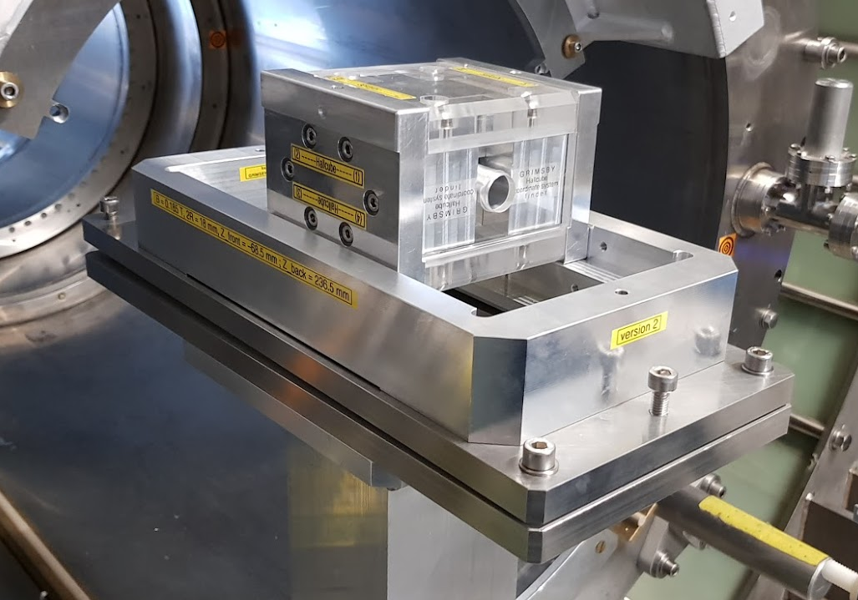
Sensor direction measurement
Sensor direction was measured by using Nd magnets which provides uniform field with known direction.
90deg rotated
y
no rotation
Stage is aligned
horizontal and parallel to Z
Nd
sensor
Φ
Nd
θ
x
Hall
sensor
z
B=0.185 T
We measured the B-field with no rotation and 90deg rotated.
Measured field correspond to BcosθcosΦ and BcosθsinΦ. → θ and Φ are calculated.

Slide 13
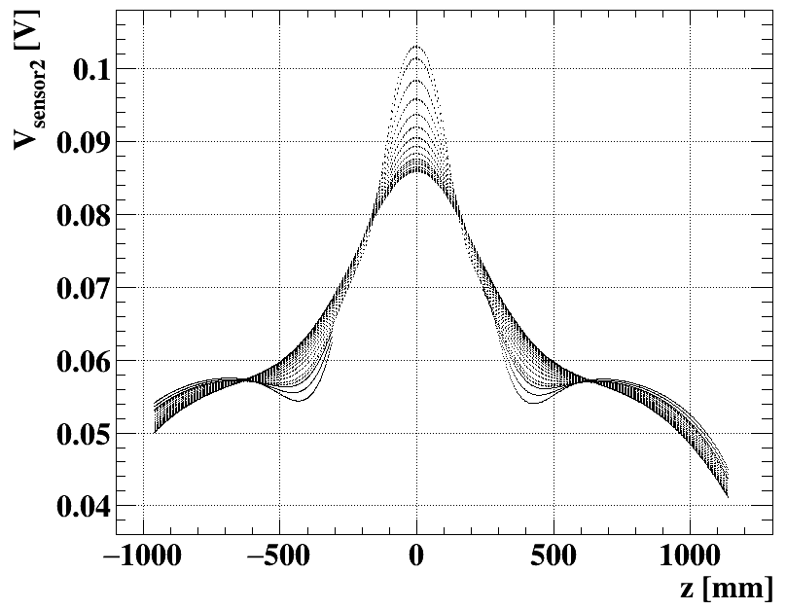
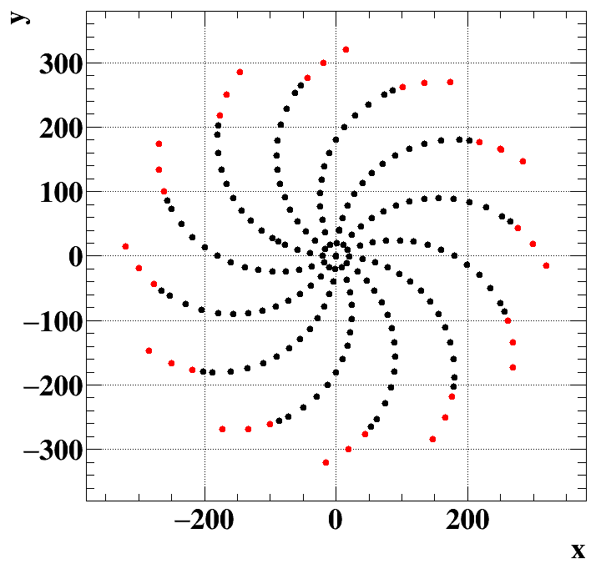
Data taking
We did a full mapping in 1 day (very quick!).
30deg step in $φ$, 2 cm (or 1 cm) step in R, ~5 mm step in Z
Example of sensor readout for sensor#2 (Z)
Measured data points (X,Y)
Φ=0
r=0, 2, …26 cm
(∝Bz)

Slide 14
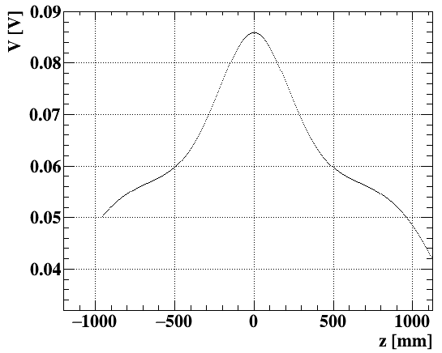
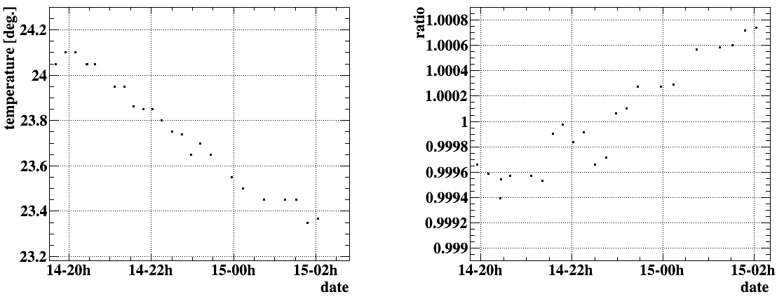
Stability check
Gain of Hall sensor may vary due to temperature etc.
We monitored the gain and offset by scanning over Z every 10 min. at COBRA center.
Variation of offset was negligible. Gain change of ~0.1% will be corrected.
Example of monitoring data
Gain vs. time
Temperature vs. time

Slide 15
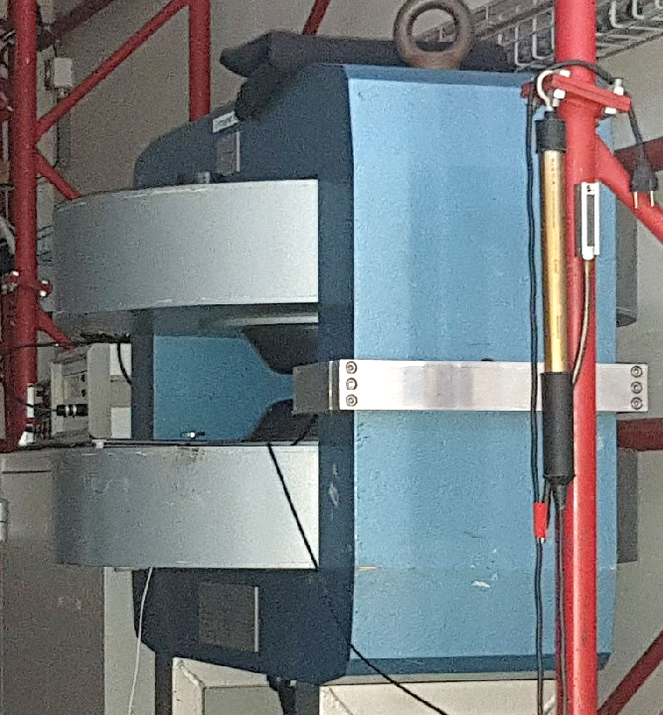
Next steps
Dipole magnet
Calibration (V→Gauss) of Hall sensor Using dipole magnet + NMR probe (reference)
Interpolate discrete points to make full 3D map Previous method: B-spline (2D spline) fit in each R-Z planes at different φ New method:
Fit with solutions to Maxwell equations for generic solenoid
$B_{Z}=\sum_{n,m}{\left(C_{n}cos\left(nφ\right)+D_{n}\sin\left(nφ\right)\right)}k_{m}I_{n}(k_{m}r)(−A_{nm}\sin\left(k_{m}z\right)+B_{nm}\cos\left(k_{m}z\right))$ etc.
Fitting software used in Mu2e is adopted for MEG. Misalignment of the sensors can be included in the fit parameters.

Slide 16
Summary
High precision (~0.1%) is required for the measurement of the gradient B-field of MEG II COBRA magnet.
We successfully performed mapping:
3D “Hallcube” developed at PSI + moving system were used.
Moving stage was carefully surveyed with good precision (e.g. ΔZ~30 $μm$).
Direction of the sensor was measured by dedicated setup with permanent magnet.
Stability (gain variation of <0.1%) of the sensor was monitored every ~10 min.
Calibration of the sensor and interpolation of the data points will be done to make a final B-field map for MEG II.

