Slide 1
MEG II実験 液体キセノンガンマ線検出器における 光センサーの較正
東大素セ
家城佳, 他MEG IIコラボレーション
JSPS
Core-to-Core Program

Slide 2
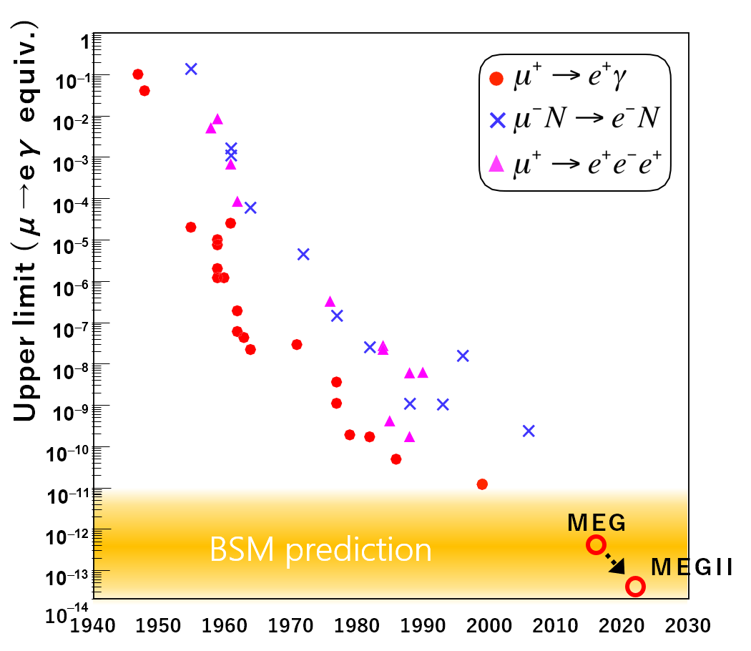
$μ→eγ$ decay
History of $μ$ LFV upper limits
MEG II experiment searches for cLFV decay, $μ→eγ$.
Sensitivity goal: $6×{10}^{−14}$ (10 times better than MEG)
BSM prediction : $Ο\left({10}^{−14}\right)$ (e.g. SUSY-seesaw)
$$γ$$
$$\tilde{μ}$$
$$\tilde{e}$$
$$μ$$
$$e$$
$${\tilde{χ}}^{0}$$
If $μ→eγ$ is found
Discovery new physics!

Slide 3
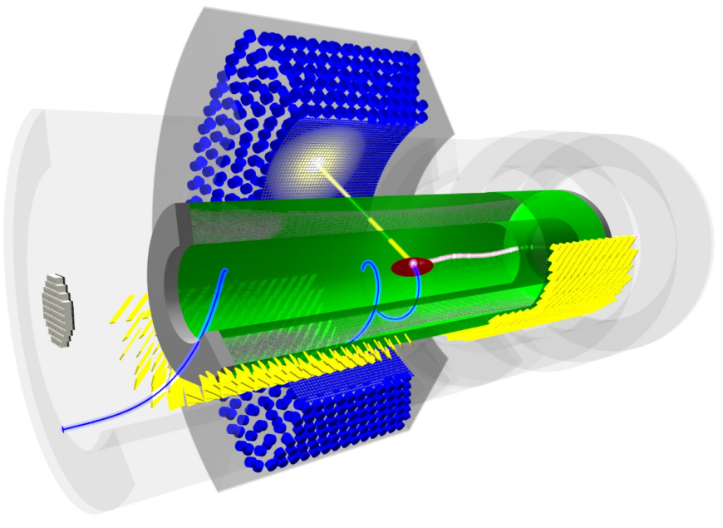
MEG II experiment
900l LXe detector
Key concepts:
- High rate continuous $μ^{+}$ beam at PSI ($7×{10}^{7}μ/sec⁡)$ - High resolution detectors to distinguish $μ→eγ$ from accidental BG
γ
μ⁺
$$γ$$
$$γ$$
$μ→eννγ$ or $e^{+}e^{−}→2γ$
e⁺
$$μ$$
Finally, all detectors were installed in 2018!
Signal
BG (Accidental)
(w/ partial readout electronics)
back-to-back same timing
$E_{γ}=E_{e}=52.8 MeV$
Cylindrical drift chamber
+ Timing counter
e
e
$$μ→eνν$$

Slide 4
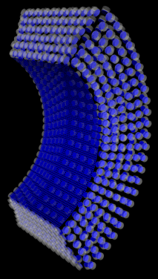
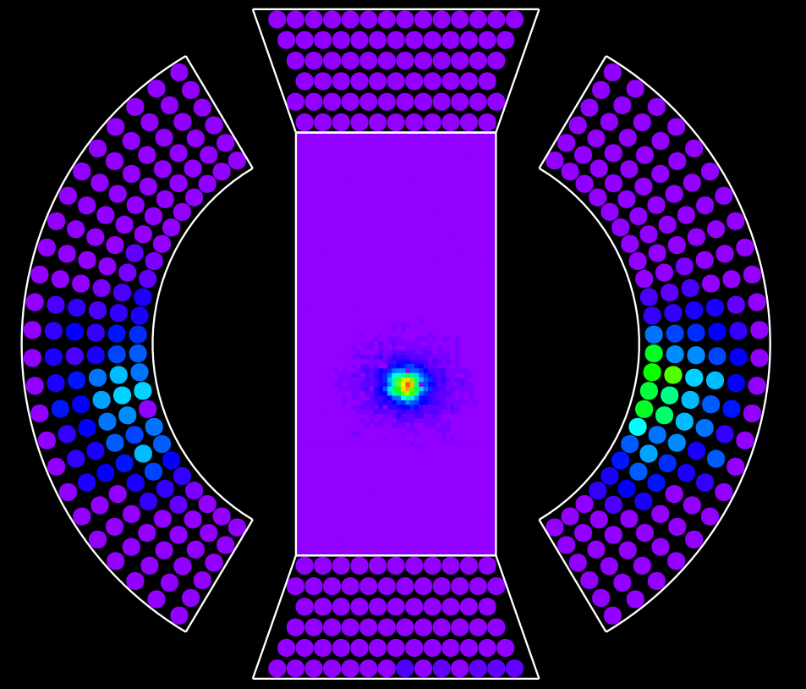
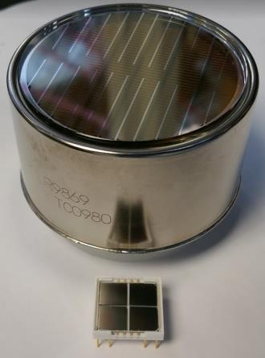
LXe $γ$ detector
900L liquid Xe (LXe) scintillator to detect energy, position and timing of $γ$
In MEG II, $γ$ entrance face is replaced from 216 PMTs (2 inches) to 4092 MPPCs (12x12 mm²)
$$γ$$
2 inch
1 m
12 mm
Light collection uniformity and granularity improved! → x2 energy and position resolution improvement expected

Slide 5
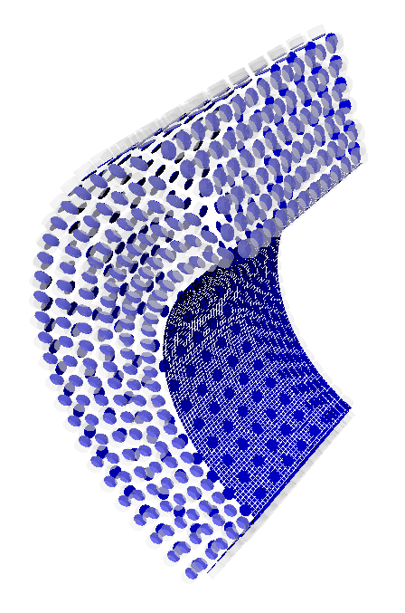
Pre-engineering run 2018
$γ$ data taking in Nov.-Dec. 2018
- 17.6 MeV $γ$ from radiative capture of $p$ on $Li$ target with CW proton beam (first time in MEG II) - 40~55 MeV $γ$ from $μ→eννγ$ & $e^{+}e^{−}→2γ$ with $μ$ beam
$$γ$$
$μ$ beam + CH₂ target
Measure detector resolution
Measure BG
or
p beam + Li target
Only ¼ of readout electronics (1.2 GHz waveform digitizer) was available.

Slide 6
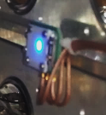
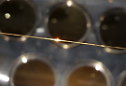
Calibration of MPPC and PMT
To achieve good resolution, characteristics of sensors must be understood well.
Gain: charge of 1 p.e.
EQF: Excess charge factor = crosstalk + afterpulse of MPPC
PDE: Photon Detection Efficiency
N_{photons} = $\frac{charge}{Gain∗EQF∗PDE}$
Calibration sources:
LEDs → Gain, EQF $α$ sources → PDE
LEDs
α (²⁴¹Am) on wires

Slide 7
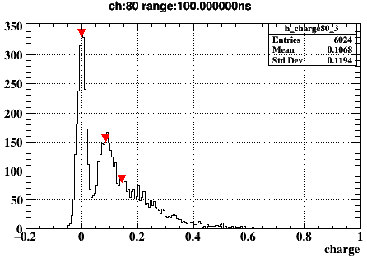
Gain and EQF (MPPC)
Gain and EQF are measured in weak LED data.
Example of charge distribution
Gain = (1p.e. charge) – (0p.e. charge)
0 p.e.
EQF (= crosstalk + afterpulse)
=
$$\frac{charge mean (observed)}{charge mean (expected)}$$
1 p.e.
Estimated from fraction of 0p.e. events assuming Poisson statistics. P(0p.e.) = exp(-charge_mean)

Slide 8
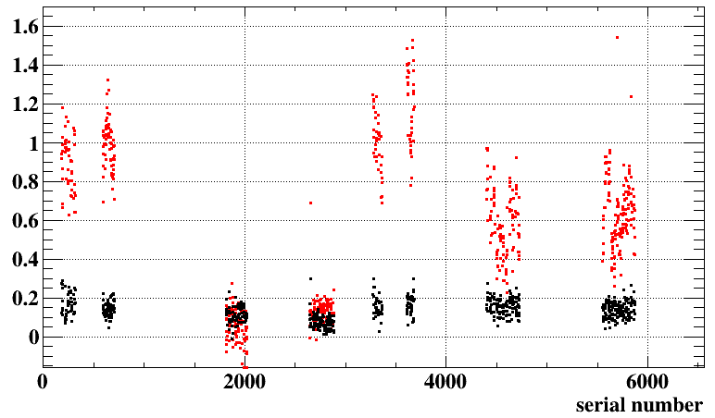
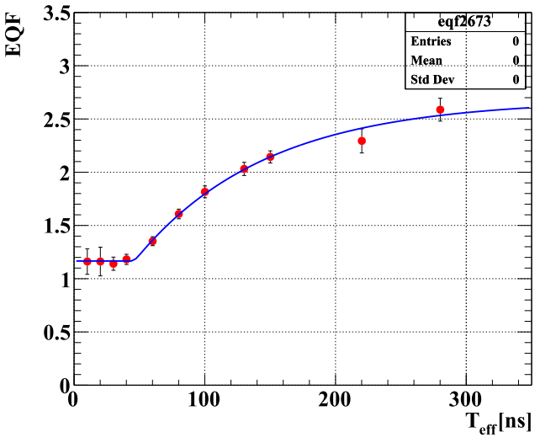
EQF and production lot
S. Kobayashi
Effect of crosstalk and afterpulse can be measured separately by changing charge integration time.
example of EQF vs. integration time
crosstalk, afterpulse vs. serial number
crosstalk
afterpulse
V_{over}=7V
~640 MPPCs
crosstalk
afterpulse
fit with
C_{CT} + C_{AP}(1-exp(t-t₀))
lot A
B
C
D
Afterpulse was measured to be largely dependent on production lot, but it is not a problem as far as we measure it.

Slide 9
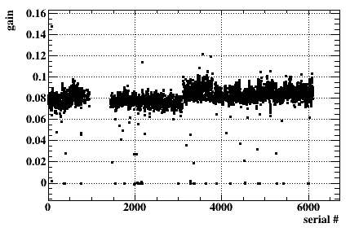
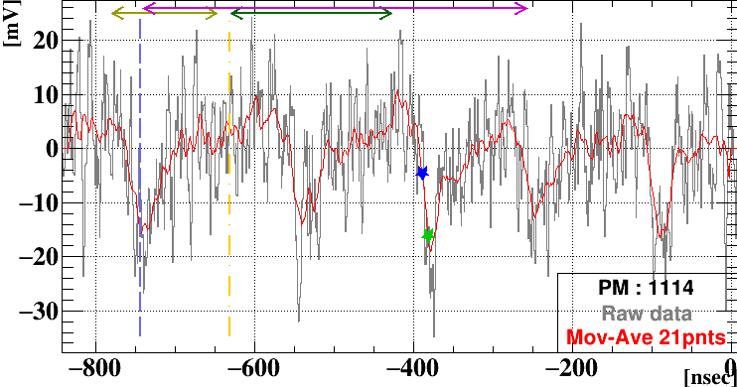
Test of all MPPCs
Gain, EQF of all MPPCs were measured with LED after pre-eng. run.
Outliers in gain distribution are mainly due to bad readout electronics channels, but some of them are not due to electronics:
Gain vs. serial no.
Dead channel:
9 channels (0.2% of total) Most likely due to bad cables
V_{over}=7V
~4000 MPPCs
Waveform of high dark rate ch.
High dark current channel: 19 channels Reason is unknown
C
D
lot A
B
These bad channels does not make a big effect on resolution.

Slide 10
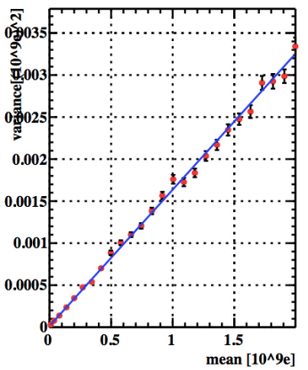
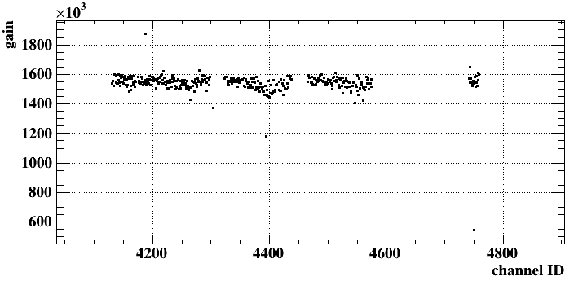
Gain (PMT)
K. Toyoda
Charge variance vs. charge mean
For PMTs, gain is derived from variance and mean of LED data.
Mean = gain * N_{p.e.} * e Variance = gain² * $σ_{p.e.}^{2}$ * e² + $σ_{0}^{2}$
gain = slope of variance vs. mean
N_{p.e.}
noise, LED variation
Gain vs. channel ID
Bias voltage is adjusted to equalize the gain.

Slide 11
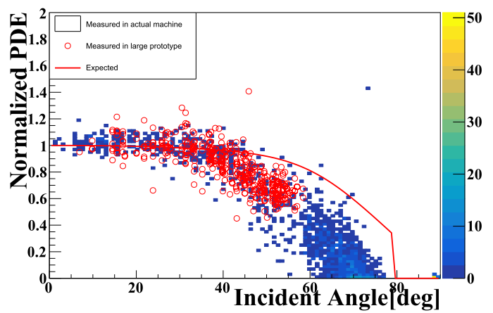
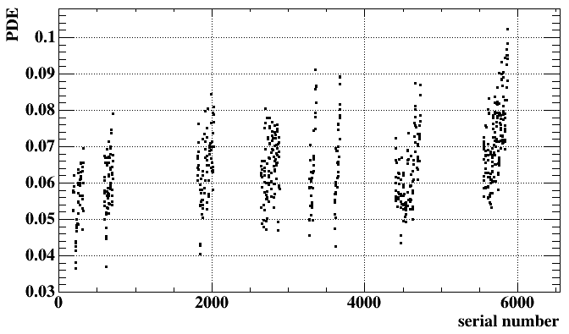
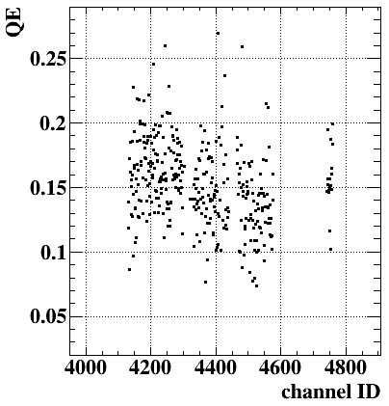
PDE (MPPC), QE (PMT)
S. Kobayashi
PDE, QE was measured with ²⁴¹Am $α$ source inside LXe detector.
PDE vs. incident angle
PDE = Np.e.(measured) / Np.e.(expected in MC)
Measured this time
Measured in prototype test
PDE (MPPC) vs. serial number
QE (PMT) vs. channel
expected curve
(Fresnel reflection)
lot
A
C
D
B
MPPC PDE was measured to be small (~7%), for the reason not understood yet.
It is measured to be small at large incident angle, as we observed in prototype test.
Effect on performance is expected to be small at least for energy and timing resolution.

Slide 12
Summary
Calibration constants of MPPCs and PMTs are measured successfully. - Afterpulse of MPPC was found to differ largely in different production lot. - For MPPCs, dead channels (x9) and high dark rate channels (x19) were found. - PDE was measured to be small (~7%), compared to the values measured before construction (~20%). Effect on energy and timing resolution is expected to be small, and effect on position resolution is being evaluated.
Variation of calibration constants over time is an other important topic → next talk
Effect on resolution is expected to be minor.

Slide 13
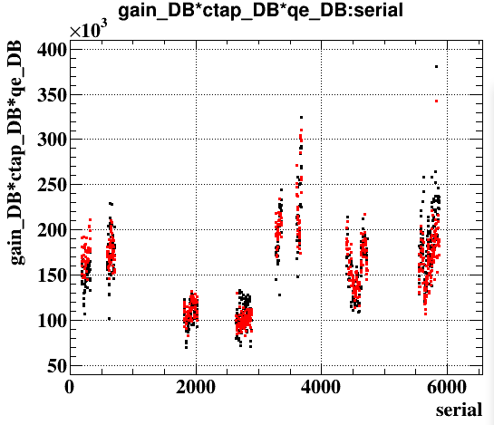
Crosscheck with current
gain*CTAP*PDE vs. current
gain*EQF*PDE vs. serial number
gain*EQF*PDE
current*scale_factor
gain*EQF*PDE

Slide 14
Backup slides

Slide 15
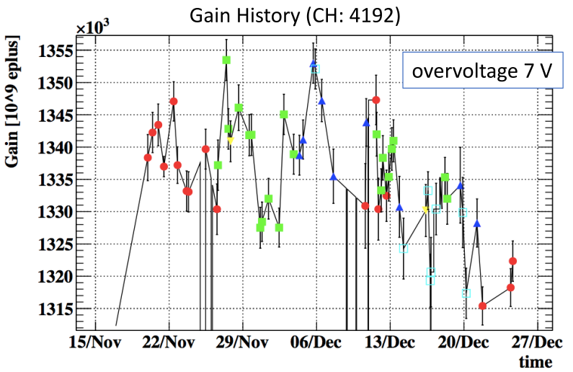
Gain monitoring
K. Toyoda

