Slide 1



機械学習を活用した
高計数率ドリフトチェンバーのヒット再構成
High-rate drift chamber hit reconstruction
with machine learning technique
内山 雄祐 (The University of Tokyo)
on behalf of MEG II collaboration
日本物理学会2021年年次大会
令和3年3月14日
14aT3-7

Slide 2
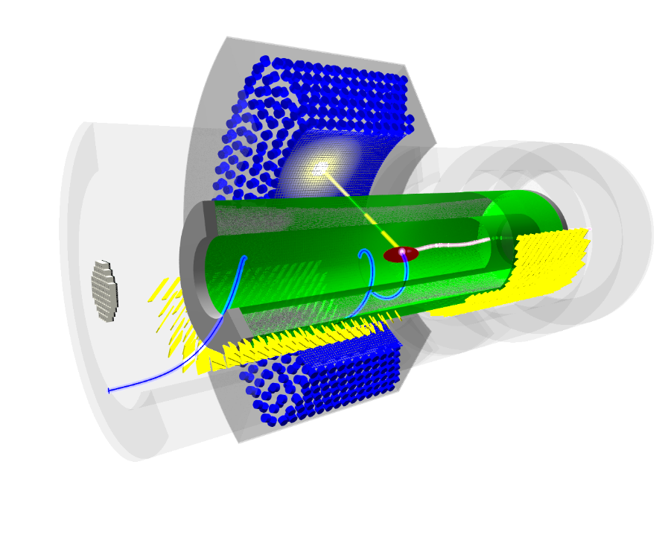
MEG II experiment
EPJ-C 78 (2018) 380
Search for rare muon decays
  to find definitive evidence for BSM
Use world’s most intense DC muon beam
  continuously emits 7×10⁷ e⁺/s
  detected by a cylindrical drift chamber
The detector signals are read
out as waveform
  by DRS4 waveform digitizer
  1024 points @ 1.2 – 1.8 GSPS
All the detectors as well as computing resource and analysis framework have been prepared.
Starting physics data taking in 2021
  Engineering data were taken in previous years.
  In this study, use 2020 data.
γ
μ⁺
e⁺
Cylindrical drift chamber (CDCH)
(~1.6×10⁻³X₀, σ_{p}~100 keV)

Slide 3
Drift chamber: a nutshell
Signal formation
Charged particle generates primary ionization clusters discretely in gas
The ionized e⁻s drift to an anode wire and form avalanche near the wire
Reconstruction
Measure the timing of the 1st cluster
Draw a drift circle
Fit a track to the drift circles
+1450 V
~7 mm
Primary ionization ~ 13 e⁻ cluster/cm
v_{drift} ~ 3 cm/μs
Gas gain ~ 5×10⁵
t₀
MEG II CDCH: an ultra low-mass chamber
Gas: He:iC₄H₁₀ = 90:10
Wires: 20 μm W anode
+ 40/50 μm Al cathode
  2 m long, 9 layers,
  1152 readout cells in total
drift time
t
~ 300 ns

Slide 4
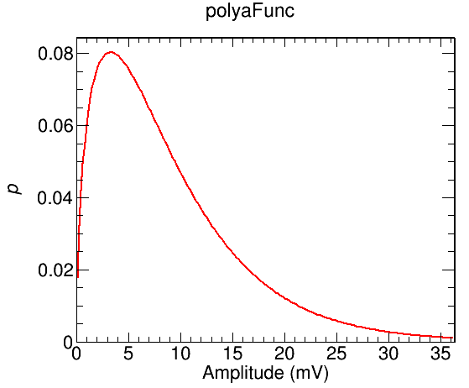
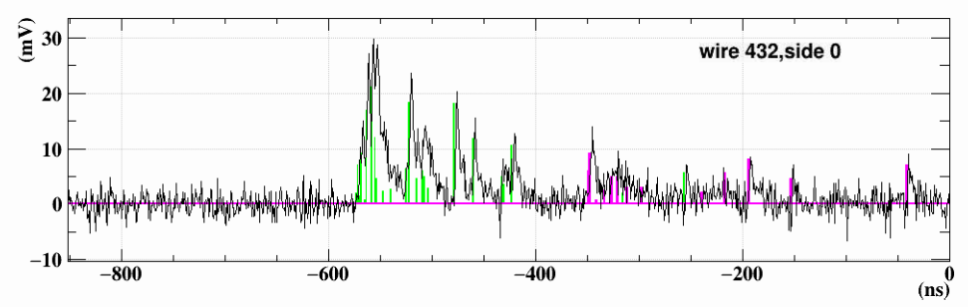
Challenges
Detecting the 1st cluster signal is essential for the experiment
  The efficiency is directly connected to the e⁺ reconstruction efficiency,
  and thus, search sensitivity.
Two difficulties:
S/N
  The amplification in avalanche process (gas gain) has large fluctuation obeying a Polya distribution. The 1st cluster signal can be very small.
Pileup
  Very high hit rate in MEG II: up to 1.7 MHz per cell, 35% occupancy in 250ns.
mean: 9 mV
p(<5 mV) = 0.35
p(<2 mV) = 0.11
MC
pileup hit
signal hit
Apply ML to the complicated waveform analysis.
As the first step, apply to noise reduction to improve S/N

Slide 5
Denoising autoencoder
target
input
latent
space
output
target
add
noise
encoder
decoder
Autoencoder: train network so that output = input
  Latent space holds the features of signal
Denoising autoencoder: add noise to the target for the input
  More effectively learns the feature and becomes more robust
  Can be used to denoise noisy data
Apply to waveform data
  Use MC signal w/o noise + noise data (random trigger data w/o beam)
  (mix events randomly in time at 7×10⁷ s⁻¹) (non-Gaussian non-white noise)
  Tried in two directions: estimating signal or estimating noise

Slide 6
The model: signal estimation
Input (1024, 2)
Output (1024, 2)
1D conv (9)
concatenate
1D conv
(1024, 128)
(1024, 128)
Max pool (2)
(1024, 128)
Up sample
(512, 128)
(512, 128)
1D conv (9)
concatenate
1D conv
(512, 128)
(512, 128)
Max pool (2)
(512, 128)
Up sample
(256, 128)
(256, 128)
1D conv (9)
concatenate
1D conv
(256, 64)
(256, 64)
Adam, ReLU,
512 batch size,
100 epochs,
373k parameters
Max pool (2)
1D conv(9)
(256, 64)
Up sample
(128, 64)
(128, 64)
Extend the denoising autoencoder with:
1D convolutional network
‘UNet’-like structure with skip connections
2-channel input with 2-end waveforms from a wire
Use ‘mean squared logarithmic error (msle)’ loss function.
  with 1 mV offset to avoid 0-division.
https://arxiv.org/abs/1505.04597 (image segmentation)

Slide 7
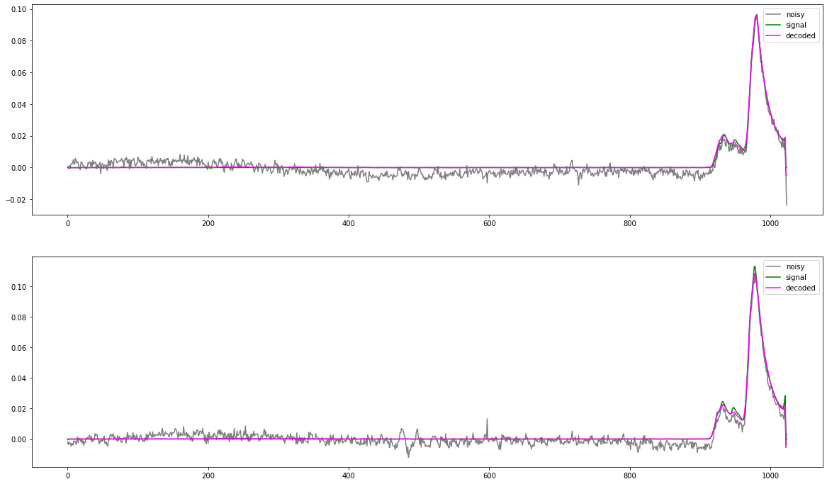
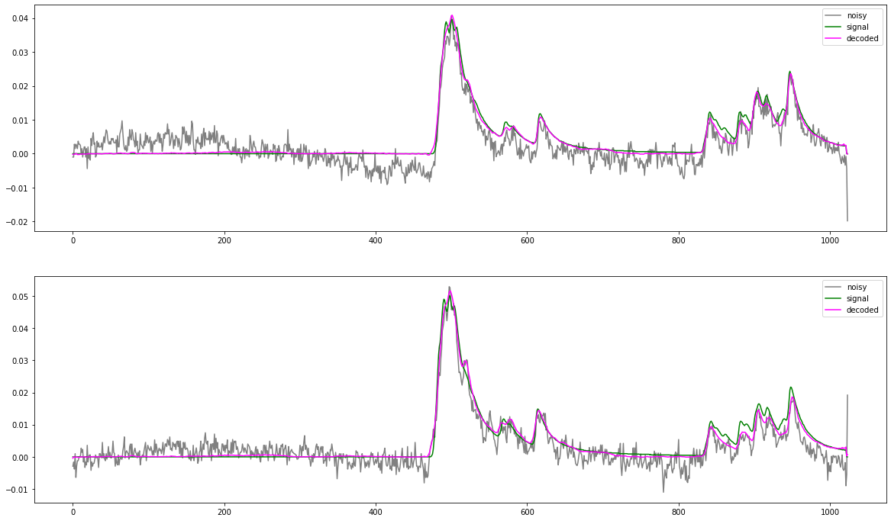
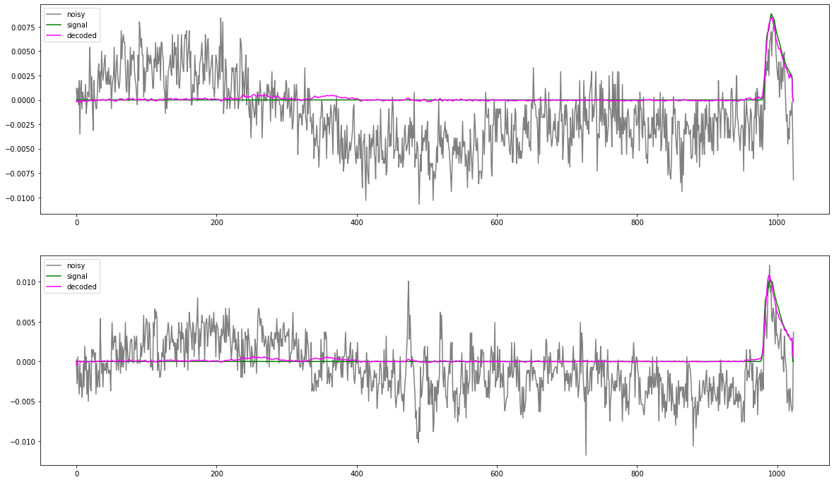
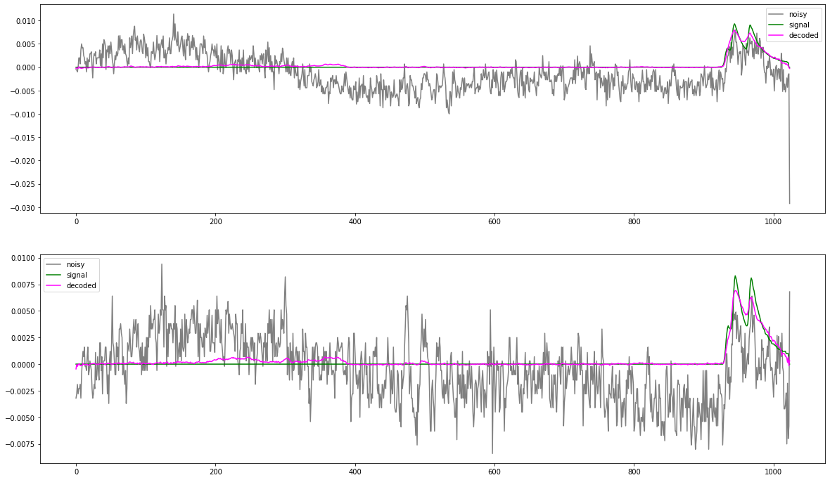
Signal estimation with 1D autoencoder
Signal + noise (input)
True signal (target)
Estimated signal (output)

Slide 8
Noise estimation
Want to use other wires information together
  which contains information for coherent noise.
However, neither increasing input channels nor extending to
2D input works well.
  It is difficult to extract different signal patterns in different wires with CNN.
Change the view of the data → estimate noise instead of signal.
  Coherent noise changes gradually over different wires. → 2D CNN can deal with it well.
  Existence of signal masks the noise, but estimate it using other wires waveform.
  Group 8 wires that connect to the same front-end cards into an input.

Slide 9
The model: noise estimation
Input (8, 1024, 2)
Output (8,1024, 2)
2D conv (1, 7)
concatenate
2D convT
(8, 1024, 128)
(8, 1024, 128)
Max pool (1, 2)
(8, 1024, 128)
Up sample
(8, 512, 128)
(8, 512, 128)
2D conv (3, 7)
concatenate
2D convT
(8, 512, 128)
(8, 512, 128)
Max pool (2, 2)
(8, 512, 128)
Up sample
(4, 256, 128)
(4, 256, 128)
2D conv (3, 5)
concatenate
2D convT
(4, 256, 64)
(4, 256, 64)
Adam, ReLU,
512 batch size,
150 epochs,
1.1M parameters
Max pool (2, 2)
(4, 256, 64)
Up sample
(2, 128, 64)
2D conv (3, 5)
(2, 128, 64)
2D convolutional network
‘UNet’-like structure with skip connections
2-channel input with 2-end waveforms from 8 wires
Use ‘mean squared error (mse)’ loss function.
https://arxiv.org/abs/1505.04597 (image segmentation)
This is equivalent to the residual learning

Slide 10
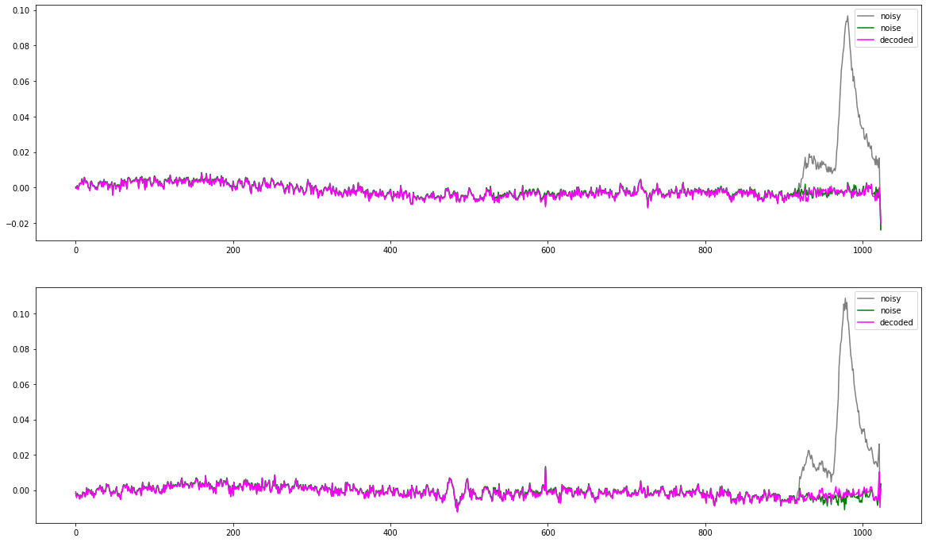
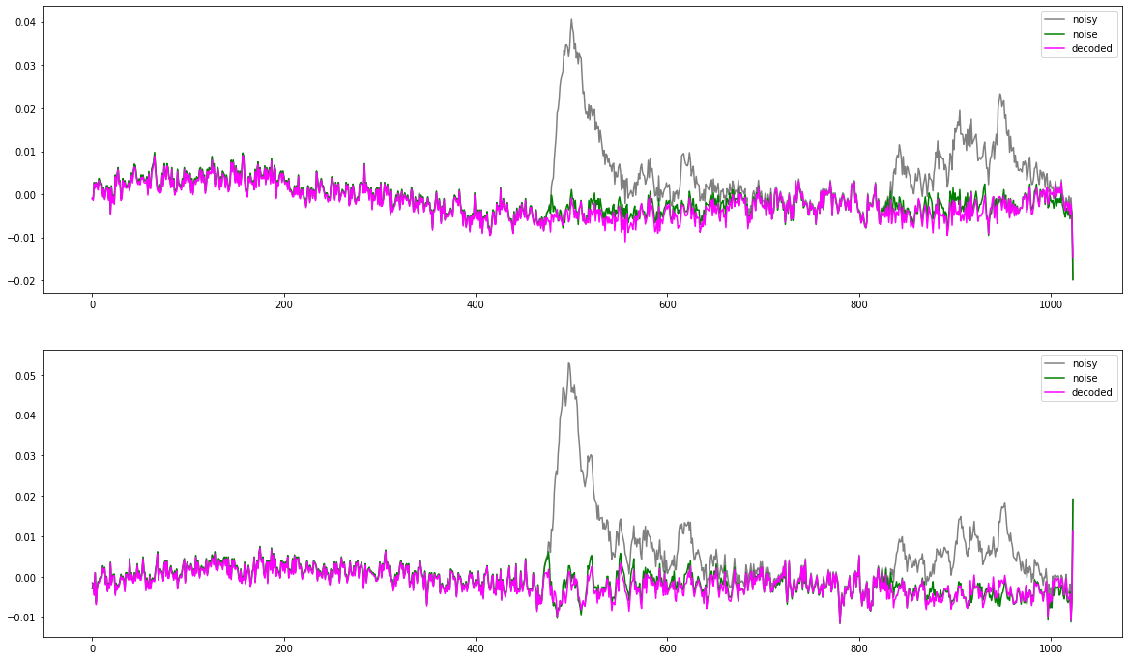
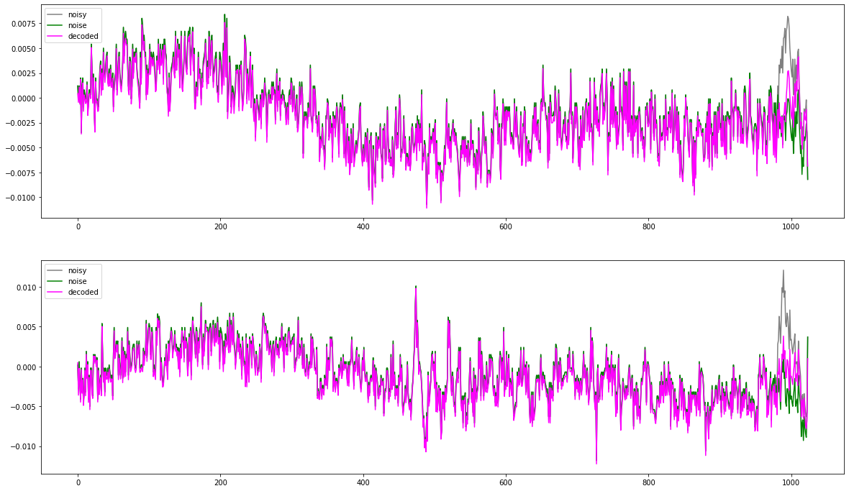
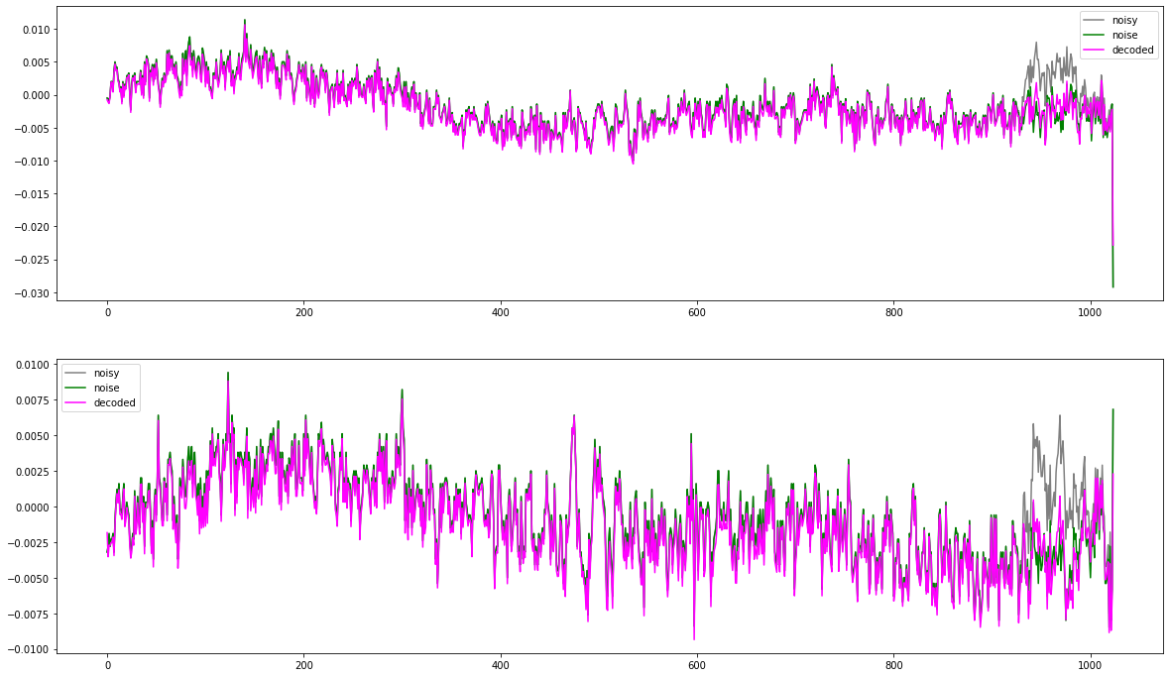
Noise estimation with 2D CNN autoencoder
Noise + signal (input)
True noise (target)
Estimated noise (output)

Slide 11


Implementation
Training
Inference
Tensorflow 2.4 + Keras
in Python3.7
on Google Colab
with Tensor Processing Unit (TPU)
convert to ONNX format
ROOT based MEG II reconstruction framework
in C++17
ONNX Runtime C++ API
with CPU single thread
(Xeon Gold 6138 2.0 GHz)
High flexibility × Easy maintenance
  Use one’s preferred package (one good at the problem under consideration) for model building & training.
  Use a common interface in C++ to use the trained model in inference/prediction.
  GPU/TPU in cloud are available for training, while only CPU (single thread) is available in the MEG II resource & framework.

Slide 12
Results
Apply to cosmic-ray (low rate) data in 2020 run.
  128 wires were readout (only 1/5 of the whole).
  Triggered by scintillation counters. → t₀
Evaluate the performance from the hit time distribution
Recovered
1st cluster hits
1st cluster detection efficiency improves.
Thresholds are lowered from 5.5 mV to
3.5 mV with signal estimation,
3.0 mV with noise estimation.
Signal estimation tends to generate fake
pulses from noise fluctuation.
The number of hits matched with CR tracks increases by 17%.
Fake hits
Detected timing
threshold
missing 1st cluster
t

Slide 13
Next
Improve
  Tune hyperparameters
  Increase training samples or augmentation
  Develop a better model
Speedup inference
  Compress the model with pruning
  Use a simpler or more efficient model with distillation
Apply to muon beam data
Extend to directly detecting hits (times and amplitudes) from the input waveforms
  Combine the noise & signal networks with transfer learning.
  Disentangle clusters from different hits (pileup).
  Require delicate MC tuning and precise data calibration.
 | Signal estimation | Noise estimation
Training (TPU) | 2.6 s/epoch | 1.3 s/epoch
Inference (CPU) | 1.2 s/events | 1.5 s/events
* only 1/5 of full readout wires
* 60k waveforms used in training

Slide 14
Conclusions
Applied denoising autoencoders to MEG II CDCH waveform data.
The models certainly learn the features of signal and noise.
Denoising enables lowering hit detection threshold and
improves the detection efficiency of the 1st cluster signal.
  Superior to conventional waveform analysis with digital filters.
  A promising technique to improve the experiment sensitivity.
Flexible & sustainable framework matching HEP analysis was established.
Computation time in inference is an issue for practical application,
  in which only single thread CPU is available.
  Speeding up by a factor 5 is desirable.

Slide 15
1D conv ⇔ FIR digital filter. Apply multiple filters to catch different patterns.
Activation → nonlinear response.
CNN → position invariant signal detection,
but not scale invariant → learn from data. ←Augmentation will help it.
Pooling → allow timing variation, good for local pattern recognition but loose global timing information
U-net skip connection → recover global timing information

Slide 16
⊗
filter kernels
patterns to be recognized
=
low-pass filter
(moving average)
high-pass filter
(differential)
Shaped (filtered) waveform = feature map
strongly ignited
Activation (relu) → nonlinearity

Slide 17
channels
n channels
⊗
independent kernel (k points)
for each channel
n×m kernels,
n×m×k parameters in total
⊕
⊕
sum over channels
m channels
to the next layer

Slide 18
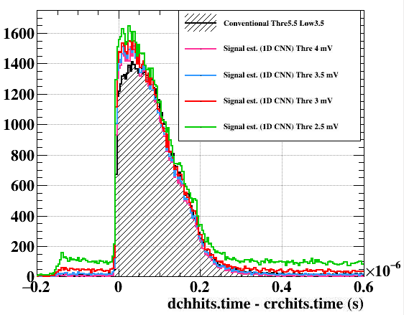
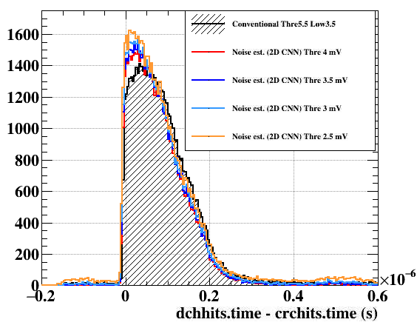
Signal estimation
Noise estimation

Slide 19

ONNX
The best solution as of today, we concluded, is using ONNX.
Open Neural Network Exchange (ONNX) is an open standard format for representing machine learning models.
  Able to exchange the models built by different frameworks.
Supported by

Slide 20
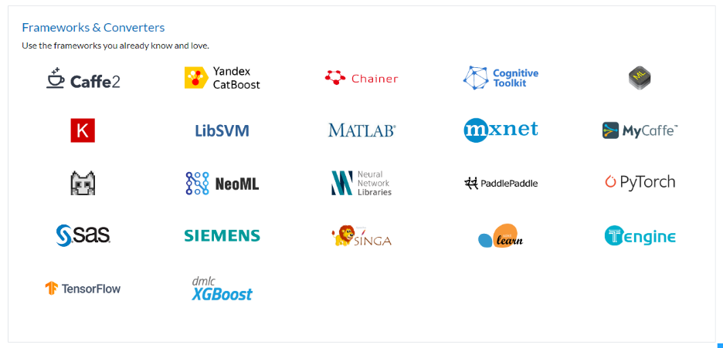
Supported frameworks
For example, following exchange is possible:
Building & training model in
PyTorh
ONNX file
Inference in
Tensorflow
Note that not all the features may be supported.

Slide 21





In python scripts,
.onnx file
in c++
MEGAnalyzer

Slide 22
The model: residual learning
Output (8,1024, 2)
Input (8, 1024, 2)
add
2D conv (1, 7)
concatenate
2D convT
(8, 1024, 128)
(8, 1024, 128)
Max pool (1, 2)
(8, 1024, 128)
Up sample
(8, 512, 128)
(8, 512, 128)
2D conv (3, 7)
concatenate
2D convT
(8, 512, 128)
(8, 512, 128)
Max pool (2, 2)
(8, 512, 128)
Up sample
(4, 256, 128)
(4, 256, 128)
2D conv (3, 5)
concatenate
2D convT
(4, 256, 64)
(4, 256, 64)
Adam, ReLU,
512 batch size,
150 epochs,
1.1M parameters
Max pool (2, 2)
(4, 256, 64)
Up sample
(2, 128, 64)
2D conv (3, 5)
(2, 128, 64)
2D convolutional network
‘UNet’-like structure with skip connections
2-channel input with 2-end waveforms from 8 wires
Use ‘mean squared error (mse)’ loss function.
https://arxiv.org/abs/1505.04597 (image segmentation)

