Slide 1



MEG II陽電子スペクトロメータ
における機械学習を活用した
ヒット再構成の改善
T
Improving hit reconstruction for MEG II positron spectrometer using machine learning technique
内山 雄祐
on behalf of MEG II collaboration
日本物理学会2022年秋季大会
令和4年9月8日
8aA421-2

Slide 2










MEG II in search of μ⁺ → e⁺γ
An intensity frontier experiment
Upgraded from MEG experiment
To get definitive evidence for BSM
UTokyo
KEK
Kobe Uni.
PSI
ETHZ
INFN Genoa
INFN Lecce
INFN Pavia
INFN Pisa
INFN Roma
BINP
JINR
UC Irvine
~60 physicists
MEG result (2016)
B(μ⁺ → e⁺γ) < 4.2×10⁻¹³
@90% C.L.
(while 5.3×10⁻¹³ expected)
higher intensity muon beam
higher resolution everywhere
higher efficiency
Search for μ⁺ → e⁺γ down to
6×10⁻¹⁴
(90% C.L. sensitivity)

Slide 3
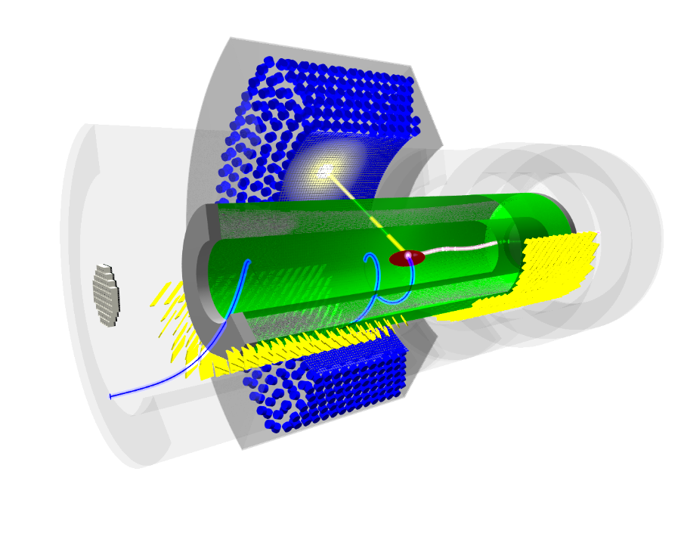
MEG II
EPJ-C 78 (2018) 380
World’s most intense DC muon beam
  continuously emits (3 – 6) ×10⁷ e⁺/s
  detected by a cylindrical drift chamber
γ
μ⁺
e⁺
Cylindrical drift chamber (CDCH)
(~1.6×10⁻³X₀, σ_{p}~100 keV)
Detector signals are read out
as waveform
  by DRS4 waveform digitizer
  1024 points @ 1.2 GSPS
Started physics data taking in 2021!
  In this study, use 2021 data.

Slide 4
Drift chamber: a nutshell
Signal formation
Charged particle generates primary ionization clusters discretely in gas
The ionized e⁻s drift to an anode wire and form avalanche near the wire
Reconstruction
Measure the timing of the 1st cluster
Draw a drift circle
Fit a track to the drift circles
+1450 V
~7 mm
Primary ionization ~ 13 cluster/cm
v_{drift} ~ 3 cm/μs
Gas gain ~ 5×10⁵
t₀
~ 300 ns
MEG II CDCH: an ultra low-mass chamber
Gas: He:iC₄H₁₀ = 90:10
Wires: 20 μm W anode + 40/50 μm Al cathode
  2 m long, 9 layers, 1152 readout cells in total
drift time
t
From a timing detector
To be measured

Slide 5
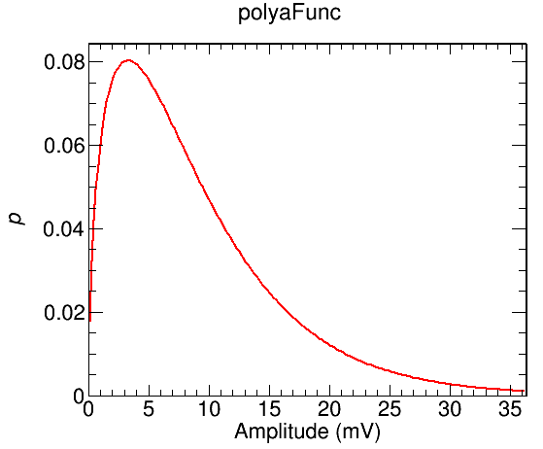
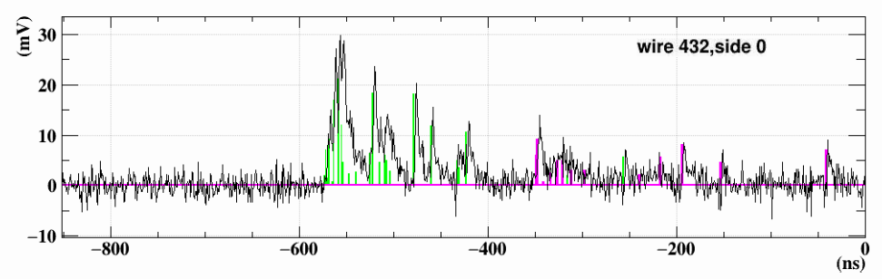
Challenges
Detecting the 1st cluster signal is essential for the experiment
  The efficiency is directly connected to the e⁺ reconstruction efficiency, and thus, search sensitivity.
Two difficulties:
S/N
  The amplification process (gas gain) has large fluctuation obeying a Polya distribution.
  The 1st cluster signal can be very small.
Pileup
  Very high hit rate in MEG II: up to 1.7 MHz per cell, 35% occupancy in 250ns.
MC
pileup hit
mean: 9 mV
p(<5 mV) = 0.35
p(<2 mV) = 0.11
signal hit
Apply ML to the complicated waveform analysis.

Slide 6
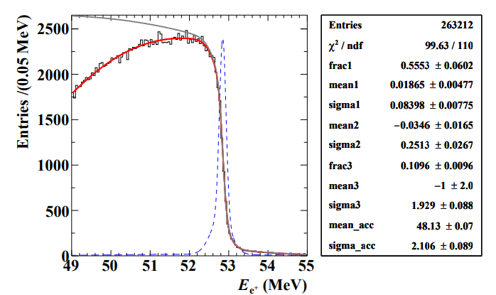
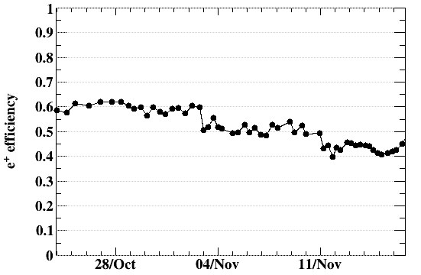
Current performance
7aA442-2 大矢
3×10⁷ s⁻¹
A good momentum resolution achieved
  ~4 times better than that in MEG
Efficiency is not as good as designed
  In particular, at high beam intensity
  The goal: 70%
σ=84 keV
(core)
Gradually increased beam intensity
2×10⁷
3×10⁷
4×10⁷
5×10⁷
date in 2021

Slide 7
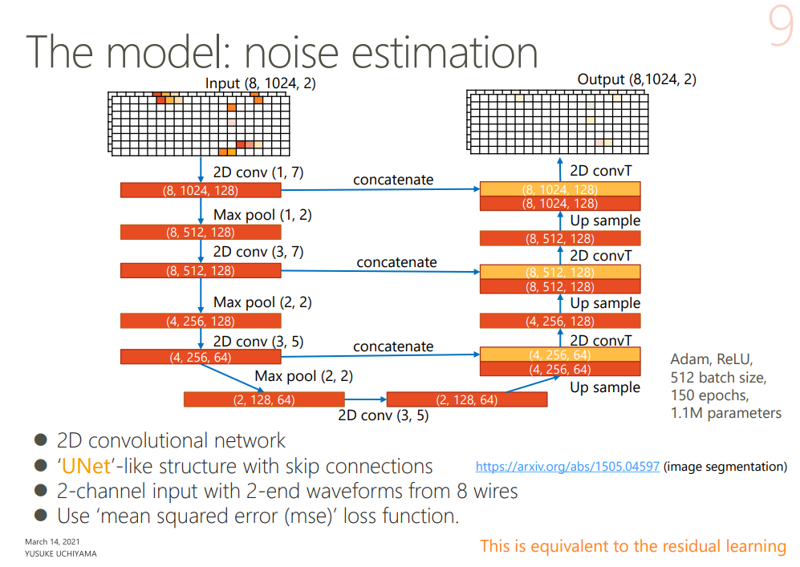
Y. Uchiyama, JPS 2021 annual
Waveform from 8 wires × 2 ends

Slide 8


Implementation
Training
Inference
Tensorflow 2.8 + Keras
in Python3.7
on Google Colab
with Tensor Processing Unit (TPU)
convert to ONNX format
ROOT based MEG II reconstruction framework
in C++17
ONNX Runtime C++ API
with CPU single thread
(Xeon Gold 6138 2.0 GHz)
High flexibility × Easy maintenance
  Use one’s preferred package for model building & training.
  Use a common interface in C++ to use the trained model in inference/prediction.
  GPU/TPU in cloud are available for training, while only CPU (single thread) is available in the MEG II resource & framework.

Slide 9
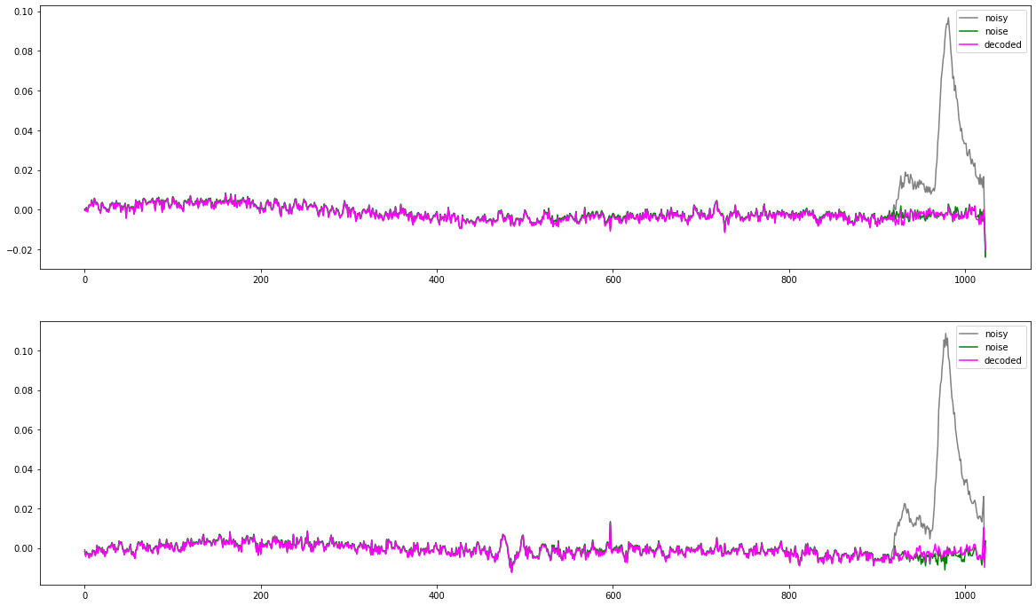
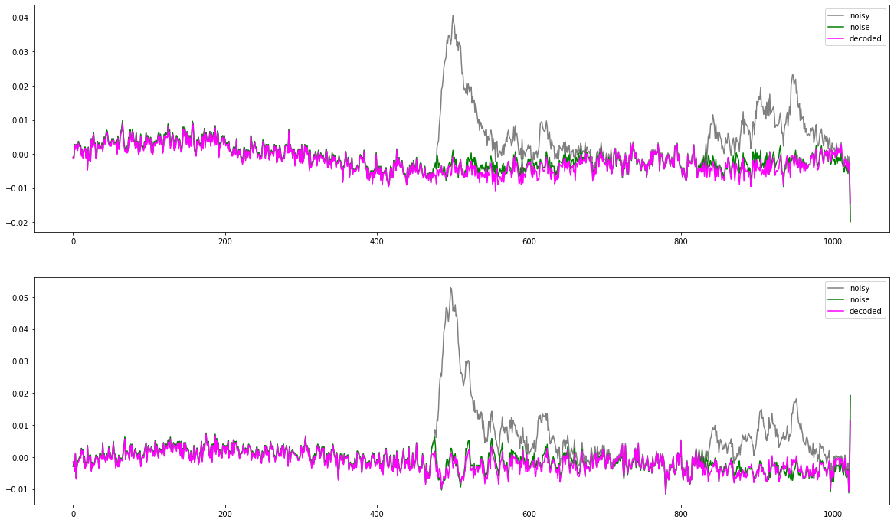
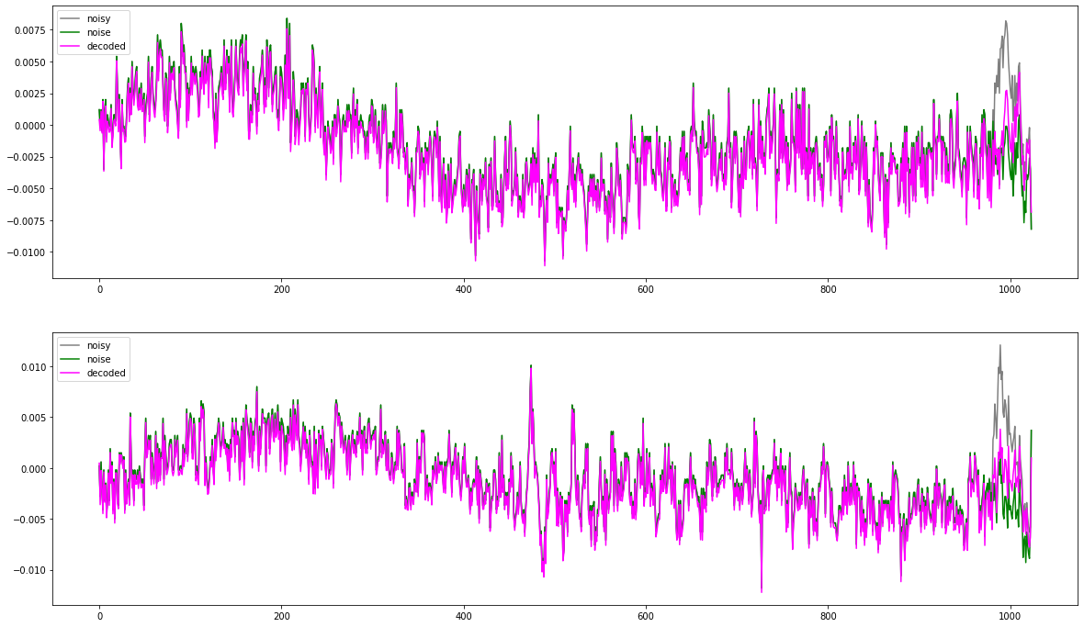
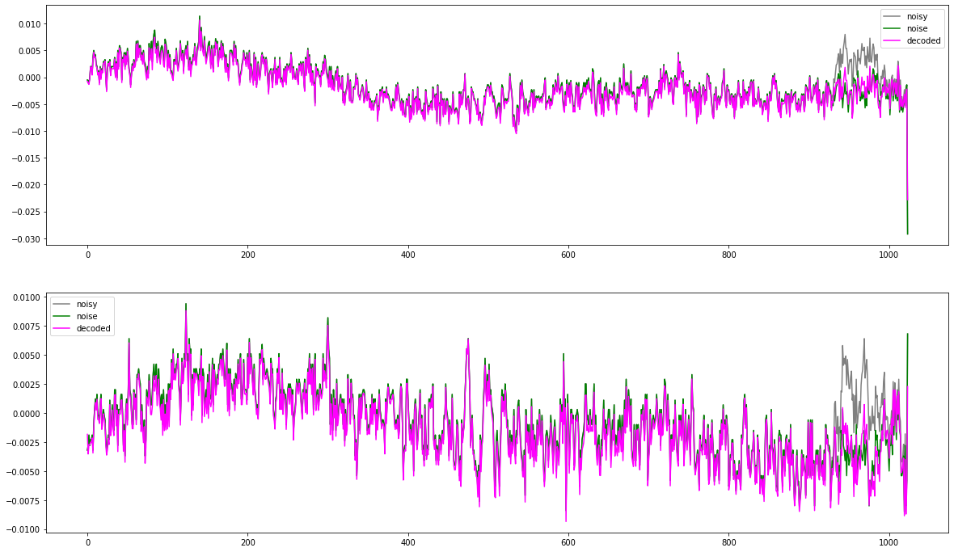
Noise estimation with 2D CNN autoencoder
Noise + signal (input)
True noise (target)
Estimated noise (output)

Slide 10
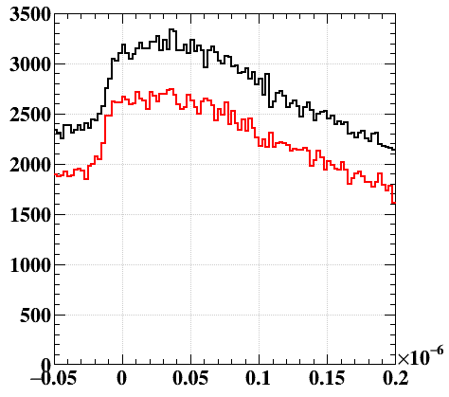
Apply to 2021 data
Not better than the conventional analysis.
  Almost comparable performance with the best model
  but with > 10 times computation time (3.4 s/event)
Detected hit timing
Input (8, 512, 2)
CNN noise estimator
Standard wf analysis
Conventional
With ML
⊖
Output: signal wf
(8, 512, 2)
Standard wf analysis
(μs)
Trigger counter time
ML detects almost same number of hits associated with trigger e⁺ with less fake hits.
However, final tracking efficiency is lower.
Track finder can reject fake hits. Better to input more hits.
Track finder,
pattern recognition
Track finder,
pattern recognition

Slide 11
Extended model
Input
CNN noise estimator
Standard wf analysis
⊖
Output1: signal wf
Pulse detection
cluster
detection
Transfer
learning
Combine pulses detected by conventional & ML analyses
Output2: cluster timing
⊕
Track finder,
pattern recognition
Hit rec

Slide 12
Efficiency
14%
23%
Two different architectures
(Discussed later)

Slide 13
Computation time (ML)
  Inference speed is an issue!
  GPU/TPU is not available in MEG II resource & framework; only CPU (single thread).
  ~30 times slower (Unfeasible!)
  Can speedup with ‘separable convolution’
    Replacing all conv-layers with separable conv speeds up by factor 3.5 with comparable performance
    Feasible!
5×10⁷ s⁻¹ data
However, more practical problem is…

Slide 14
Computation time (Total)
5×10⁷ s⁻¹ data
Pattern recognition (track finding)
is dominant part and becomes
4 times slower by adding more hit candidates
With current resource, it is not feasible to apply this to all events…

Slide 15
Conclusions
Efficiency can be improved by feeding more hits to track finder
Even contaminated by fake or wrong timing hits
Track finder is clever enough to find true track
ML model was extended (from denoising) to detecting cluster timing and the results are added to the results from conventional waveform analysis. → 23% higher efficiency.
Significant increase in computation time is problem
More by track finder than ML itself.
Next: developing global pattern recognition with ML to handle large number of hits in realistic computation time.

Slide 16
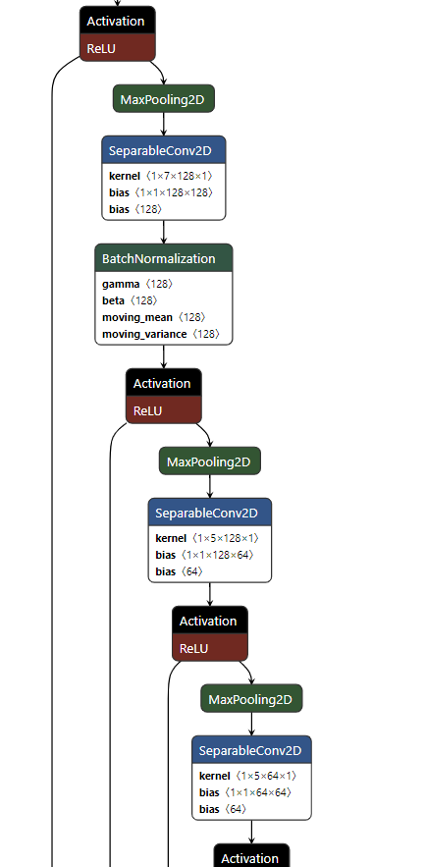
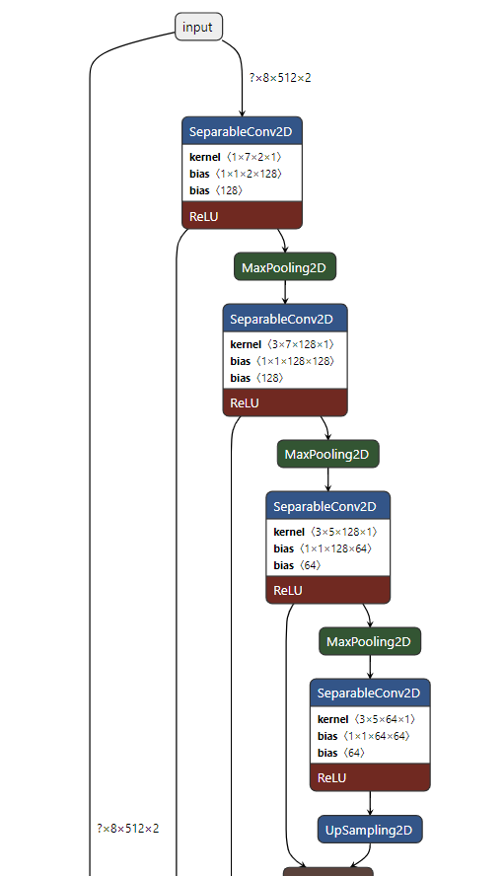
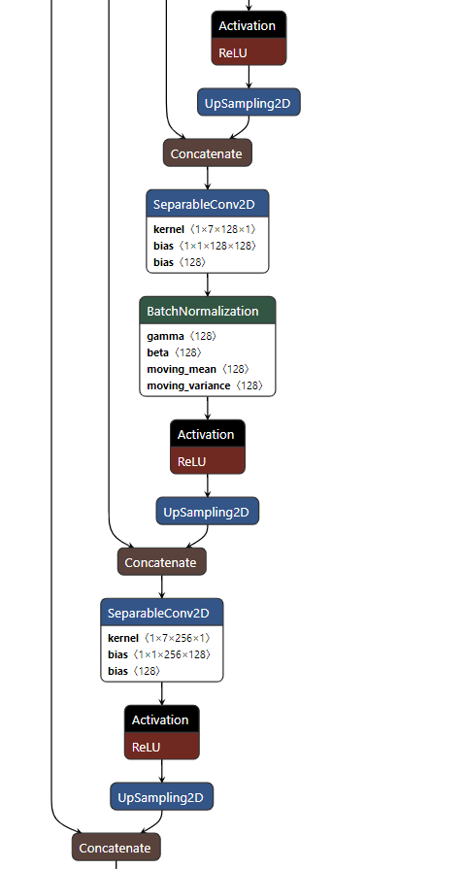
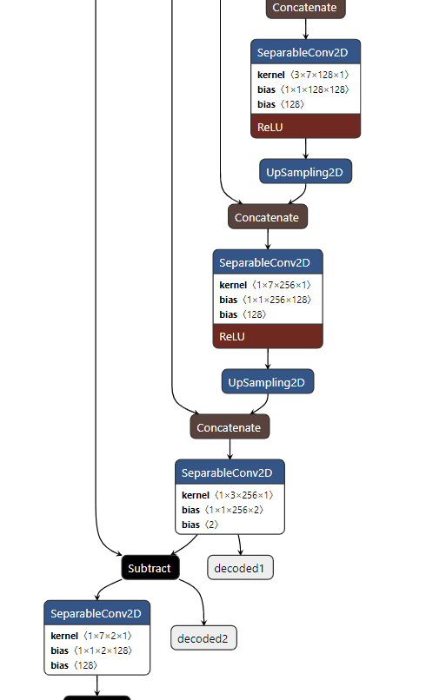
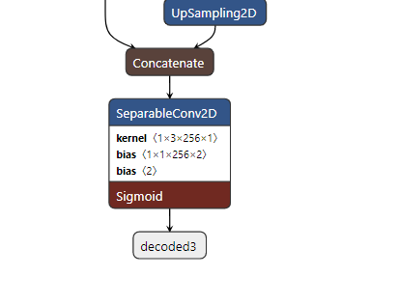
Architecture

Slide 17
⊗
filter kernels
patterns to be recognized
=
low-pass filter
(moving average)
high-pass filter
(differential)
Shaped (filtered) waveform = feature map
strongly ignited
Activation (relu) → nonlinearity

Slide 18
channels
n channels
⊗
independent kernel (k points)
for each channel
n×m kernels,
n×m×k parameters in total
⊕
⊕
sum over channels
m channels
to the next layer

