Slide 1
μ⁺→e⁺γ探索実験 MEG II Run 2022のまとめと今後の展望 T Summary of Run 2022 of μ⁺→e⁺γ experiment MEG II and the prospects
内山 雄祐 on behalf of MEG II collaboration
日本物理学会2023年春季大会 令和5年3月23日
23pT1-3

Slide 2
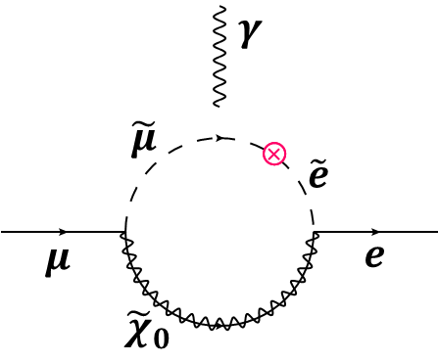
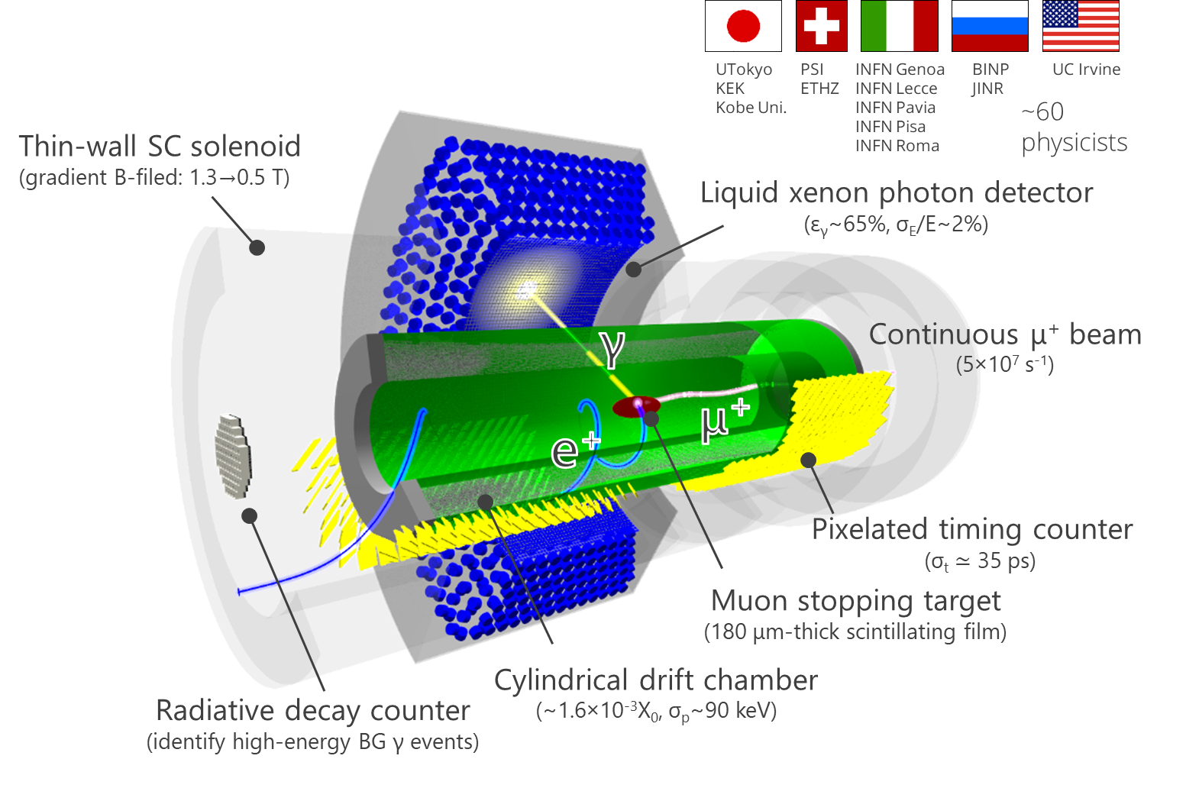
MEG II has started!
The pilot run in 2021demonstrated:
Detector operates stably with sufficient resolutions,
Electronics, trigger, and DAQ system work,
Reconstruction algorithms are ready,
Physics analysis ongoing.
First physics result with sensitivity comparable to MEG is foreseen to be published this summer
with <10% of data aimed

Slide 3
Timeline
previous 2 talks
this talk
Now
2012 | 2013 | 2014 | 2015 | 2016 | 2017 | 2018 | 2019 | 2020 | 2021 | 2022 | 2023 | 2024 | 2025 | 2026 | 2027
MEG DAQ
MEG final result
conceptual design
proposal
R&D
Construction
Long shutdown of PSI accelerator
RDC
pTC
LXe
CDCH
Elec.
Beam tests, pilot runs
pTC
RDC
LXe
CDCH
Physics run
10 years to start physics run
1st result

Slide 4
What we need next
Improve resolutions
Improve reconstruction efficiencies
Reduce backgrounds
Reduce systematic uncertainties
Collect data as much as possible
23aT3-2,6,7
23pT2-5,6,7

Slide 5
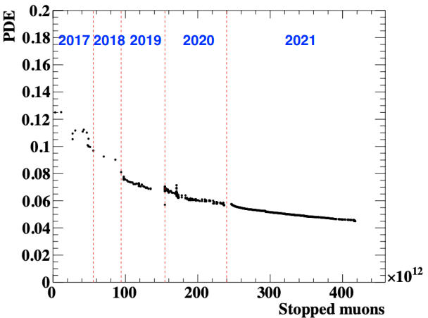
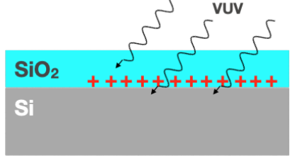
For long stable run: LXe detector
MPPC PDE for VUV light decreases with beam use
Must recover to >12%
to start 2022 run and to run for ~6 months
Mean
Critical problem
Minimum required
Surface damage (hole buildup)

Slide 6
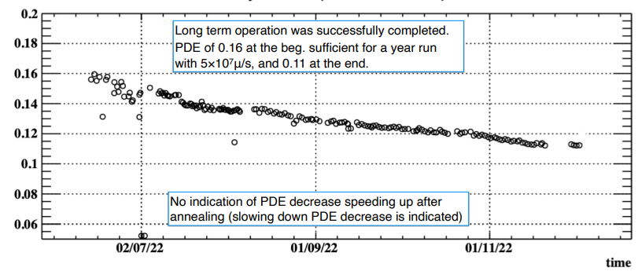
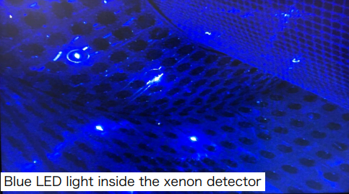
For long stable run: LXe detector
2022
MPPC PDE for VUV light decreases with beam use
Must recover to >12%
to start 2022 run and operate ~5 months
In situ annealing was applied to all the MPPCs
in Feb. – May (accel. shutdown period)
using Joule heat induced by MPPC current S. Ban et al., JPS 2022 autumn 7aA441-3
Mean
Minimum required
Safe and effective method was established.
Annealing towards 2023 was already completed in more efficient way (Feb. – Mar.).
MPPCs
Gas Xe
See 23aT3-7

Slide 7
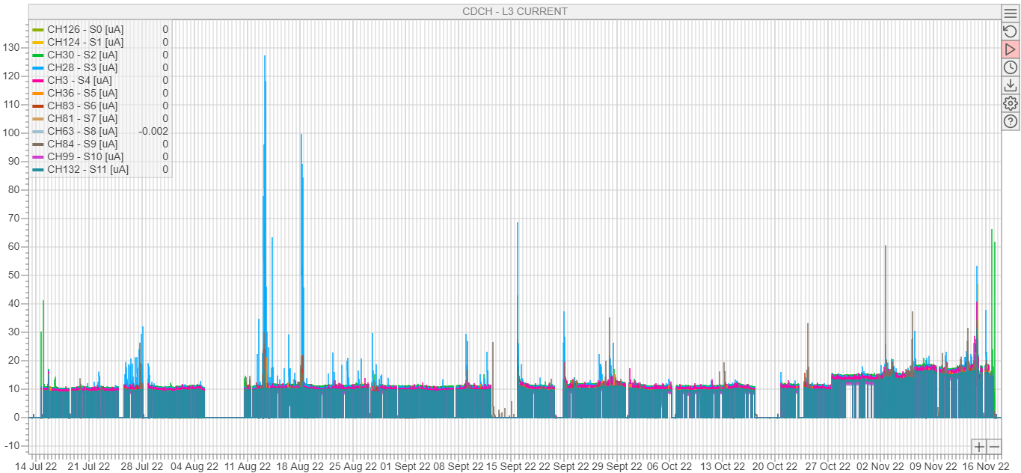
For long stable run: e⁺ spectrometer
Minimum maintenance to start 2022 run smoothly
No wire has broken since 2020. → Did not open chamber.
Did not extract detectors from beamline. Also, for this year.
No need of conditioning with optimized gas mixture (He:IsoB (90:10) + 1.5% isopropanol + 0.5% O₂)
Stably operated during the whole 2022 run
spikes due to irregular isopropanol flow
Current (μA)
5×10⁷
4×10⁷
3×10⁷

Slide 8
Beam time
1 | 2 | 3 | 4 | 5 | 6 | 7 | 8 | 9 | 10 | 11 | 12
2021
Accel. shutdown
Other exp.
MEG II beam time (4.5 mon)
Detector maint.
Elec. installation
Detector installation
Detector/elec. commissioning
Beam tuning
Physics run （1.5 mon）
Calib. run
Engineering run
2022
Accel. shutdown
MEG II beamtime (6.5 mon)
Other exp.
MPPC annealing
Detector/beam commissioning
Physics run （４ mon）
Calib. run
First long production run
Essential to collect as much data as possible

Slide 9
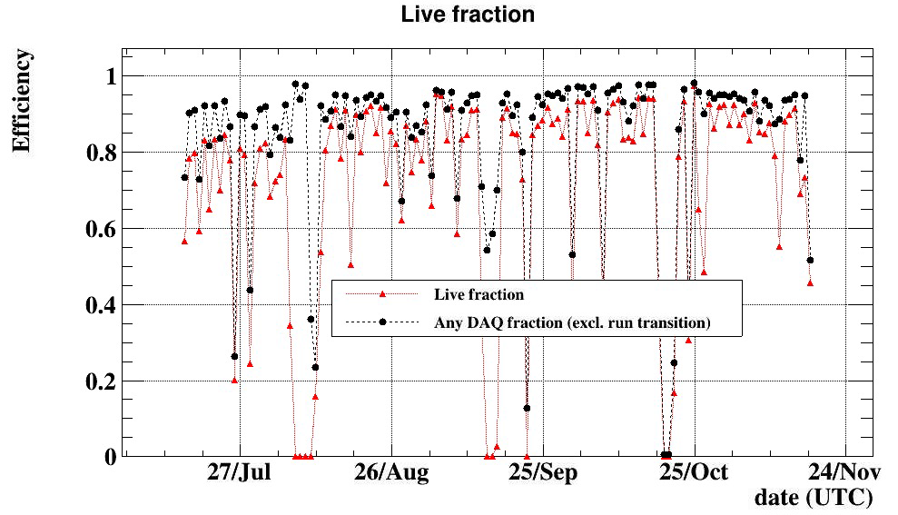
Improving run efficiency
Optimizing run scheme Physics run vs. calib. run
Periodical calibration is indispensable for long run.
At the beg. dead time due to LXe calib was ~10%.
At the end, it is <5%, by reducing length and frequency of calibrations
Other dead time (~5%)
Beam down
Human error
Run transition

Slide 10
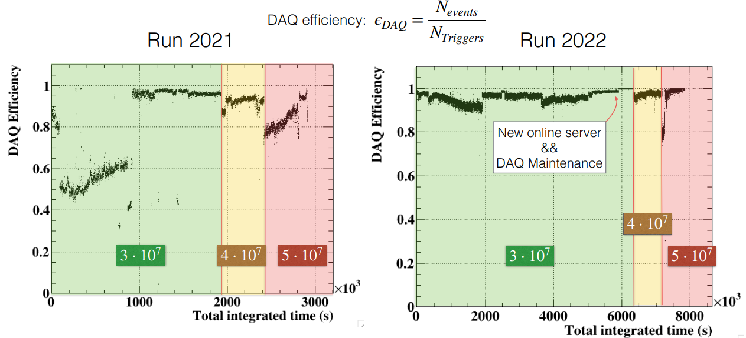
Improving DAQ efficiency
Move data compression from online to offline
DAQ capability improved from 65 MB/s to 180 MB/s
New DAQ machine & tuning of DAQ system
Still too high trigger rate causes inefficiency in DAQ. Trigger rate ∝ (beam intensity)².
More effort on trigger logic is necessary for higher beam, limited in 2022 by LXe energy scale non-uniformity (online calibration).

Slide 11
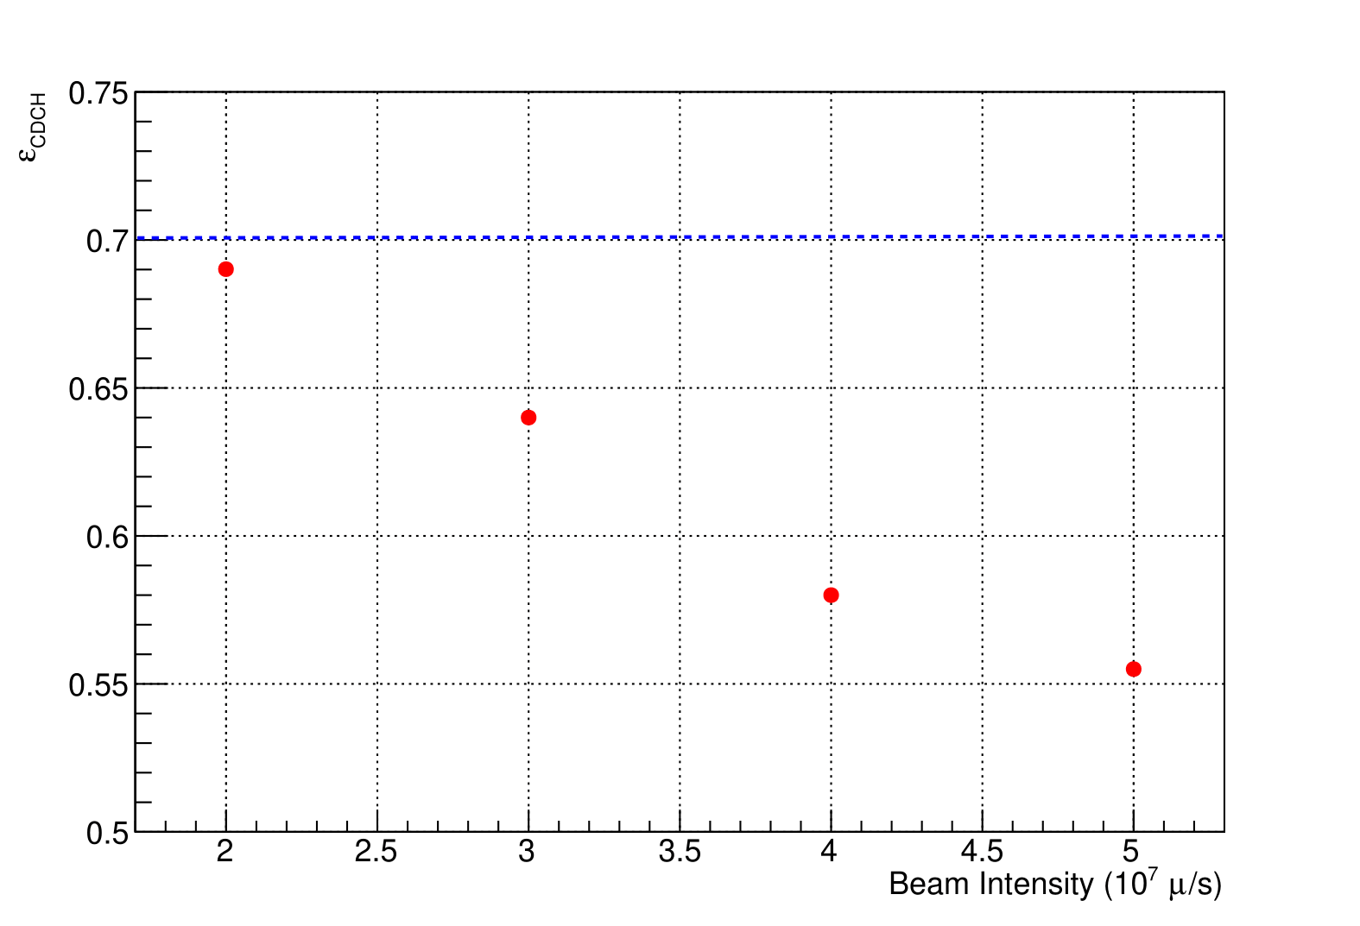
Beam intensity
Must be chosen to optimize sensitivity considering many factors:
Capability & ageing of detectors
Trigger rate & data size
Reconstruction efficiency with pileup
Background level
∝ (R_{μ})²
Statistics
e⁺ tracking efficiency
Started with 3×10⁷ s⁻¹
we were not sure MPPC PDE can sustain until the end
DAQ rate exceeded the capability
Increased to 4×10⁷ and 5×10⁷ s⁻¹.
Analyze these data to optimize it in next runs.

Slide 12
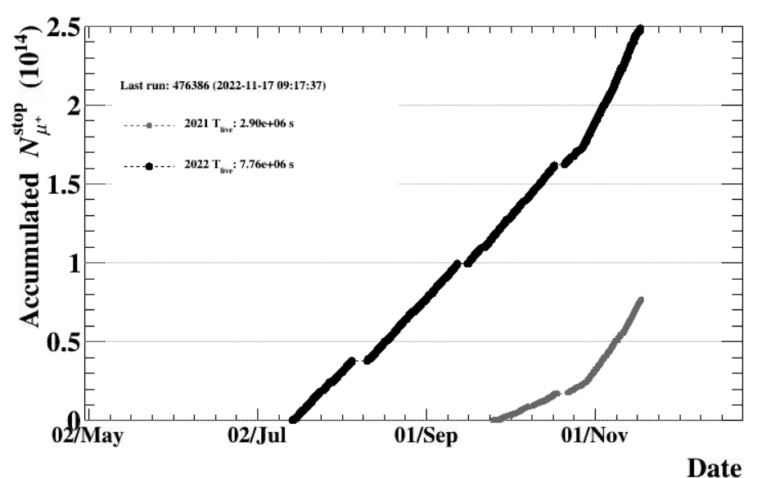
4-month stable run!
Run 2022
Run 2012 (MEG longest run)
2012 T_{live} : 7.4e6 s
Run 2021
Longest run we ever achieved,
×3.5 statistics of 2021

Slide 13
Sensitivity estimate
“Sensitivity”: median 90% CL UL for BG-only hypothesis
S₂₀₂₁ = 8.2×10⁻¹³
S₂₀₂₁₊₂₀₂₂ = (2.0 – 2.4)×10⁻¹³
× 2.5 better than MEG
Still statistical limited
Assuming same detector performance as 2021
Aim to finalize analysis with further improvement
and publish new result by the end of this year
previous talk 23pT1-2
A new limit (or maybe evidence) for μ→eγ foreseen with this dataset

Slide 14
Next
1 | 2 | 3 | 4 | 5 | 6 | 7 | 8 | 9 | 10 | 11 | 12
2021
Accel. shutdown
Other exp.
MEG II beam time (4.5 mon)
Detector maint.
Elec. installation
Detector installation
Detector/elec. commissioning
Beam tuning
Physics run （1.5 mon）
Calib. run
Engineering run
2022
Accel. shutdown
MEG II beamtime (6.5 mon)
Other exp.
MPPC annealing
Detector/beam commissioning
Physics run （４ mon）
Calib. run w/ pion beam
Shorten these periods to maximize physics run
What will it be?? (mu3e experiment)

Slide 15
2023 beamtime
1 | 2 | 3 | 4 | 5 | 6 | 7 | 8 | 9 | 10 | 11 | 12
2021
Accel. shutdown
Other exp.
MEG II beam time (4.5 mon)
Detector maint.
Elec. installation
Detector installation
Detector/elec. commissioning
Beam tuning
Physics run （1.5 mon）
Calib. run
Engineering run
2022
Accel. shutdown
MEG II beamtime (6.5 mon)
Other exp.
MPPC annealing
Detector/beam commissioning
Physics run （４ mon）
Calib. run
2023
Accel. shutdown (longer to save electricity)
5/16
MEG II beamtime (6.5 mon)
11/30
Other exp.
MPPC annealing
completed
Detector/beam commissioning
Physics run （~5 mon）
Calib. run
Longer run is possible

Slide 16
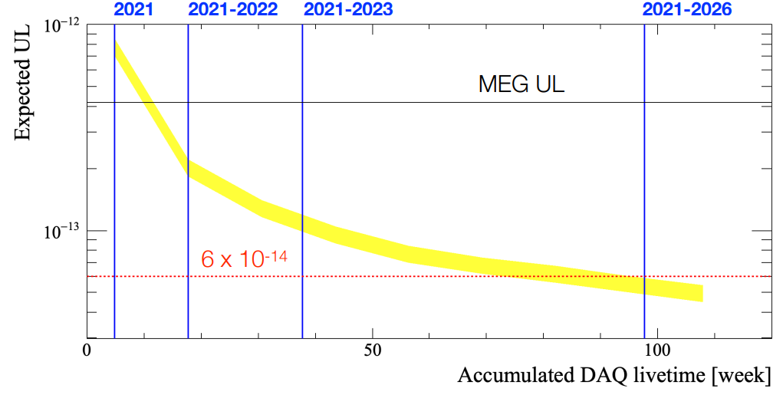
Projection
If 50:50 share with mu3e in 2024–2026
Run next 3 years to reach the goal sensitivity
No beam
2027 & 2028
Two constraints
Long shutdown in 2027–2028 planned
to build a new high-intensity muon beamline
Share πE5 beamline with mu3e
once they get ready. They also conduct phase I experiment before the shutdown…

Slide 17
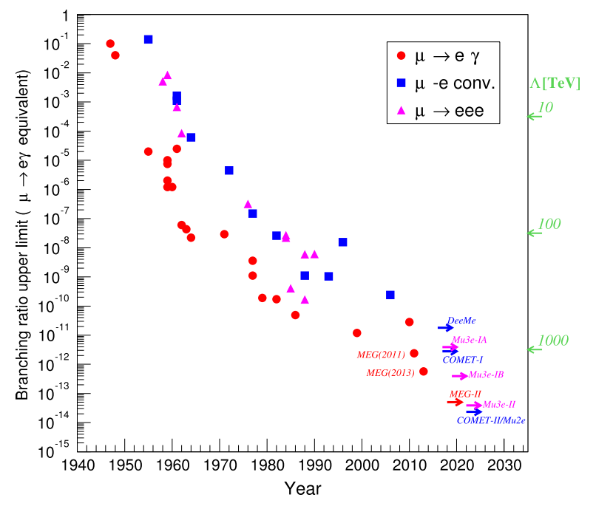
Conclusions
Run 2022 was the 1st long production run of MEG II
The dataset will give us a new limit or evidence for μ→eγ
Look forward to 2021 result first (summer), and then 2021+2022 one later in this year.
To reach the goal sensitivity, we’ll run at the end of 2026
This will be the best input to new physics from CLFV experiments in 2020s.
Important to collect as much data as possible.

